Slide 1


Slide 2
INTRODUCTION
The role of social media in the context of elections is a hotly debated topic. Social media exerts a growing impact on people’s opinions and choices. Social media platforms are increasingly immersive and host a significant part of public discourse.
Fueling the debate is the perceived rise of disinformation – fake news, manipulation, and foreign influence – in recent elections in the United Kingdom, United States, and Columbia. While these are not new phenomena, the dissemination of information via social media is new. The Internet has radically changed how people are exposed to and access news; it has also reduced the role of information gatekeepers, such as traditional media.
We analyzed more than 8 million shared links on social media plus 1,000+ media sources to provide a new perspective on the role of social media as a source of information and influence on the 2017 French Presidential election.

Slide 3
INTRODUCTION
The French Election Social Media Landscape Report 2017 has three phases: this is the final report. It summarizes previously published reports and presents new findings that leverage people’s behaviour to learn about what and why people share. This exploratory study was produced by Bakamo.Social and a team of 20 analysts with support from The Open Society Foundation and input from journalist Pierre Haski.
The report:
Illuminates the emerging space between the news media and audiences, covering types of content, users’ behaviours, and patterns of disinformation.
Maps and documents the role of social media in the dissemination of news and the influence exerted by social media networks.
Confirms a set of widely-held assumptions, provides additional detail and a broad basis, and contributes to the body of knowledge on the subject.

Slide 4
What this study does:
Confirms widely held assumptions:
Far-Right media content in French social media has a massively outsized presence
Manipulation techniques are used to boost the Far-Right’s dominance in social media.
Russian attempts to influence French media reporting in the run-up to the 2017 elections are real.
Expands understanding on the subject matter:
The study grounds the media landscape within the entire French political online discourse
Provides detail on 800 non-traditional media publishers and their impact
Traces patterns and mechanisms of disinformation campaigns
Contributes new insights and suggests solutions:
The study discovers and maps people’s social media behaviour and motivations
Explores the fake news phenomenon to find underlying drivers
Provides a set of recommendations to address and mitigate the dangers to democratic societies

Slide 5
We explored conversations on Facebook, Twitter, blogs, and forum sites from November 1, 2016 to May 22, 2017. We used TalkWalker, a social media monitoring technology platform. Results in the French Election Social Media Landscape Report 2017 are based on the following research:
20 million Captured more than 20 million social media conversations.
8 million Analyzed over 8 million shared links.
1,000+ Analyzed 1,000+ media sources.
800 Of the 1,000+ media sources, 800 were non-traditional media.
50,000 Read and coded 50,000 social media posts.
20 Over 20 analysts contributed to the research by exploring, reading, interpreting, and coding conversations.

Slide 6
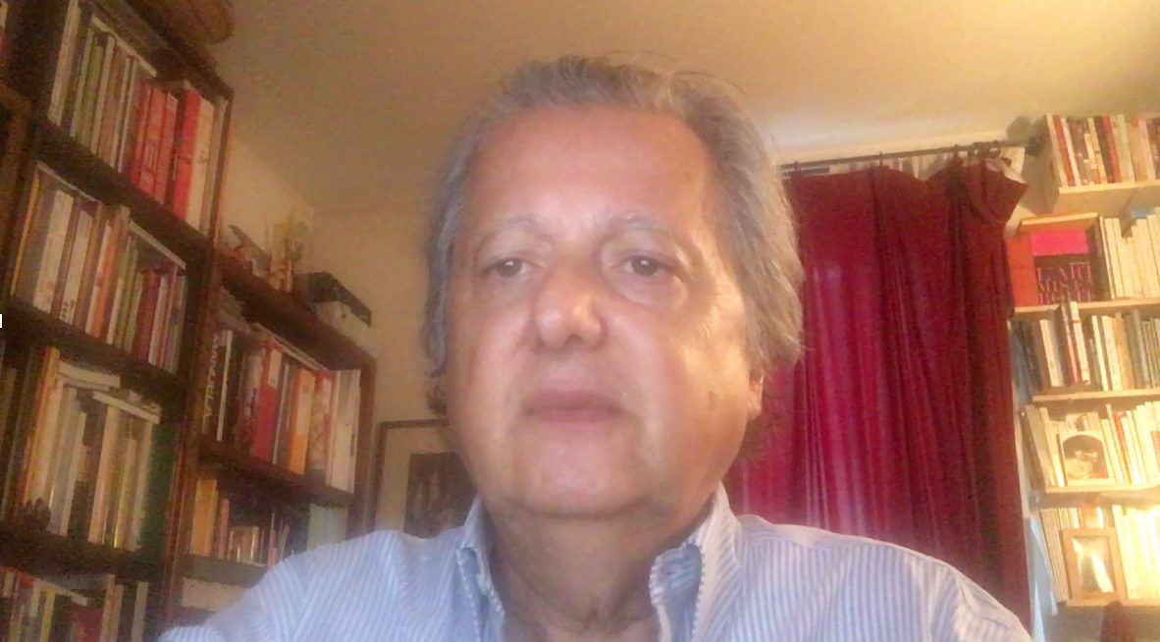
Perspective from Pierre Haski
Please click play to view the interview
Please click below to see the video
https://youtu.be/cVk7gu97DtY
Pierre Haski is a long-time journalist with Agence France-Presse and Libération, and a foreign correspondent in Johannesburg, Jerusalem and Beijing, Pierre Haski is the co-founder of the French news-website Rue89.com, currently a columnist with the magazine L'Obs. He is the author of several books, his latest, an essay on France : "Le droit au bonheur - la France à l'épreuve du monde" (Stock, 2017). Recently, Pierre was elected as the President of Reporters without Borders.

Slide 7
❶

Slide 8
CONTENTS
Executive Summary Non-Traditional Media Map Landscape Social Media Sharing Behaviour Patterns of Disinformation Detailed Findings and Background Data Methodology
❶
Executive Summary
Key Insights
Key Implications
Recommendations
The French Media Content Landscape
Media Map Sections
Media Map Clusters
Candidate Support and Influence
Foreign Influence
Media Map Trends
Two-Step Model of Social Media Influence
Posting Behaviour
Discuss Behaviour
Quantitative Sharing Behaviour Analysis
Credibility Cloak
Time Shifting
Fake Polls
Hoax Sites
Russian Influence
Cluster by Cluster Analysis
Quotes
5 Steps of the Media Map
Conversations
Overview
Non-Traditional Media Map Landscape
❷
Social Media Sharing Behaviour
Three phases of the research study
Patterns of Disinformation
Detailed Findings and Background Data
❸
Details about the underlying data
Methodology

Slide 9
Executive Summary Non-Traditional Media Map Landscape Social Media Sharing Behaviour Patterns of Disinformation Detailed Findings and Background Data Methodology
EXECUTIVE SUMMARY KEY INSIGHTS
Media Map
Narrative frames
Media clusters
How people share
Patterns of disinformation
Other observations

Slide 10
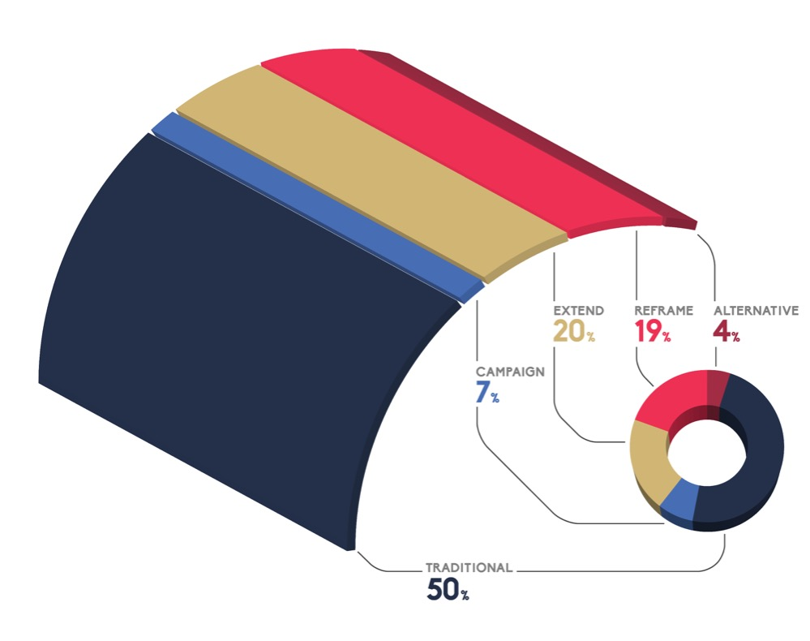
MEDIA MAP
Executive Summary Non-Traditional Media Map Landscape Social Media Sharing Behaviour Patterns of Disinformation Detailed Findings and Background Data Methodology
Five types of media sources are publishing content relevant to the public discourse.
These sources were differentiated, classified and charted on the Media Map:
Traditional: commercial or public news organizations
Campaign: official party or candidate media sources
Extend: civic media sources adhering to journalistic standards
Reframe: media sources aiming to counterbalance traditional sources
Alternative: publishers of conspiratorial and ‘confusionist’ content
Click here to jump to the detailed analysis

Slide 11
MEDIA MAP
Executive Summary Non-Traditional Media Map Landscape Social Media Sharing Behaviour Patterns of Disinformation Detailed Findings and Background Data Methodology
Media sources can be divided into two camps: traditional publishers and non-traditional publishers.
57 percent of shared links point to traditional media or campaign sites
43 percent of shared links point to non-traditional sources
Click here to jump to the detailed analysis

Slide 12
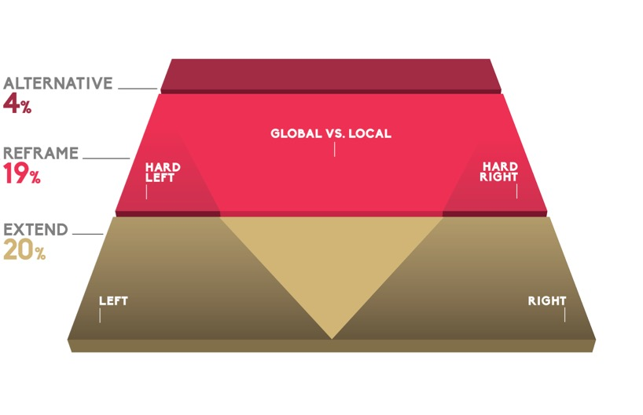
The narrative frame positions the source: left vs. right or global vs. local
Executive Summary Non-Traditional Media Map Landscape Social Media Sharing Behaviour Patterns of Disinformation Detailed Findings and Background Data Methodology
“Narrative frames” are used to orient and position opinions on the media map. They are a key distinction between media sources of Non-Traditional media.
Left vs. right frame: The entrenched binary opposition between left and right works for Traditional media sources. It also works for parts of the Extend and the Reframe publishers (as shown in the diagram).
Global vs. local frame: For media sources located further up on the media map, the familiar left vs. right divide is supplanted by a new divide: the global vs. local narrative frame. It pits globalization and transnational organizations against local patriotic interests.
Click here to jump to the detailed analysis

Slide 13
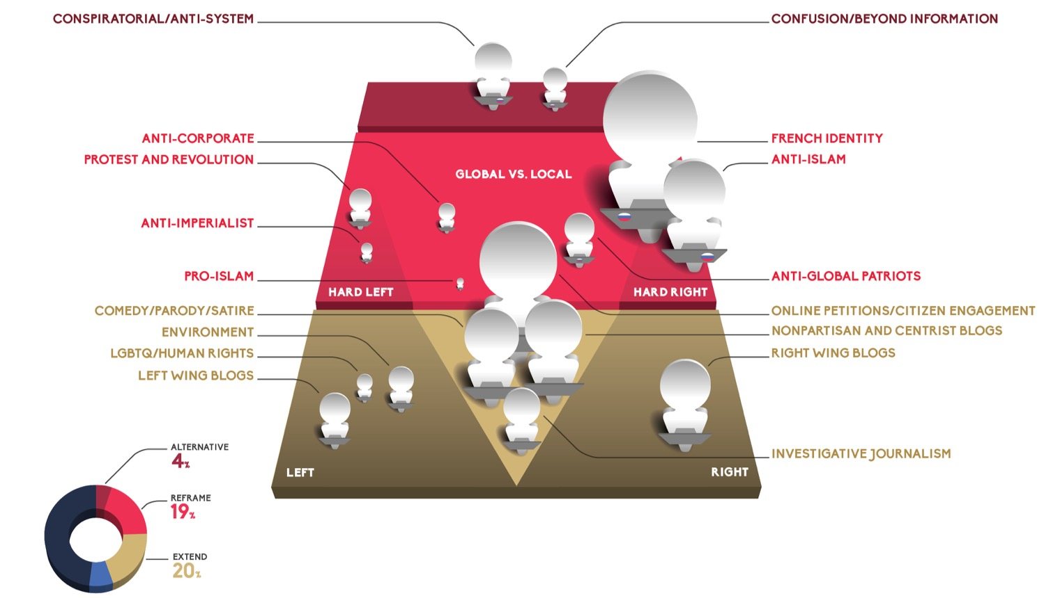
Non-traditional media can be clustered by topic
Executive Summary Non-Traditional Media Map Landscape Social Media Sharing Behaviour Patterns of Disinformation Detailed Findings and Background Data Methodology
800 non-traditional media sources fall into 17 media clusters

Slide 14
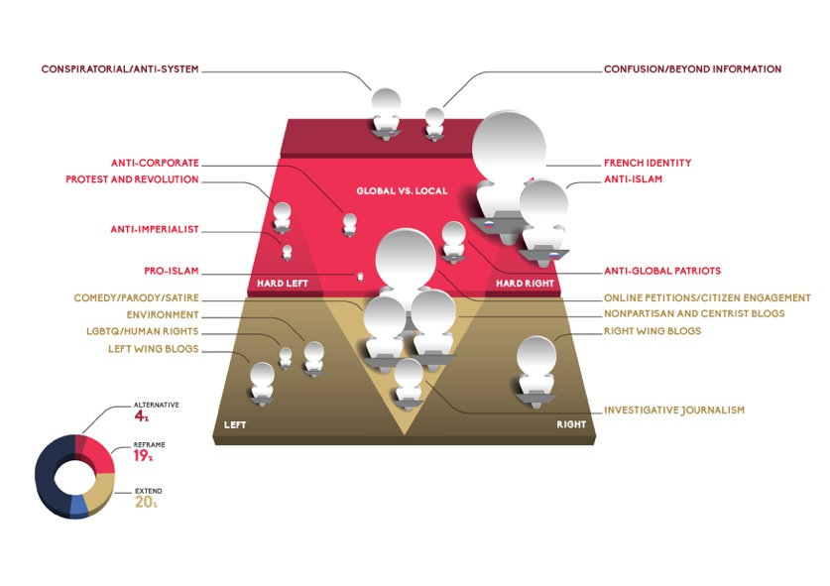
MEDIA CLUSTERS
Executive Summary Non-Traditional Media Map Landscape Social Media Sharing Behaviour Patterns of Disinformation Detailed Findings and Background Data Methodology
We looked at the 800 most-frequently cited non-traditional media sources. We then identified the topics discussed in the articles published, the narrative frames invoked, and other differentiators. The resulting qualitative classifications are called “clusters”. We grouped the sources into 17 clusters and placed them on the Media Map.
Within non-traditional media sources, measurements of cluster size show:
Three intertwined hard right clusters resonated most: French Identity, Anti-Islam and Anti-Global Patriots.
Media sources located in the centre of the Extend (gold) section are made up of petitions, comedy sites, non-partisan blogs, and investigative journalism outlets.
Click here to jump to the detailed analysis

Slide 15
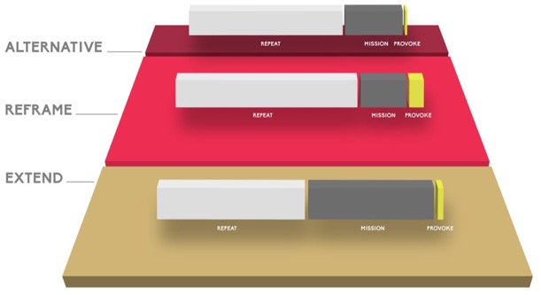
How people share
Executive Summary Non-Traditional Media Map Landscape Social Media Sharing Behaviour Patterns of Disinformation Detailed Findings and Background Data Methodology
“Repeat” (the white bar) is the most widespread behaviour across all sections. Its dominance increases in the Reframe and Alternative sections of the Media Map.
People exhibit three distinct sharing behaviours when using social media:
Repeat: The posted message contains the title and the URL link to the article. The message does not contain any personal comment or interpretation.
Mission: Users’ individual interpretations frame the cited articles. They operationalize the article towards their own objectives.
Provoke: Articles are shared with the intent to hurt and humiliate users holding views opposed by the poster.
Click here to jump to the detailed analysis

Slide 16
Patterns of disinformation
Executive Summary Non-Traditional Media Map Landscape Social Media Sharing Behaviour Patterns of Disinformation Detailed Findings and Background Data Methodology
The analysis identified four main kinds of disinformation campaigns.
Disinformation campaigns are often referred to as fake news. These activities aim to confuse and disorient readers who hold opposing views, and reinforce preconceptions of aligned audiences.
The four main patterns differ in tactics but all aim to co-opt the trustworthiness of traditional media to (1) catapult their message and (2) undermine the credibility of traditional publications.
Users’ sharing behaviours indicate that disinformation campaigns resonate with audiences on an emotional level. They understand the information to be false, yet perpetuate “fake news” to soothe their anger.
Credibility Cloak
This method leverages the open platforms provided by respected media sources to place false information or allege that reputable news organizations suppress information.
Fake Polls
Several un-scientific polls were published in the months leading up to the elections. Those engaged in these efforts assert that the polls conducted by traditional media sources are biased towards ‘elitist’ candidates.
Time Shifting
A frequently-used method to seed confusion is the re-publishing of outdated information. Content that was factually true at the time of publishing is misleadingly recycled to give the impression the information is still valid.
Hoax Sites
Fake or cloned websites in disguise of reputable sites are used to mislead readers.
Click here to jump to the detailed analysis

Slide 17
OTHER OBSERVATIONS
Executive Summary Non-Traditional Media Map Landscape Social Media Sharing Behaviour Patterns of Disinformation Detailed Findings and Background Data Methodology
CANDIDATE SUPPORT
A large share of Non-Traditional media sources in all three section of the Media Map express both direct political support for candidates. Expressed support is strongest for candidates aligned with an anti-establishment agenda and negative sentiments against candidates.
Click here to jump to the detailed analysis
FOREIGN INFLUENCE
The investigation aims to detect any foreign media influence on media sources analyzed for the Media Map. The study found the sole source of such influence to be Russian. Russian influence manifests itself in citations and references of content published by Russian broadcasters such as RT and Sputnik and via a range of French-speaking Russian news blogs.
Click here to jump to the detailed analysis
CROSS-SHARING IS MINIMAL
The study found that social media users tend not to share articles from across the Media Map. Overwhelmingly, users share article links from only one section of the Media Map. This indicates that there is little visibility and awareness of the narratives from opposing views.
Click here to jump to the detailed analysis

Slide 18
Executive Summary Non-Traditional Media Map Landscape Social Media Sharing Behaviour Patterns of Disinformation Detailed Findings and Background Data Methodology
EXECUTIVE SUMMARY KEY IMPLICATIONS
The analysis of the content, sharing behaviour, and disinformation campaigns sheds light on
five broad implications.
There is virtually no common ground
Fake news is emotional, not factual
Information dynamics: how narratives and content move around
People seek community and identity
Debunking fake news has its limits

Slide 19
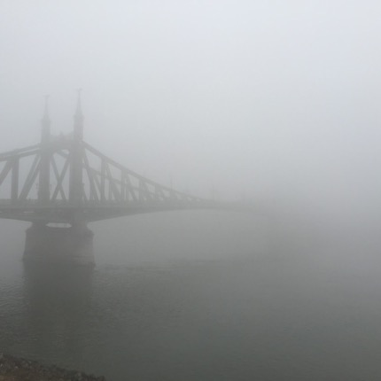
There is virtually no common ground
Executive Summary Non-Traditional Media Map Landscape Social Media Sharing Behaviour Patterns of Disinformation Detailed Findings and Background Data Methodology
Democracy needs common ground: Public discourse is a cornerstone of democratic societies. Awareness and understanding of other views is key to allow for consensus to emerge. Visibility of the “other” enables people to map (dis-)agreement and opens a path of mutual understanding.
The study uncovered a worrying fragmentation of public discourse. Conversations around the French elections were partitioned into two camps: (1) sources of traditional media and the Extend section, and (2) sources of the Reframe and Alternative section. The latter is home to multiple echo chambers, which offer audiences different immersive and exclusive points of views.

Slide 20
No common ground (continued)
Executive Summary Non-Traditional Media Map Landscape Social Media Sharing Behaviour Patterns of Disinformation Detailed Findings and Background Data Methodology
Re-information: Narratives propagated by the Reframe and Alternative sections are rooted in the media sources self-definition of “re-information” – the need to counter an alleged elitist deceit perpetrated by traditional media. Content published by Reframe and Alternative sources aims to reduce the opportunity of common ground between its audience and people who do not hold the same views.
Echo chambers: Social media users appear not to engage with articles from opposing views. In fact, users either share (1) sources of traditional media and the Extend sections, or (2) sources of the Reframe and Alternative sections – but not both. This phenomenon, also known as the echo chamber, reduces the chance of awareness and understanding of opposed views (binary schematization).
The schism in public discourse emerges on a content level and is manifested in (and reinforced by) people’s sharing behaviour.

Slide 21
What is fake news?
Executive Summary Non-Traditional Media Map Landscape Social Media Sharing Behaviour Patterns of Disinformation Detailed Findings and Background Data Methodology
Fake news is a popular but misleading term. Most simply, it is news (material reported in a newspaper or blog, etc.) that is fake (false, counterfeit). Fake news stories are episodic bursts.
Fake news stories are elements of disinformation campaigns aiming to confuse audiences of opposed views. They do this by sowing doubt in the accuracy and credibility of reporting by Traditional media sources. Disinformation campaigns can have both political and monetary motivations.
Fake news stories emerge from the counter-narratives propagated by the Reframe and Alternative sections of the media landscape. The counter-narrative nests fake news stories into the public discourse with a conspiratorial, cynical attitude towards an alleged elitist scheme. The counter-narrative interprets news and events with the assumption of distrust and deceit. The line between its interpretations and the fake news stories it promulgates is opaque. In practice, they are inseparable, forming a coherent and mutually reinforcing source of influence.

Slide 22

Fake news is emotional, not factual
Executive Summary Non-Traditional Media Map Landscape Social Media Sharing Behaviour Patterns of Disinformation Detailed Findings and Background Data Methodology
Our analysis of sharing behaviour sheds light on the emotional dimension of fake news and the underlying counter-narratives.
Counter-narratives resonate with audiences on a personal and emotional level. The stories speak to their sense of frustration and fear. Fake news, seen from this vantage point, is an outcry to gain attention.
Counter-narratives and fake news are soothing and meet emotional needs. They help in elevating the user’s sense of self-worth.
Fake news functions as a proof-point to counter- narratives whose credibility is reinforced by efforts to debunk the piece of news by traditional sources of authority.
Fake news often carries highly symbolic meanings that can be decoded as such.
Fake news
Counter- narratives
Emotional needs

Slide 23
Information dynamics: how narratives move
Executive Summary Non-Traditional Media Map Landscape Social Media Sharing Behaviour Patterns of Disinformation Detailed Findings and Background Data Methodology
Information dynamics
are discernable on two levels:
(1) narratives and (2) dissemination of content. This is about the circulation of ideas.
Narratives move around the Media Map by being cited and reflected on by other publications. Media sources reference stories along three haulage routes:
Traditional to Extend: Extend publications elaborate on and critique news and opinions from Traditional media.
Alternative to Reframe: Conspiratorial and nativist narratives of the Alternative media sources are used to prove wrong Traditional media sources in the Reframe section – exposing a broader audience to confusionist ideas.
Foreign Influence to Alternative and Reframe: Publishers in the Reframe and Alternative sections of the Media Map cite French language content from Russian sources. These stories dovetail with the counter-narrative, providing it with a constant stream of stories.

Slide 24
Sharing a post moves and amplifies content
Executive Summary Non-Traditional Media Map Landscape Social Media Sharing Behaviour Patterns of Disinformation Detailed Findings and Background Data Methodology
Social media networks, especially Facebook and Twitter, are the persistent layer of information dissemination. These sites host the public’s discourse and are the venues where people share and encounter news content.
The study found that social media users form a symbolic relationship with publications aligned with their views and opinions. The media source publishes content that resonates with the audience, while members of the audience take it upon themselves to to amplify the publications’ impact. They do this by sharing its content to their friends and followers.
This relationship is mutually beneficial for publication and the audience, as the boosted voice of the publication substantiates the audiences’ sense of self-worth and identity: “My opinion is that of many.”

Slide 25
By sharing, people seek community & identity
Executive Summary Non-Traditional Media Map Landscape Social Media Sharing Behaviour Patterns of Disinformation Detailed Findings and Background Data Methodology
Our analysis indicates that the quest for belonging is a strong motivational driver of user behaviour. Users of social media form tribal communities differentiated by topics, attitudes and patterns of sharing to enter a symbolic relationship with publications.
This behaviour is most evident around sources of the Reframe and Alternative sections of the Media Map. Polarizing and controversial content (such as anti-homosexual, anti-migrant or anti-elite narratives) has the capacity to self-reflexively enable the individual user to stand out. The act of sharing becomes a performative, compensating display of identity.
The quest to strengthen identity, belonging and self-worth indicates that participating users experience a sense of insecurity and emotional distress in their everyday life.

Slide 26
Debunking fake news has its limits
Executive Summary Non-Traditional Media Map Landscape Social Media Sharing Behaviour Patterns of Disinformation Detailed Findings and Background Data Methodology
Fact-checking and debunking “fake news” is necessary but has limited impact, and may even backfire. Refutations of stories will not directly reach those who posted them in the first place (largely Reframe and Alternative audiences), and may be interpreted as confirmation of the information’s validity.
Viewed through the lens of audiences for Reframe and Alternative media sources, it is a futile attempt to obstruct truth. In this narrative frame, fact-checking becomes entangled with conspiratorial, anti-elitist narratives.
It works both ways. Media organizations located in the Reframe and Alternative maintain counter fact-checkers. They are aligned with their counter-narrative and are charged with debunking news stories published by Traditional media organizations.
Debunking of individual false stories obscures engagement with the larger and arguably more important counter-narrative. Fighting fake stories one by one does not resolve the issues that inspired them in the first place.
Truth
Myth

Slide 27
EXECUTIVE SUMMARY RECOMMENDATIONS
Executive Summary Non-Traditional Media Map Landscape Social Media Sharing Behaviour Patterns of Disinformation Detailed Findings and Background Data Methodology
The study formulates a set of recommendations to address the worrying issues discovered. The recommendations are based on the understanding that open, successful, and democratic societies require a healthy public discourse.

Slide 28
EXECUTIVE SUMMARY: RECOMMENDATIONS
Executive Summary Non-Traditional Media Map Landscape Social Media Sharing Behaviour Patterns of Disinformation Detailed Findings and Background Data Methodology
Recommendations are presented for the four stakeholders:
Media
Social media platforms
Regulatory bodies
Citizens
FOR MEDIA
FOR SOCIAL MEDIA PLATFORMS
FOR REGULATORY BODIES
FOR CITIZENS

Slide 29
Win larger audiences for traditional media
Executive Summary Non-Traditional Media Map Landscape Social Media Sharing Behaviour Patterns of Disinformation Detailed Findings and Background Data Methodology
Traditional media organizations adhering to journalistic standards are under attack by non-traditional media organizations propagating a counter-narrative. They are losing audiences to Reframe and Alternative media sources.
The study indicates that about one third of the audience has disengaged with traditional sources of information.
Recommendations for media organizations:
Develop offerings that resonate with audiences currently unengaged with traditional media. Address contentious topics and issues such as national identity, community and migration. Speaking to themes associated with existential fears in non-nativist frames will gain trust and journalistic authority.
Simplify language and avoid labels. Labels are counterproductive as they create distance rather than engage the issue at hand (e.g., racist).
Educate audiences about the existence of the counter-narrative and their alternative interpretations of issues.
Engage hateful audiences in conversations; provide space to sound their concerns and vent frustrations. An emotional discharge lays the foundation for meaningful conversations.

Slide 30
Call on platforms to reverse harmful trends
Executive Summary Non-Traditional Media Map Landscape Social Media Sharing Behaviour Patterns of Disinformation Detailed Findings and Background Data Methodology
The role of social media platforms such as Facebook and Twitter in the dissemination of information and formation of opinions – and hence the democratic election process – is hard to overestimate.
Social networks act as a persistent layer of information distribution. This means people use these venues to learn and share about news. Thus these online venues form a part of the infrastructure of the public discourse, which is vital to the democratic process.
The analysis has identified adverse trends that are exacerbated by the design and practices of commercial social media platform operators.
Recommendations for social media network companies address these trends:
Segregation
Lack of meaningful conversation, linked to repeating posts
Fake accounts
Lack of transparency, linked to algorithms, dark advertising and dark campaigns
Echo chambers

Slide 31
Some background on segregation
Executive Summary Non-Traditional Media Map Landscape Social Media Sharing Behaviour Patterns of Disinformation Detailed Findings and Background Data Methodology
Echo chamber: Our research finds that “cross-sharing” from opposed views is minimal. Users subscribing to a specific political orientation neither share nor encounter views they do not agree with. Through this phenomenon – also called the echo chamber – users fortify and escalate their beliefs, and encounter only like-minded others.
Business interests: The echo chamber problem is aggravated by the social network platform features and functions. Platforms are businesses and their business interest is to maximize the time people spend on their sites – not ensuring the common ground required for the democratic process. Platforms have no interest in exposing users to content that is incongruent or counters their beliefs. Algorithmic news feeds, segmentations and targeting ensure users remain within walled gardens. They remain unaware of public discourse at large and are being served a filtered view.
No visibility of others: The social media landscape revealed by this research holds several separate communities that have no visibility of each other’s topics, problems, issues or arguments. The features and functions of social media platforms results in these communities becoming segregated. Partitioning of users serves business interests and not the public interest.

Slide 32
Encourage meaningful conversations
Executive Summary Non-Traditional Media Map Landscape Social Media Sharing Behaviour Patterns of Disinformation Detailed Findings and Background Data Methodology
Insights into the sharing and discussion behaviour of social media users point towards the limited role of genuine discussion and debate between different communities. The vast majority of conversations follow a battlefield logic, with communities intent to dominate the public discourse and humiliate each other instead of engaging in consensus seeking conversations.
Users can participate in discussions with minimal effort, by repeating messages without engaging with the content. Platform’s functionality encourages sharing without the addition of personal opinion or meaning. This behaviour crowds out genuine debate and is barrier to meaningful conversations.
More than half of the entire discourse is
made up of shared news articles without personal opinions.
Recommendations for social media platforms:
Disincentivize the Repeat behaviour.
Encourage users to engage with content and share their personal opinions and experiences.
Rank meaningful conversations higher and so contribute to a genuine public discourse instead of suppressing it.
Fight automated botnets. The Repeat behaviour is prone to manipulation by automated botnets, as no intelligence is needed to flood social media platforms with links to shared articles.

Slide 33
Eliminate fake accounts
Executive Summary Non-Traditional Media Map Landscape Social Media Sharing Behaviour Patterns of Disinformation Detailed Findings and Background Data Methodology
Conversations around political and social issues entail a high share of suspicious fake accounts. The aim of these accounts is to drown out other voices.
Automated botnets are likely a driving factor behind the predominance of the Repeat behaviour in social media use. Accounts operated by botnets are disguised as authentic users. They are deployed to skew the conversation and project a false numerousness of individual users.
Social media platforms are gatekeepers of the public discourse. Their systems decide who is eligible to participate in conversations.
Recommendations for social media platforms:
Recognize the gatekeeper role played by social media platforms in public access to information. Fake accounts means less real access and a weaker public discourse.
Platforms must take steps to eliminate fake accounts. While contrary to their business interest, social media companies should be transparent to their user base.
Make it your goal to host authentic users having real conversations.

Slide 34
Shine light on algorithms and dark money
Executive Summary Non-Traditional Media Map Landscape Social Media Sharing Behaviour Patterns of Disinformation Detailed Findings and Background Data Methodology
Social media platforms are part of the public information infrastructure. Akin to public broadcasters or telecommunication companies their systems provide an important venue for the public discourse.
Platforms use algorithms to decide what content shows up in users’ feeds. The visibility (or invisibility) of opinions influences voters’ perceptions, and thus can have impact on the outcome of elections.
Platforms also make dark advertising possible. In contrast to traditional campaigns, messages targeted to specific segments of society are hidden from others. Dark campaigns can be used to promote voter suppression or misleading claims.
Recommendations for social media platforms:
Recognize social media platforms as part of the public information infrastructure.
Make the mechanisms selecting and prioritizing content (e.g. algorithms) understandable and accessible for any member of the public.
Platforms should make all political paid campaign communication public.

Slide 35
End echo chambers in social media
Executive Summary Non-Traditional Media Map Landscape Social Media Sharing Behaviour Patterns of Disinformation Detailed Findings and Background Data Methodology
Recommendations for social media platforms:
Take active steps to counter the segregation of users according to their views and opinions. Take action to remove echo chambers. This is in addition to taking steps to foster an environment conducive to meaningful conversations.
Platform operators should identify divisive and contentious topics and ensure that segregated communities are exposed to alternative views. Users engaged in political discourse should not be able to fully immerse themselves in a single point of view, but be made aware of divergent perspectives.
Add new features connecting users along themes, introducing a degree of randomness to simulate real-life chance encounters, to help pierce echo chambers.

Slide 36
Regulatory bodies must enforce transparency
Executive Summary Non-Traditional Media Map Landscape Social Media Sharing Behaviour Patterns of Disinformation Detailed Findings and Background Data Methodology
Social media networks are essential elements of the communication landscape. Governments and regulatory bodies have a vested interest in ensuring social networks contribute to the public discourse. Akin to other forms of media, social networks play a role in ensuring a plurality of opinions. Yet, regulation of for-profit enterprises comes with the risk of limiting freedom of speech.
Recommendations for REGULATORY BODIES:
Educate citizens on the role of social networks, personalization, and behavioural targeting and retargeting. Citizens are often unaware that their newsfeed is not universal but is individually tailored content to suit their assumed preferences.
Create a legal framework to enforce transparency on moderation, content prioritization mechanisms, and targeted dark advertising.
Regulate, monitor and publish campaign spends. Encourage citizens to report political ads. Force platform operators to make user complaints public.

Slide 37
Political actors: adhere to a code of conduct
Executive Summary Non-Traditional Media Map Landscape Social Media Sharing Behaviour Patterns of Disinformation Detailed Findings and Background Data Methodology
Political actors, parties, candidates, and interest groups use social media to build and engage communities, and deliver campaign messages. Social platforms are a central part of voter activation. They enable political actors to get closer to the people they are trying to represent.
However, the possibilities granted by technologies commonly referred to as “big data” can easily be coopted to manipulate voters.
Recommendations for Political actors:
While political actors should be free to utilize novel opportunities to connect with people, they should adhere to a transparent code of conduct.
A code of conduct should encompass transparency of data operations, use of personality identifiable information, targeting of voter segments, and use of dark advertising.
Platform providers and election regulating bodies should enforce the agreed code of conduct.

Slide 38
Citizens should participate in discussions
Executive Summary Non-Traditional Media Map Landscape Social Media Sharing Behaviour Patterns of Disinformation Detailed Findings and Background Data Methodology
Members of the public have a critical role in defending the democratic process. The public discourse explored by this study is driven by citizens, who through sharing and discussions shape the political discourse.
Recommendations for CITIZENS:
Follow people you don’t agree with. Initiate and engage in constructive conversations. Do not simply share articles; express what they mean to you.
Pay for journalism. Reporting that is funded by advertising revenue exposes journalism to outside influences.
Explore the media landscape. Explore how facts are reinterpreted, shaped and transformed: Be your own fact-checker.
Pressure Facebook, Twitter and others to evolve the platform. Facebook can be influenced by its user base. Platforms are constantly monitoring user behaviour and will adapt to people’s needs.

Slide 39
❷

Slide 40
CONTENTS
Executive Summary Non-Traditional Media Map Landscape Social Media Sharing Behaviour Patterns of Disinformation Detailed Findings and Background Data Methodology
❶
Executive Summary
Key Insights
Key Implications
Recommendations
The French Media Content Landscape
Media Map Sections
Media Map Clusters
Candidate Support and Influence
Foreign Influence
Media Map Trends
Two-Step Model of Social Media Influence
Posting Behaviour
Discuss Behaviour
Quantitative Sharing Behaviour Analysis
Credibility Cloak
Time Shifting
Fake Polls
Hoax Sites
Russian Influence
Cluster by Cluster Analysis
Quotes
5 Steps of the Media Map
Conversations
Non-Traditional Media Map Landscape
PHASE ONE
❷
Social Media Sharing Behaviour
Patterns of Disinformation
❸
Detailed Findings and Background Data
Methodology

Slide 41

The French Election Social Media Landscape 2017
Executive Summary Non-Traditional Media Map Landscape Social Media Sharing Behaviour Patterns of Disinformation Detailed Findings and Background Data Methodology
OBJECTIVE
The study’s objective is to map and document the social media landscape around the 2017 French Presidential elections.
STRUCTURE
The study was conducted in three phases, presented here in the following chapters:
Phase One: Non-Traditional Media Map Landscape
Phase Two: Social Media Sharing Behaviour
Phase Three: Patterns of Disinformation

Slide 42
METHODOLOGY Social understanding from social listening
Executive Summary Non-Traditional Media Map Landscape Social Media Sharing Behaviour Patterns of Disinformation Detailed Findings and Background Data Methodology
Bakamo.Social employs a social media listening methodology that combines technology and human qualitative analysis at scale. The methodology is geared to discover what and why users share in the social web.
All insights presented in this report are derived from the analysis of public social media conversations across all major social media platforms, including Facebook and Twitter, captured over a six-month time horizon from November 2016 to May 2017.
Please see the methodology section for a detailed explanation of the research approach and steps employed by this study.
CONTACT
Please contact Bakamo.Social if you have questions or seek clarification at daniel.fazekas@bakamosocial.com

Slide 43
Phase 1 NON-TRADITIONAL MEDIA MAP LANDSCAPE
Executive Summary Non-Traditional Media Map Landscape Social Media Sharing Behaviour Patterns of Disinformation Detailed Findings and Background Data Methodology

Slide 44
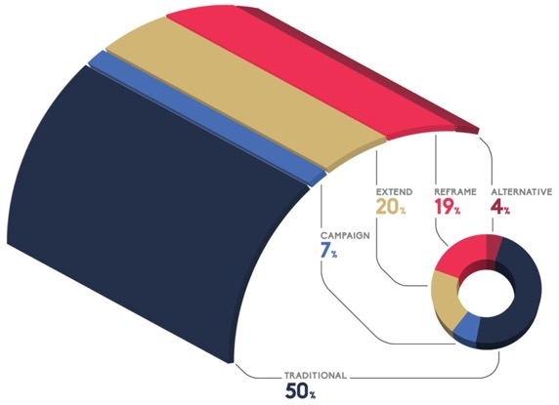
HOW TO READ THE MEDIA MAP
Executive Summary Non-Traditional Media Map Landscape Social Media Sharing Behaviour Patterns of Disinformation Detailed Findings and Background Data Methodology
The Media Map is based on the prevalence of shared URL links to media sources across public social media when talking about the election, candidates, parties, or issues. The sizing represents the intensity with which social media users share links pointing to articles published by media sources.
More than half of all social posts point towards content from traditional media sources (50 percent) and to party campaign sites (7 percent). The remaining 43 percent are divided between the three identified sections of non-traditional media: the Extend, Reframe and Alternative sections. The study focused on the analysis of latter three sections.
The curvature of the map serves to juxtapose the difference in worldviews represented through the narratives used to frame information by media sources across the Media Map. Audiences immersing and informing themselves exclusively through non-traditional media sources lead to a segregated understanding of the world, reducing the “common ground” across society.

Slide 45
SECTIONS OF THE MEDIA MAP
Executive Summary Non-Traditional Media Map Landscape Social Media Sharing Behaviour Patterns of Disinformation Detailed Findings and Background Data Methodology
Traditional media: This section of the Media Map is populated by media sources that belong to the established commercial and conventional media landscape, such as websites of national and regional newspapers, TV, and radio stations, online portals adhering to journalistic standards, and news aggregators. These are principally France-based sources; however, French-speaking international media sources exhibiting these same characteristics were also placed into the Traditional media section.
Campaign media: The Campaign section of the Media Map holds the official web presences of the candidates and parties. All sites located in this section are clearly marked and operated by the campaigns. This section includes official party pages, candidate sites, and local and regional party chapters.
Extend: This section holds media sources that act to extend the journalistic scope of the traditional media. While broad in content and function, media sources in the Extend section contribute to the public’s discourse in a constructive manner. Some offer non-partisan or scholarly investigative reporting or explore in greater depth stories that have appeared in traditional media sources. Others are anti-corruption watchdogs. Still others share content along personal or community perspectives. Some media sources are engaged in activating their readership for political ends, while others offer their readers humorous content.
Reframe: Media sources in the Reframe section share the motivation to counter the Traditional Media narrative. The media sources see themselves—and express themselves unambiguously—as part of a struggle to “re-inform” readers of the real contexts and meanings hidden from them when they are informed by Traditional Media sources. This section breaks with the traditions of journalism, expresses radical opinions, and uses both traditional and alternative sources of reference to craft a disruptive narrative.
Alternative: The Alternative section of non-traditional media sources is an incoherent, confusing space. It fuses radical left and right views which are unified in their opposition to globalization. Narratives are often mythical, almost theological in nature, or discuss an intricate web of international conspiracy-like dependencies. Traditional political orientations are not present.

Slide 46
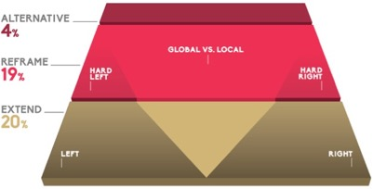
NARRATIVE FRAMES IN NON-TRADITIONAL MEDIA
Executive Summary Non-Traditional Media Map Landscape Social Media Sharing Behaviour Patterns of Disinformation Detailed Findings and Background Data Methodology
Analysis of the media sources across the Media Map identified two distinct underlying
narrative frames (binary oppositions) functioning as the organizing ideological frameworks:
1. Left versus Right
Media sources in this narrative frame publish content along this established continuum of left and right. Non-traditional media sources located on the left or right might be discussing different themes or hold opposing views, but they operate within the same narrative frame. This is most visible in the Extend section of the Media Map, where sources widen the coverage of the Traditional Media sources. Media sources in the Reframe section are informed by the left vs. right frame to a lesser extent. Content published in the Alternative section cannot be classified by this frame.
2. Global versus Local
Content published in this narrative frame is positioned as being for or against globalization. The left vs. right frame does not apply. Indeed, the further away media sources are from the Traditional section, the less a conventional left vs. right attribution is possible. While there are media sources in the Reframe section on both on the hard right and hard left sides, they converge in the global versus local narrative frame. They take concepts from both left and right, but reframe them in a global vs. local context. One can find left or right leanings of media sources located in the middle of Reframe section, but this mainly relates to attitudes about Islam and migrants. Otherwise, left-leaning and right-leaning media sources in the Reframe section share one common enemy: globalization and the liberal economics that are associated with it. Content published by Alternative sources is fully immersed in the global vs. local narrative frame.

Slide 47
CLUSTERING OF MEDIA SOURCES
Executive Summary Non-Traditional Media Map Landscape Social Media Sharing Behaviour Patterns of Disinformation Detailed Findings and Background Data Methodology
To populate the Media Map, the study developed a framework for analysing the top 800 non-traditional media sources shared in the social media discourse around the election. The analysis developed the following criteria to differentiate and group individual media sources:
1. Content
Issues and topics areas covered by articles published by the media source
Narrative frame employed by the media sources (e.g., left vs. right or global vs. local)
Candidates or social and economic views rejected in articles published by the media source
Citations of articles published by other media sources and in other Media Map sections
2. Look and feel of the media sources, e.g., sites that looked like broad online news portals vs. sites that had a blog-like appearance
3. Support for presidential candidates, measured by the overt statements advocating for a given candidate
4. Presence of Russian influence, i.e., citations of RT, Sputnik News, or other Russian sources
5. Advertisements and other commercial activity
The above approach resulted in the identification of 17 distinguishable clusters of publishers of Non-Traditional media content.
Extend section (20%)
Comedy/Parody/Satire
Online Petitions & Citizen Engagement
Environment
Nonpartisan and Centrist Blogs
Right and Left Wing Blogs
LGBTQ/Human Rights
Investigative Journalism
Reframe section (19%)
French Identity
Anti-Islam
Anti-Global Patriots
Anti-Imperialist
Anti-Corporate
Protest/Revolution
Pro-Islam
Alternative section (4%)
Confusion/Beyond information
Conspiracy/Anti-System
Click here to jump to the detailed cluster description

Slide 48
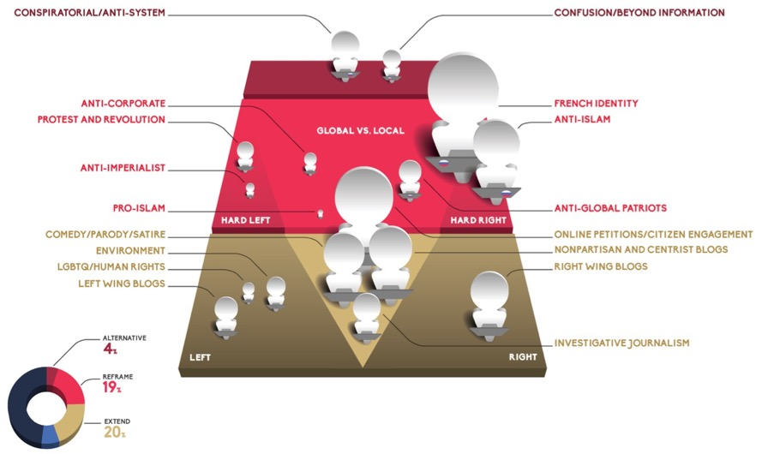
CLUSTERING ON THE MEDIA MAP
Executive Summary Non-Traditional Media Map Landscape Social Media Sharing Behaviour Patterns of Disinformation Detailed Findings and Background Data Methodology
The map indicates the location and relative size of the 17 identified groupings within the 800 non-traditional media publishers.
The Extend section is dominated by Petition and Comedy and Non-Partisan blogs.
The Reframe section is dominated by three hard-right clusters: French Identity, Anti-Islam and Anti-Global Patriots, which are closely intertwined with each other.
Click here to jump to the detailed cluster description

Slide 49
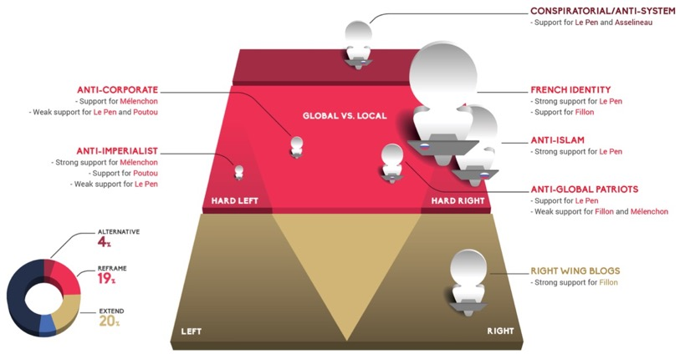
CANDIDATE SUPPORT AND INFLUENCE
Executive Summary Non-Traditional Media Map Landscape Social Media Sharing Behaviour Patterns of Disinformation Detailed Findings and Background Data Methodology
The investigation into media sources included the analysis of expressed explicit support of presidential candidates. Levels of support are divided into strong support, support, and weak support.
Strong support: More than 40 percent of the analysed media sources in the cluster express support for a candidate.
Support: Between 20–40 percent of the analysed media sources in the cluster express support for a candidate.
Weak support: Fewer than 20 percent of the analysed media sources in the cluster express support for a candidate.

Slide 50
CANDIDATE SUPPORT AND INFLUENCE
Executive Summary Non-Traditional Media Map Landscape Social Media Sharing Behaviour Patterns of Disinformation Detailed Findings and Background Data Methodology
Among Non-Traditional media sources:
Marine Le Pen and her Front National party dominate the largest clusters. The media sources in the French Identity cluster overwhelmingly support the election of Le Pen, though a few sites support François Fillon. In the Anti-Islam cluster, Le Pen was the only candidate supported.
Support for candidates across the political spectrum is evident in clusters where the global vs. local narrative dominates. The Anti-Global Patriots cluster exhibits support for both Le Pen and Jean-Luc Mélenchon. While support for Le Pen is greater, this overlap is noteworthy because the two are traditionally seen at opposite ends of the left vs. right political spectrum.
The global vs. local narrative is also seen in clusters located on the left hemisphere of the Reframe section. Though significantly smaller in size, both the Anti-Corporate and Anti-Imperialist clusters offer support mainly for Mélenchon and Poutou and, interestingly, to a limited extent Le Pen, historically an ideological enemy. This is further evidence that the global vs. local narrative supersedes left vs. right distinctions and is turning into a dominant narrative frame.
Media sources in the Conspiratorial/Anti-System cluster show some support for both Le Pen and Asselineau.

Slide 51
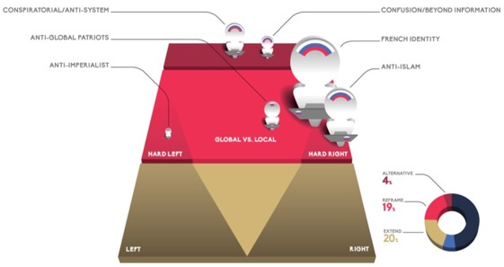
FOREIGN INFLUENCE
Executive Summary Non-Traditional Media Map Landscape Social Media Sharing Behaviour Patterns of Disinformation Detailed Findings and Background Data Methodology
The content analysis explored the presence of foreign influence in individual media sources. Four criteria were used to classify a media source as being exposed to foreign influence:
Overt support for a foreign nation’s perception or policy goals
Usage of foreign media sources in countering traditional media narratives
Recommendation and linkage to foreign media sources
Foreign operated French-speaking media sources
The analysis explored a minimum of five articles from each media source as well as static elements of each source. Indicators of foreign influence had to be present in either the articles or the source’s other permanent content, e.g., other media sources that that source recommended.
The analysis only identified foreign influence connected with Russia. No other foreign source of influence was detected. The Media Map shows the clusters within which media sources are exposed to Russian influence. Only those clusters where influence was detected are shown.

Slide 52
FOREIGN INFLUENCE (continued)
Executive Summary Non-Traditional Media Map Landscape Social Media Sharing Behaviour Patterns of Disinformation Detailed Findings and Background Data Methodology
Russian influence comes across in a different way. Some media sources are explicitly marked as Russian: the layout of the media sources includes Russian symbols, such as the Russian flag. Some sites link directly to Russian government institutions, such as the Ministry of Defence.
Alternative section: The two clusters in this section displayed the highest level of exposure: almost half of the media sources show signs of Russian influence.
Reframe section: One third of the media sources in the French Identity cluster (the largest of the clusters) and the Anti-Islam cluster show signs of Russian influence. Only a tenth of the media sources in the Anti-Global Patriots show signs of Russian influence. One third of the media sources in the hard left Anti-Imperialist cluster show signs of Russian influence. Thus, the impact of the Russian influence is greatest on the Far-Right, as it reaches a much larger audience.
The research approach employed by the study is not suited to detect intentional manipulation or state-sponsored disinformation campaigns. It identifies correlation, not causality. That said, the presence of Russian influence generally coincided with a critical anti-elitist and counter-traditional media narrative. Media sources in the Reframe section tend to cite content from Russian media sources such as Sputnik News or Russia Today and other minor sites in their own coverage. Content from Russian media sources tends to be pitted against news stories reported by traditional media sources. This counter-citing behaviour is used by exposed sources to highlight how, in their view, Traditional media fails to cover the whole story.
A dominant theme reflected by sources where Russian influence is detected is the war in Syria, the various actors involved, and the refugee crisis. In these articles, Bashar al Assad becomes the protagonist, a perspective opposite to that which is reported by Traditional media. Articles touching on refugees and migrants tend to reinforce anti-Islam and anti-migrant positions.

Slide 53
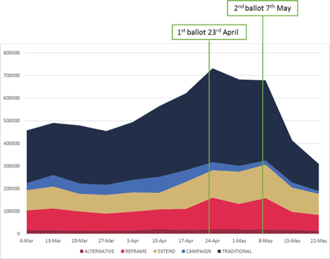

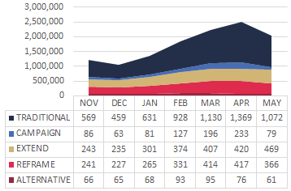

MEDIA MAP TRENDS
Executive Summary Non-Traditional Media Map Landscape Social Media Sharing Behaviour Patterns of Disinformation Detailed Findings and Background Data Methodology
NUMBER OF LINKS (CONTENT) SHARED BY SOCIAL MEDIA USERS RELATED TO THE FRENCH PRESIDENTIAL ELECTION
(BY WEEK)
Of the 20+ million posts with political content covered in this study, just over 8 million were publicly shared by French social media users containing a URL link in the six months prior to the election.
As the election grew closer, the sharing of content increased. While there was more content to share, the underlying data show:
New users were steadily attracted to the conversation.
The election commands a greater share of users’ attention, as they share more content per person.
NUMBER OF LINKS (CONTENT) SHARED BY SOCIAL MEDIA USERS RELATED TO THE FRENCH PRESIDENTIAL ELECTION
(BY MONTH)
 | 6-Mar | 13-Mar | 20-Mar | 27-Mar | 3- Apr | 10-Apr | 17-Apr | 24-Apr | 1-May | 8-May | 15-May | 22-May
 | 233 | 231 | 257 | 237 | 256 | 313 | 340 | 415 | 382 | 355 | 186 | 121
 | 31 | 51 | 46 | 44 | 56 | 70 | 52 | 36 | 26 | 19 | 23 | 12
 | 89 | 97 | 78 | 83 | 86 | 73 | 120 | 122 | 143 | 148 | 107 | 93
 | 88 | 95 | 85 | 75 | 83 | 88 | 92 | 140 | 112 | 138 | 79 | 71
 | 16 | 17 | 14 | 15 | 15 | 21 | 18 | 19 | 20 | 19 | 18 | 12
all numbers in thousands
all numbers in thousands

Slide 54
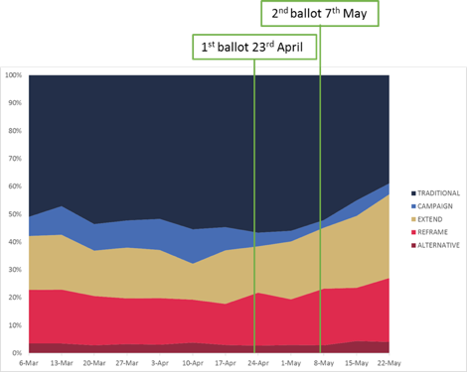
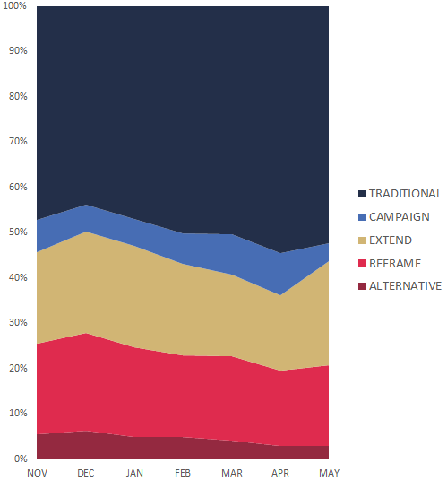
MEDIA MAP TRENDS
Executive Summary Non-Traditional Media Map Landscape Social Media Sharing Behaviour Patterns of Disinformation Detailed Findings and Background Data Methodology
While the sharing of content increased from all media sources as the election drew near, some showed other changes:
Traditional and Campaign sources grew in impact as social media users increasingly relied on and shared their content. In April, almost two thirds of content shared came from traditional news or official campaign sources.
Nontraditional sources did not benefit as greatly from the increased attention to the election, though remained a significant part of the discourse.
PROPORTION OF LINKS (CONTENT) SHARED BY SOCIAL MEDIA USERS RELATED TO THE FRENCH PRESIDENTIAL ELECTION
(BY MONTH)
PROPORTION OF LINKS (CONTENT) SHARED BY SOCIAL MEDIA USERS RELATED TO THE FRENCH PRESIDENTIAL ELECTION
(BY WEEK)

Slide 55
Phase 2 SOCIAL MEDIA SHARING BEHAVIOUR
Executive Summary Non-Traditional Media Map Landscape Social Media Sharing Behaviour Patterns of Disinformation Detailed Findings and Background Data Methodology

Slide 56
CONTENTS
Executive Summary Non-Traditional Media Map Landscape Social Media Sharing Behaviour Patterns of Disinformation Detailed Findings and Background Data Methodology
❶
Executive Summary
Key Insights
Key Implications
Recommendations
The French Media Content Landscape
Media Map Sections
Media Map Clusters
Candidate Support and Influence
Foreign Influence
Media Map Trends
Two-Step Model of Social Media Influence
Posting Behaviour
Discuss Behaviour
Quantitative Sharing Behaviour Analysis
Credibility Cloak
Time Shifting
Fake Polls
Hoax Sites
Russian Influence
Cluster by Cluster Analysis
Quotes
5 Steps of the Media Map
Conversations
Non-Traditional Media Map Landscape
❷
Social Media Sharing Behaviour
PHASE TWO
Patterns of Disinformation
❸
Detailed Findings and Background Data
Methodology

Slide 57
Social media sharing behaviour sheds light on engagement in election discussions
Executive Summary Non-Traditional Media Map Landscape Social Media Sharing Behaviour Patterns of Disinformation Detailed Findings and Background Data Methodology
This part of the study aims to uncover the motivations and levels of involvement users exhibit in the social media conversation around the French Presidential elections.
Influence in social media goes beyond the production and availability of media content. Influence is exerted through users sharing and engagement with the content.
The study explored the typology of people’s posting and discussion behaviours to shed light on the types of engagement with content from different clusters of media map.

Slide 58
SOME DEFINITIONS
Executive Summary Non-Traditional Media Map Landscape Social Media Sharing Behaviour Patterns of Disinformation Detailed Findings and Background Data Methodology
The question of how to measure influence in social media has a few different answers.
There are three essential concepts: post, engagement, and reach.
POST
A post is a unique social media message that contains a link to an article published by media source located in any of the sections of the Media Map.
ENGAGEMENT
Engagement in social media is defined as the number of people who act upon viewing an update of an account they follow. These are the “likes” or “shares” in Facebook, or “favourites” or “retweets” in Twitter. Higher engagement tends to correlated with higher reach.
REACH
Reach in social media is defined as the number of potential users to who the shared content is visible. In real world terms, reach is basically the number of people who are interested in what another person has to say.

Slide 59

TWO-STEP MODEL OF SOCIAL MEDIA INFLUENCE
Executive Summary Non-Traditional Media Map Landscape Social Media Sharing Behaviour Patterns of Disinformation Detailed Findings and Background Data Methodology
Social media impact (or audience reach) is generated by the sharing of articles and conversations triggered.
Reach and impact of the piece of content is determined by the resonance it triggers.
Social media users respond to shared content in comments.
Three engagement subtypes: - Agree
- Debate
- Debunk
REACH &
IMPACT
Audiences share article links to their followers to draw attention.
Three engagement subtypes: - Repeat
- Mission
- Provoke
Media publishers generate stream of articles , which are published on websites and to the social media handles of the media source.
French Identity, Anti-Islam, Comedy, Petitions, etc. (see the Media Map).

Slide 60
POSTING BEHAVIOUR
Executive Summary Non-Traditional Media Map Landscape Social Media Sharing Behaviour Patterns of Disinformation Detailed Findings and Background Data Methodology

Slide 61
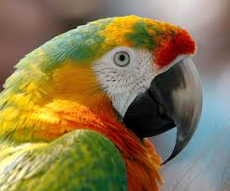

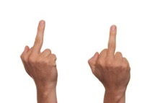
TYPES OF POSTS
Executive Summary Non-Traditional Media Map Landscape Social Media Sharing Behaviour Patterns of Disinformation Detailed Findings and Background Data Methodology
Post – Repeat | Post – Mission | Post – Provoke
REPEAT
Posts contain only the title of an article with a link published to a user’s profile pages or personal streams.
The sharing delivers the content to a user’s followers or friends, amplifying the reach of the content.
Posting content without commentary implies the user wants others to read the article. This recommendation conveys an identification with the content or its implications.
Repeat sharing can also be understood as an affirmation of community membership.
MISSION
Posts are made up of a personal expression along the shared link to a user’s profile pages or personal streams.
Purposefully created posts frame the information and steer impact towards the author’s objectives.
The user situates him/herself as part of the political debate, assuming a facilitating role in the dispersion of information.
Mission-type sharing provides a communicative opening as it is intended to involve others in their community discourse.
PROVOKE
Posts combine a shared link with a customized message intended to incite audiences of contrarian views.
Posts are tactically crafted and placed to maximize the chance the message confuses, insults, and slanders the author’s political or cultural opponents.
Users act along ideological dichotomies when engaging hostile audiences. Enemies are the projections of fears of an homogenous other.
“Provoke” posting is an emotionally asymmetric behaviour, where self-affirmation is obtained by negating others.

Slide 62
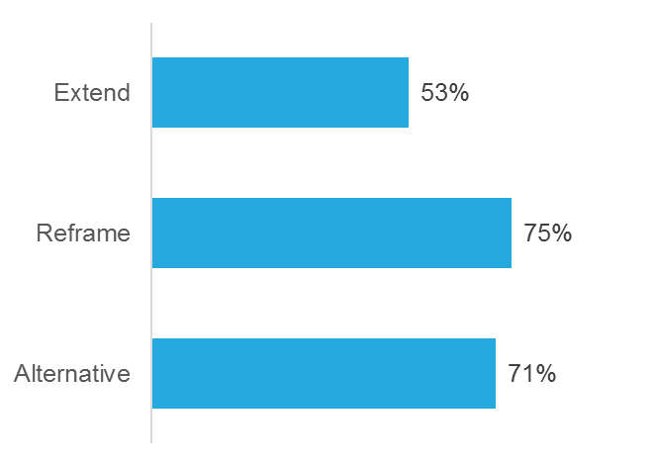
The Repeat behaviour is the most common
Executive Summary Non-Traditional Media Map Landscape Social Media Sharing Behaviour Patterns of Disinformation Detailed Findings and Background Data Methodology
Post – Repeat | Post – Mission | Post – Provoke
Summary of the behaviour | Quotes and examples | Drivers | Presence on the Media Map
Users add no content to their posting. The posts consist of the article titles and the link to the article.
With no personal opinion added, it can be assumed the person is in agreement with the stance taken by the article or has an interest in boosting the article’s reach.
Posts are likely generated by recommend functions of the media sources and may be retweets/reshares and may be composed by automatic sharing tools.
Depending on the context, content that is ironic or misinformative adds an additional layer of complexity. This happens when shared articles are incongruent with the user’s profile information.
The “Repeat” behaviour is the dominant behaviour across all three sections of Non-Traditional media sources (Extend, Reframe, Alternative) on the Media Map.
More than two thirds of the conversations within Reframe and Alternative media sources are Repeat posts.
Click here to jump
to the quotes

Slide 63
Drivers of Repeat posts
Executive Summary Non-Traditional Media Map Landscape Social Media Sharing Behaviour Patterns of Disinformation Detailed Findings and Background Data Methodology
Post – Repeat | Post – Mission | Post – Provoke
Summary of the behaviour | Quotes and examples | Drivers | Presence on the Media Map
RATIONAL
Two rational motives can be associated the Repeat behaviour. They serve the dual objective to (1) exhibit an opinion and (2) contribute to a higher share of voice of that opinion.
To add reach, users turn themselves into repeaters of the information. Their aim is to add to the buzz, by exposing their social circle to the content.
Lending credibility to the article, users extend their reputation, by placing it into their stream and associating it with their own identity.
Potentially hijacking the Repeat behaviour, users may operate multiple accounts projecting phantom identities to orchestrate buzz.
EMOTIONAL
The Repeat behaviour is an involved but a seemingly low-risk engagement, enabling a differentiated perception:
The individual's relationship with the content remains unstated: if pinned down, the user could always claim to “just” spread interesting articles, but not endorse them.
Simultaneously, by repeating content, users can exhibit fidelity to the cause and confirm their membership in a community of kindred thinkers: sharing means having done something for the cause.
Highly polarizing content speaks for itself.

Slide 64
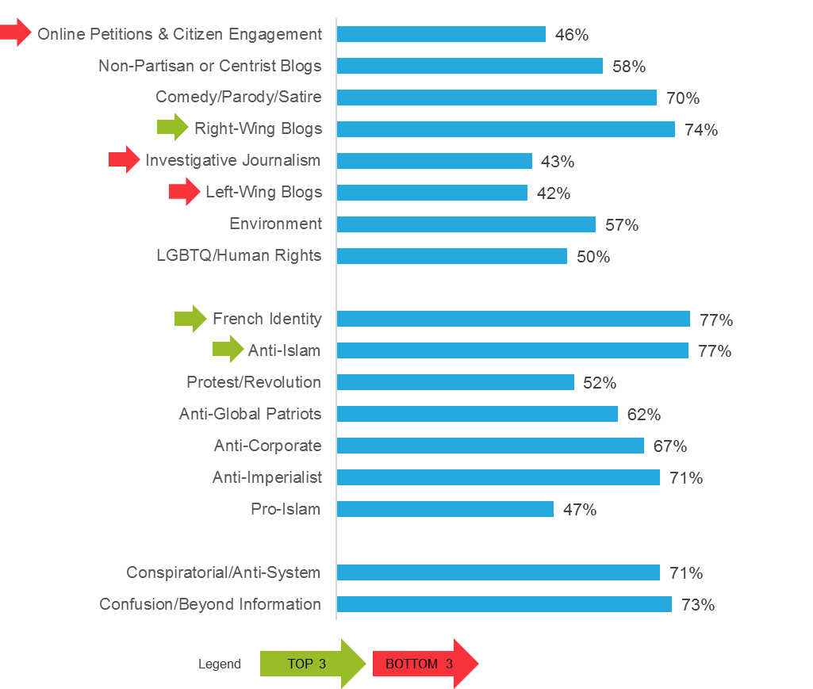
Where Repeat posts appear on Media Map
Executive Summary Non-Traditional Media Map Landscape Social Media Sharing Behaviour Patterns of Disinformation Detailed Findings and Background Data Methodology
Post – Repeat | Post – Mission | Post – Provoke
Summary of the behaviour | Quotes and examples | Drivers | Presence on the Media Map
Over 64 percent of the analyzed conversation is made up of simple sharing of the article’s title and URL address. Across all clusters of the media map the Repeat behaviour is the most dominant.
Repeat sharing is most intense with articles published by media sources in the French Identity, Anti-Islam and Right-Wing Blogs clusters.
The community and content from Right and Far-right clusters appears to result in a publisher-user relationship, where the users help in exposing the article but do not share their own views.
As the content is typically polarizing (often misleading), the appearance of broad resonance reinforces a dominant posture. The high share of repeat sharing may also indicate significant level of automated resharing (botnets) via fake accounts.

Slide 65
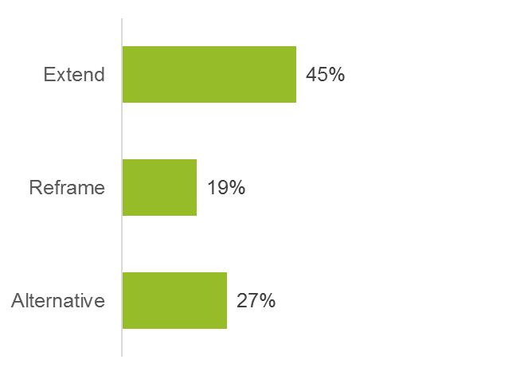
Posts with a mission
Executive Summary Non-Traditional Media Map Landscape Social Media Sharing Behaviour Patterns of Disinformation Detailed Findings and Background Data Methodology
Post – Repeat | Post – Mission | Post – Provoke
Summary of the behaviour | Quotes and examples | Drivers | Presence on the Media Map
Posts in the “Mission” behaviour category attach a personal expression to a shared URL link leading to the article. Four patterns of behaviour emerge:
FILING AND POINTING: Users add #hashtag(s) to the shared article. Hashtags are keywords to organize and search terms to search conversations. By augmenting hashtag(s) the user injects a point of reference to the shared content. Hashtags allow the user to offer his/her interpretation of the article public.
ADDRESSING AND ALERTING: Users post links to pages or include user handles to address and alert groups or individuals to a shared article and its implications. The user operationalizes the article to better express his/her opinion. Motivations may include expressing support or criticism, suggesting or requesting actions, or highlighting an individual’s role in the article.
QUOTING AND HIGHLIGHTING IMPORTANT PART OF AN ARTICLE: Users copy the decisive argument of the article as a piece of eye candy, enabling peers to instantly recognize the key message the user has identified in the article.
ASKING THE QUESTIONS: Users formulate a question along the shared article’s link. Questions tend to either ask others to validate the shared information, or invite peers for discussion. Occasionally, questions appear to be rhetorical in nature, expressing frustration. Posing questions allows users to frame the article content’s implication and position themselves simultaneously.
About one third of all analysed shares are Mission posts, making Mission the second most popular sharing behaviour.
The behaviour is most predominant in the Extend section, typically publishing content applying a journalistic, rational approach to reporting.
Click here to jump
to the quotes

Slide 66
Drivers of Mission posts
Executive Summary Non-Traditional Media Map Landscape Social Media Sharing Behaviour Patterns of Disinformation Detailed Findings and Background Data Methodology
Post – Repeat | Post – Mission | Post – Provoke
Summary of the behaviour | Quotes and examples | Drivers | Presence on the Media Map
RATIONAL
Addition of a personal opinion increases the attractivity of the post and is aimed to increase the reach and resonance the post receives.
With the published interpretation the user ensures the impact of the article is aligned with his/her own understanding of the topic.
The added information contributes to the organization of the shared information by connecting the article to a theme, issue, person, or action. With the provided context the user ensures his/her intentions are understood.
Mission posts are also driven by the intent to initiate a discussion with peers, as they are more likely to engage with the personal opinion of the poster than a post with a mere shared link.
EMOTIONAL
In Mission posts, users voice their own interpretation, their personal connection to the article. They expose themselves to shape the conversation.
Mission behaviour communicates activity and vitality. Actively responding to articles shows openness and contemporariness. Exhibiting a conscious intent displays the aspiration to community thought leadership and expertise.
Besides engagement, the user can publicly display emotions and attachment to a cause, membership in a community, and acceptance of his/her identity.

Slide 67
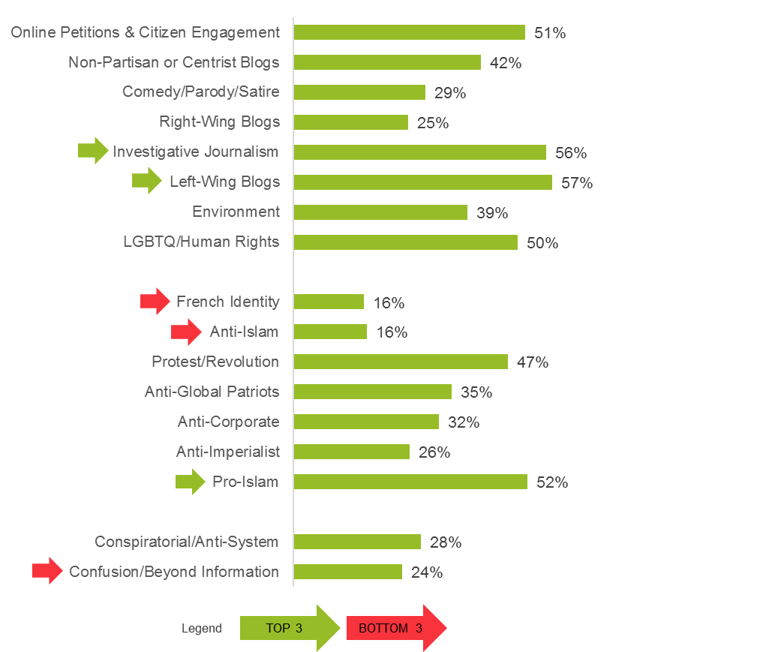
Where Mission posts appear on Media Map
Executive Summary Non-Traditional Media Map Landscape Social Media Sharing Behaviour Patterns of Disinformation Detailed Findings and Background Data Methodology
Post – Repeat | Post – Mission | Post – Provoke
Summary of the behaviour | Quotes and examples | Drivers | Presence on the Media Map
Mission sharing indicates an engaged, participatory contribution to the public discourse. Users connect the article to a context of personal priority.
This behaviour is most frequent with articles published in the Investigative Journalism, Left-Wing Blogs and the Pro-Islam clusters and least with the Anti-Islam, French Identity and the Confusion/Beyond Information clusters.
Mission sharing is stronger across the Extend section of the media map, and stands out in two left-leaning media source clusters from the Reframe section.
The finding indicates that content adhering to journalistic traditions is more likely to be lent people’s reputation, by being used as part of personal expression.
In contrast to the emotionally-charged content published in the Reframe and Alternative sections, the mission type behaviour is surprisingly low. This may be due to several factors:
The sheer repeating of the content provides sufficient gratification
The users are afraid to draw the conclusions publicly, believing the content is self-explanatory
A share of the conversation volume of the Reframe section is generated by automated bot-networks

Slide 68
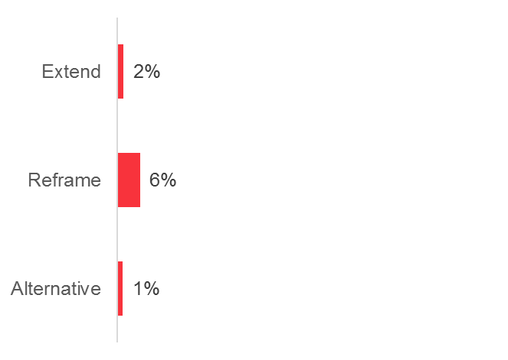
Posts intended to provoke and confuse
Executive Summary Non-Traditional Media Map Landscape Social Media Sharing Behaviour Patterns of Disinformation Detailed Findings and Background Data Methodology
Post – Repeat | Post – Mission | Post – Provoke
Summary of the behaviour | Quotes and examples | Drivers | Presence on the Media Map
The Provoke behaviour describes posting with the intention to provoke, confuse, and slander users of the adversary political camp. Content shared is highly polarizing and often entails disinformation. Provocative posts are either “content-driven provocation” or “behavioural provocation”.
Content-driven provocation is the sharing of articles whose title and body hold false, misleading, or hateful messages. The shared content clearly indicates the intention.
Behavioural provocation uses similar content but focuses on the delivery of contentious articles to users:
Attacking and Infecting Communities: users will be offended by the article.
Ironic Ambiguity: users will be confused by the article. Confusion is attempted to be brought about by creating ironic ambiguity through publishing humorous, hoax content as genuine reporting.
Click here to jump
to the quotes
Less than 5 percent of the overall sharing behaviours are Provoke posts, but this behaviour may achieve a higher reach as sharing tactics aim to expose others – not one’s own community.
The behaviour is most visible with articles from the Reframe section, whose content aims to provoke and confuse.

Slide 69
Drivers of Provoke posts
Executive Summary Non-Traditional Media Map Landscape Social Media Sharing Behaviour Patterns of Disinformation Detailed Findings and Background Data Methodology
Post – Repeat | Post – Mission | Post – Provoke
Summary of the behaviour | Quotes and examples | Drivers | Presence on the Media Map
RATIONAL
Users knowingly share controversial articles to opposed groups in order to achieve a desired impact. They may camouflage ironic hoaxes to achieve their goal of manipulating or confusing the opposition.
The rational aspect of the exhibited aggressive behaviour can be found in a war logic. The behaviour adheres to strategic individual and community objectives. The social media space is utilized to weaken the enemy, influence bystanders, and dominate the discourse.
Articles are not valued for their accuracy, but are shared for the expected impact on the targeted audience. Tactical sharing patterns are used to weaponize content and mislead readers. The goal is to frighten and weaken the enemy.
EMOTIONAL
Sharing is done with expected outcome of eliciting an emotional response. The motivations range from inducing a revelatory moment where opponents realize they have been wrong to dealing a blow to a despised enemy to drain their energy.
The delivery of hostile content induces a liberation of emotions. It is an action against a perceived source of danger.
A game-like atmosphere is conducive to perpetuating the search for opportunities to deliver Provoke posts. Participation by authentic human users has a strong community reinforcing or bonding power, i.e., they are fighting a virtual war to shape the discourse and influence the election.
Schadenfreude is the reward for the fanatic believers’ crusade.

Slide 70
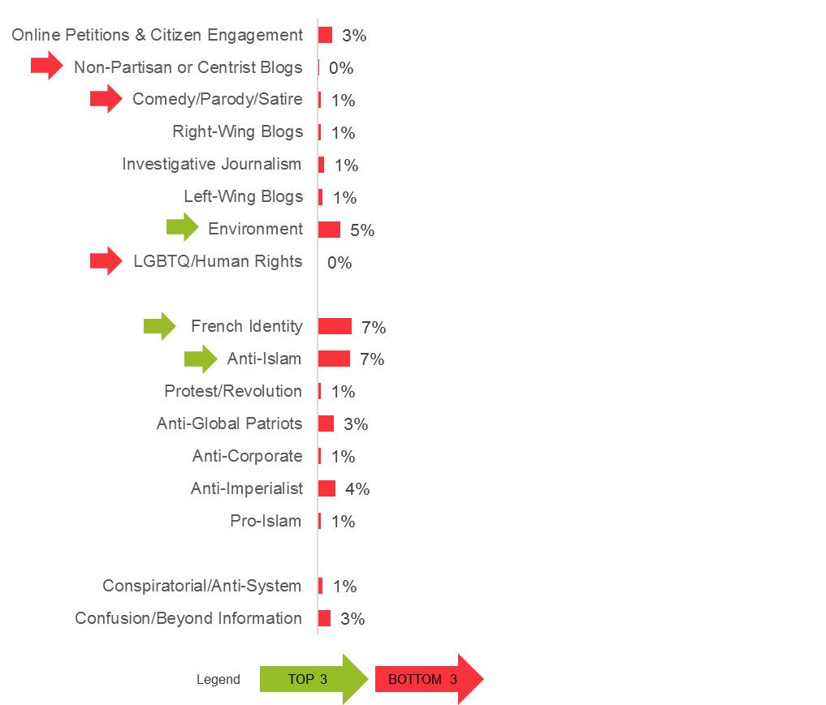
Where Provoke posts appear on Media Map
Executive Summary Non-Traditional Media Map Landscape Social Media Sharing Behaviour Patterns of Disinformation Detailed Findings and Background Data Methodology
Post – Repeat | Post – Mission | Post – Provoke
Summary of the behaviour | Quotes and examples | Drivers | Presence on the Media Map
The Provoke behaviour plays a minor part of the sharing behaviour across the media map. The behaviour is most significant in the French Identity, Anti-Islam, and Environmental clusters.
To provoke, i.e., to force an response, indicates a very developed identification with a cause. Both perceived patriotism and animal and nature protection are issues imbued with deep emotions. Provocation is the release of the pent up anxiety and a hysteric exclamation of despair: “don’t you see the f--king train coming?”
Petitions, while in the Extent section, are occasionally utilized in disinformation campaigns to enhance the false narrative’s credibility.

Slide 71
DISCUSS BEHAVIOUR
Executive Summary Non-Traditional Media Map Landscape Social Media Sharing Behaviour Patterns of Disinformation Detailed Findings and Background Data Methodology

Slide 72


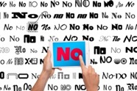
TYPES OF DISCUSS POSTS
Executive Summary Non-Traditional Media Map Landscape Social Media Sharing Behaviour Patterns of Disinformation Detailed Findings and Background Data Methodology
Discuss – Agree | Discuss – Debate | Discuss – Debunk
AGREE
Users responses go beyond liking or re-sharing the post. They express their agreement with the shared article in a public comment or reply.
The feedback is always positive, emerging enactments paths range from expressing gratitude for publicizing an article to planning political action inspired by the article.
Agreement with a publicized point of view or take on an issue is a community- forming action, whereby users publicly declare their identity and express belonging.
DEBATE
Responses to the posted article link mark the beginning of a discussion. Users engage with the content of the article.
Users make assertions, approve or disapprove of the information, and participate in the formation of an opinion.
Debate is a creative process that connects new, unaligned, and occasionally opposed views. Users aim to identify commonalities and trace differences. The conversation is marked by an honest effort on part of the participants to come to an consensus.
DEBUNK
Debunking is the rejection and discrediting of a shared article. Users flag shared articles to keep others from being tricked. Users aim to neutralize the adversarial content.
Debunking frequently is based on the results of fact-checking, which aims to instill a rational, fact-based reasoning to the discussion.
Debunking is used in political combat. Even if the content may be true, but counter to one’s view, debunking is used to counter the expressed view; often citing counter fact-checkers, which try to show traditional media’s manipulation.

Slide 73
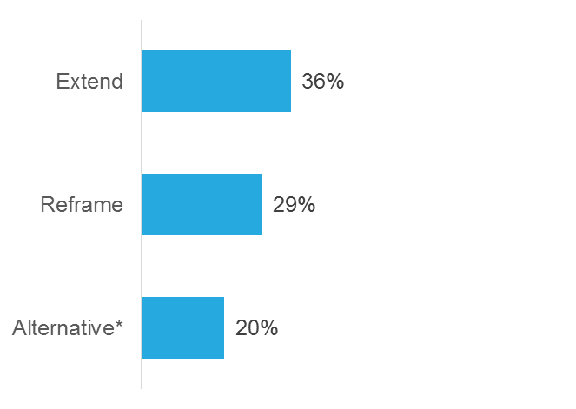
Expressing agreement adds to the discussion
Executive Summary Non-Traditional Media Map Landscape Social Media Sharing Behaviour Patterns of Disinformation Detailed Findings and Background Data Methodology
Discuss – Agree | Discuss – Debate | Discuss – Debunk
Summary of the behaviour | Quotes and examples | Drivers | Presence on the Media Map
Users contribute to the conversation by expressing their agreement with the issue or opinion in an article or comment.
APPRECIATE: Expression of agreement and gratitude for sharing the article.
ESCALATE: Grounded in agreement with the content, the user intensifies the stance taken and introduces more severe examples or implications.
OUTCRY: Emotive exclamations of anger, disdain, and outrage triggered by the article’s information.
CALL FOR ACTION: Identifying areas of possible action to address issues raised in the article.
Click here to jump
to the quotes
About one half of the conversations the analysis explored are made up of posts showing Agreement behaviour to shared content from Non-Traditional sites.
Agreement was most pronounced on articles shared that were published in the Extend section of the Media Map.

Slide 74
Drivers of Agree posts
Executive Summary Non-Traditional Media Map Landscape Social Media Sharing Behaviour Patterns of Disinformation Detailed Findings and Background Data Methodology
Discuss – Agree | Discuss – Debate | Discuss – Debunk
Summary of the behaviour | Quotes and examples | Drivers | Presence on the Media Map
RATIONAL
The reason for users to add supportive comments to the posted article is to express that the information and opinion in the article resonates with their own view of the issue. This positive feedback is being articulated in the public response of the user.
The article complements or fortifies already-existing knowledge or held opinions. The motivation to respond is the cognitive reassurance the user experiences: that they are not alone with their own opinions, but they are also shared by others.
Voicing one’s agreement is a step towards a more durable cognitive community that may have the potential to amplify the shared opinion’s impact.
The tighter the community around an issue forms, the larger the display of majority grows, the more likely their view will shape the political landscape.
EMOTIONAL
On an emotional level users can express the sensation of being understood and represented by the article’s meaning.
Users enjoy participation and acceptance within a community of kindred spirits. “Agree” comments communicate belonging and commonality: the joy of encountering someone who is like me.
Poster of “Agree” posts can hope to ascend in a perceived community hierarchy, by being noticed for their support and loyalty.
Comments are also used to vent emotions of frustration with the others, e.g., negativity towards the others helps reinforce their side, in context of the issues raised by the article.
No challenge and no criticism makes the discussion into a safe zone.

Slide 75
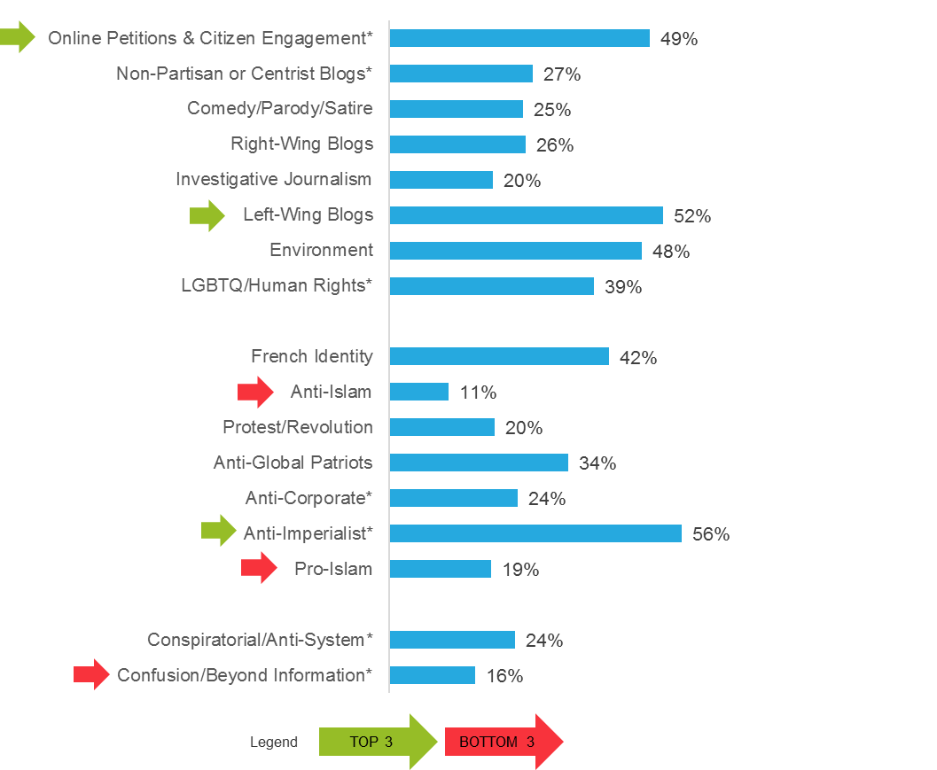
Where Agree posts appear on Media Map
Executive Summary Non-Traditional Media Map Landscape Social Media Sharing Behaviour Patterns of Disinformation Detailed Findings and Background Data Methodology
Discuss – Agree | Discuss – Debate | Discuss – Debunk
Summary of the behaviour | Quotes and examples | Drivers | Presence on the Media Map
“Agree” behaviour is reflective of a cohesive community that is unified along and for an issue. Expressing agreement strengthens the group and the user’s resolve.
This behaviour is most present in comments on shared articles from the Petitions, Left-Wing Blogs and Anti-Imperialism clusters. This indicates that users who comment on petition signature requests or Left-Wing Blogs or the Anti-Imperialist articles trigger users to express their membership to the community.
The content successfully resonates with the audience to rally around the cause, and closes the discourse to other views or dissent.
The behaviour is weakest in the Anti-Islam, Pro-Islam, and the Confusion/Beyond Information clusters. The behaviour’s role is reduced by the dominant Repeat behaviour.

Slide 76
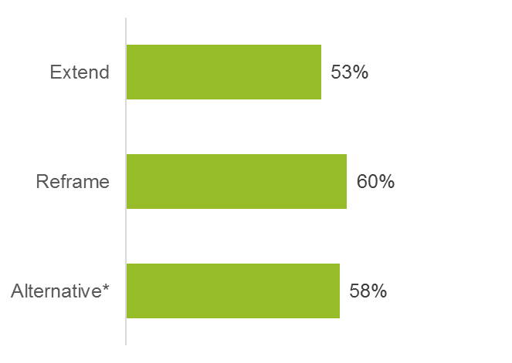
Debate behaviour is most common in Discuss posts
Executive Summary Non-Traditional Media Map Landscape Social Media Sharing Behaviour Patterns of Disinformation Detailed Findings and Background Data Methodology
Discuss – Agree | Discuss – Debate | Discuss – Debunk
Summary of the behaviour | Quotes and examples | Drivers | Presence on the Media Map
Conversations in this section exhibit three distinct communication behaviours to engage in an open and constructive ways:
MAPPING AGREEMENT: Users identify the areas they partially agree and partially disagree with in the article. In evolving threads, they chart their commonalities and differences.
EXTEND THE ARGUMENT: Users add new facets to the discussions. They widen the meaning of the article in additional aspects related to the issue, to fortify the argument and take it further.
ADVANCE RATIONAL ARGUMENTS: Users counter the arguments, with attempts to adjust the frame of reference. This brings in new perspectives that occasionally counter the opinion expressed in the posted article.
Click here to jump
to the quotes
Among the different discussion behaviours, the Debate behaviour is the most prevalent across all three sections of the media map.

Slide 77
Drivers of Debate posts in discussions
Executive Summary Non-Traditional Media Map Landscape Social Media Sharing Behaviour Patterns of Disinformation Detailed Findings and Background Data Methodology
Discuss – Agree | Discuss – Debate | Discuss – Debunk
Summary of the behaviour | Quotes and examples | Drivers | Presence on the Media Map
RATIONAL
This conversation contains the rational follow-up conversation to evolving under shared articles.
The conversation is marked by an open and rational approach to the subject matter. The key rational motive is that the users want to express themselves.
While remaining in their own ideological boundaries, users apply rational methods to map congruence with others and use rational arguments to extend the argumentation. They are interested in co-creating a coherent and encompassing world view.
Users can exert leadership on the community through the force of their arguments.
EMOTIONAL
Users participating in debate conversations are highly engaged. For them the debate is rewarding, as they can compare their sensations to that of peers who were enticed by the same article.
Differences are being refined: what are the things that connect and separate us.
Passion for debate: Users want to fully understand the other’s arguments as arguments, notwithstanding any ideological or social determination one might attribute to the speaker/poster.
Empathy: People might find it necessary to empathically invest in understanding different positions. Here, contrary to the passion of debate, empathy is a term describing the will to understand another person’s political opinion as stemming from his/her social position or group affiliation. This approach is a “positive” critique of ideology.
Glory: Leaving a mark or winning the debate.

Slide 78
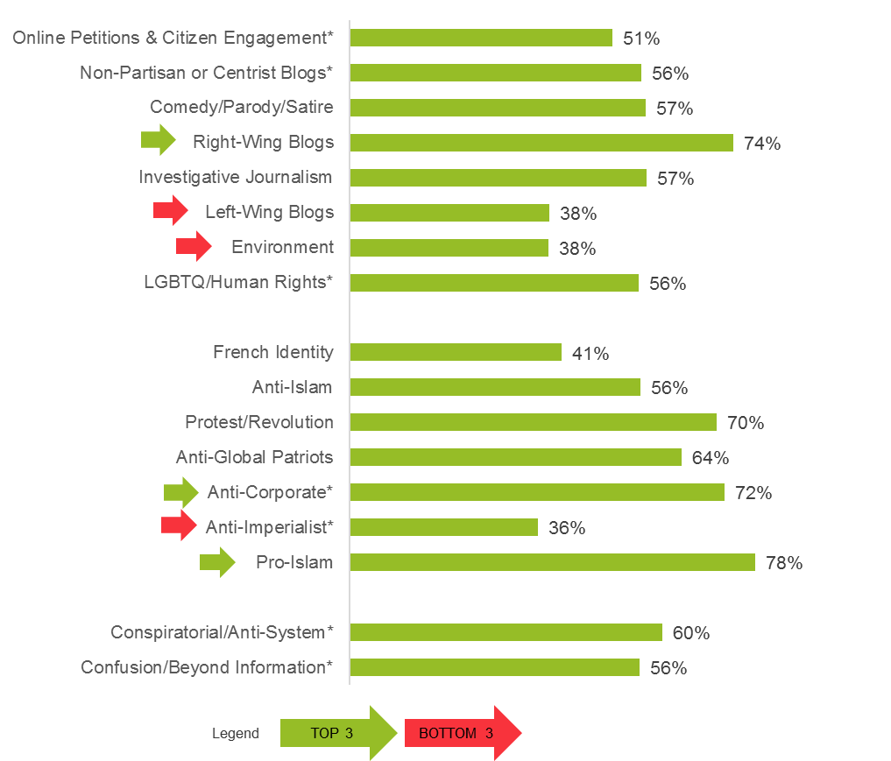
Where Debate posts appear on Media Map
Executive Summary Non-Traditional Media Map Landscape Social Media Sharing Behaviour Patterns of Disinformation Detailed Findings and Background Data Methodology
Discuss – Agree | Discuss – Debate | Discuss – Debunk
Summary of the behaviour | Quotes and examples | Drivers | Presence on the Media Map
The “Debate” behaviour is the most influential behaviour. It serves to expose the patterns of resonance to the public. Discussion participants lay out their thoughts inspired by the article and work to fit individual views into a coherent framework.
The behaviour is dominant across the Media Map, making up over half of the “discuss” conversation in most clusters. Users are utilizing the social media capability to discuss shared content and explore its meaning together.
Debate behaviour is the least present in the Left-Wing Blogs, Environment, and the Anti-Imperialist clusters. This suggests users in commenting on articles from these clusters are aware of the shared content’s meaning and are more interested in increasing community cohesion.

Slide 79
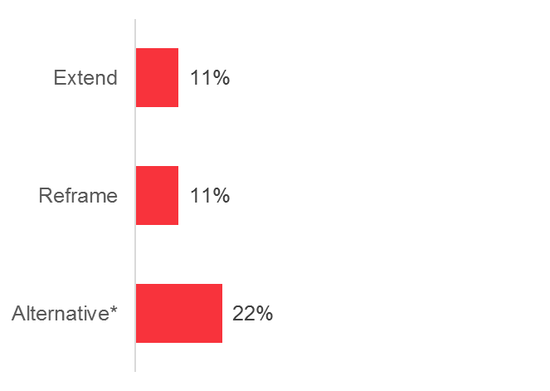
What users do to debunk false or fake stories
Executive Summary Non-Traditional Media Map Landscape Social Media Sharing Behaviour Patterns of Disinformation Detailed Findings and Background Data Methodology
Discuss – Agree | Discuss – Debate | Discuss – Debunk
Summary of the behaviour | Quotes and examples | Drivers | Presence on the Media Map
Debunking can concentrate on the messenger or “troll” (the individual poster and her supposed ideological leaning), the message (perceived fake news or ideological material) or the site, where the message was published (its supposed linkages to ideological positions or party propaganda) . A special case is when comedy sites are taken to convey fake news, which are debunked as such.
CHASING TROLLS
Outing inauthentic (not or only falsely argumentative) opinions
Unmasking provocation coming from an enemy site: the person only has the intention to disrupt real debate
Responding to a seemingly gratuitous attack or off-topic remark, when the individual cannot be identified with any adversarial ideological position
DETOXING FAKE STORIES
Users identify the story shared with the one already debunked by fact-checkers, by simply commenting that this story has been identified as fake news
Connecting posting with a link to the fact-checked analysis
DEBUNK PUBLICATION
The site has a reputation of being ideologically biased, therefore any content it publishes is suspicious
The site is an official party site, purposefully echoing propaganda and fake news
MISUNDERSTOOD COMEDY
The story published by a comedy site is taken for granted and fact-checked as authentic fake news
The story is not debunked as such, but, because of its exaggerated nature, is said to contain toxic information that needs to be refuted
The person commenting is uncertain about the nature of the publication
Debunking behaviour is present in all three sections of Non-Traditional media. Content from the Alternative section is debunked twice as frequently as articles from the Reframe and Extent sections.
Click here to jump
to the quotes

Slide 80
Drivers of Debunk posts
Executive Summary Non-Traditional Media Map Landscape Social Media Sharing Behaviour Patterns of Disinformation Detailed Findings and Background Data Methodology
Discuss – Agree | Discuss – Debate | Discuss – Debunk
Summary of the behaviour | Quotes and examples | Drivers | Presence on the Media Map
RATIONAL
The user refutes perceived fake news to preserve one’s community of its influence. Re-information is a kind of debunking that aims to create and maintain specific ideological communities, unveiling the mainstream as fake.
The aim of the post is to ruin the credibility of the adversary in order to limit its influence.
Users want to recruit like-minded members so the message to be transmitted can have a larger diffusion.
The aim is to unveil the identity (as a source of ideological bias) of the poster in order to fight the perceived harmful influence on the community.
Users may want to create objective news media, without fake news or too much ideological bias; fighting mainstream media to gain access to supposedly secret or unsaid information.
Posts fight against foreign, especially Russian, influence or against the influence of global capital controlling mainstream media.
EMOTIONAL
Refusal and projection: Debunkers often engage in invective and stigmatization or counter-stigmatization. This is the spirit of the fight for the right cause and against ideological enemies.
Promoting Enlightenment: Users are often animated by the desire and even mission to inform and unveil perceived fake news or highly biased ideological material.
Belief in conspiracy theories as a motivation for re-information thinking.
Attributing nefarious intentions, counter-attacking for fear of provocation.
Expressing disgust over the promotion of ideological perspectives and/or the spreading of perceived false information.
Group thinking or ideological closure: The post may reflect the will to preserve ideological homogeneity and group identification. The “negative” critique of ideology approach (considering always who is speaking and never what he has to say) often prevents the rational scrutiny of arguments.
Rejection of an enemy that is conceived homogeneously: No common ground is possible for debate, so no compromise is possible.

Slide 81
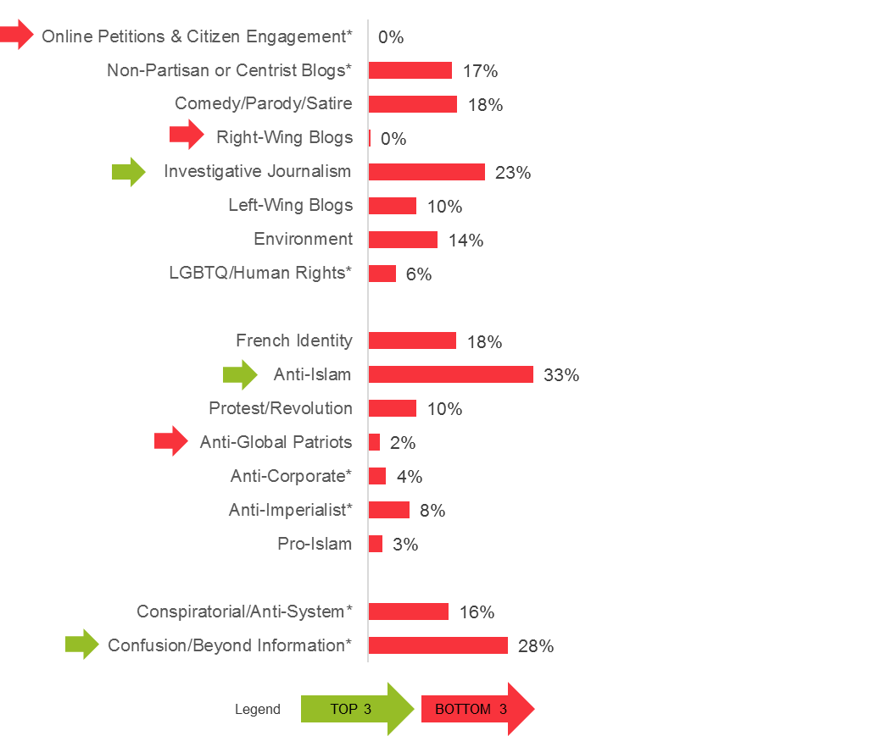
Where Debunk posts appear on Media Map
Executive Summary Non-Traditional Media Map Landscape Social Media Sharing Behaviour Patterns of Disinformation Detailed Findings and Background Data Methodology
Discuss – Agree | Discuss – Debate | Discuss – Debunk
Summary of the behaviour | Quotes and examples | Drivers | Presence on the Media Map
The Debunk behaviour is indicative of the ideological flashpoints – the war zones of the public discourse. This rejecting behaviour is triggered by the encounter of a shared article containing adversarial opinions.
The behaviour is most prevalent around articles from the Anti-Islam, Confusion/Beyond Information and the Investigative Journalism clusters. Content from these media source clusters appear to provoke users most.
With a few exceptions, the behaviour is present (albeit to a lesser degree) across all three sections of the Media Map. This indicates that depending on the user’s ideological outlook, any sources can be debunked as a false or misleading information. Debunking is the agitated rejection and defense against opposed political ideas used by all in the discourse.

Slide 82
Conclusions on sharing behaviours Post: Repeat, Mission, Provoke Discuss: Agree, Debate, Debunk
Executive Summary Non-Traditional Media Map Landscape Social Media Sharing Behaviour Patterns of Disinformation Detailed Findings and Background Data Methodology
THE DESIRE TO BELONG TO A GROUP DRIVES USER BEHAVIOUR. Community and the sense of acceptance and belonging are significant drivers of user behaviour. Users are looking for more than information. They are interested in finding communities of akin minds. The need to be part of the “in crowd" incentivizes users to distinguish and distance themselves from other communities.
Mission posts are more likely to generate discussions than any other posting behaviour. Mission post (which attach personal opinion to a shared post) are also more likely to trigger more extensive discussion, meaning more users participating in the discuss behaviour. Mission posts are most likely to start of debate type of discussions.
“REPEAT” BEHAVIOUR IS VERY COMMON BUT WEAKENS DISCUSSION: Repeat behaviour is the typical behaviour across social media. This means users do not contribute to the debate, but merely repeat content. This may crowd out more meaningful forms of expression. Massive numbers of repeat posts are intended to show the size and might of the respective community and intimidate others.

Slide 83
Executive Summary Non-Traditional Media Map Landscape Social Media Sharing Behaviour Patterns of Disinformation Detailed Findings and Background Data Methodology
Conclusions on sharing behaviours
(continued)
Debunking behaviour is omnipresent against content across almost all clusters of the media map. Debunking has become an aggressive form of rejection with the intent to decrease the credibility of the content or poster. Debunking is a double-edged sword that has lost its effectiveness and contributes to the segregation of different opinion communities. Debunk-type comments are mostly a response to Provoke behaviour.
Debating Behaviour makes up about half of the discuss behaviour of posted content that inspired conversations. This clearly shows there is need for debate, although it is unclear what ideological barriers the debate can overcome. Mapping agreement and disagreement is the most constructive behaviour. This should be encouraged and made more prominent.

Slide 84
QUANTITATIVE SHARING BEHAVIOUR ANALYSIS
Executive Summary Non-Traditional Media Map Landscape Social Media Sharing Behaviour Patterns of Disinformation Detailed Findings and Background Data Methodology

Slide 85
METRICS OF SHARING BEHAVIOUR
Executive Summary Non-Traditional Media Map Landscape Social Media Sharing Behaviour Patterns of Disinformation Detailed Findings and Background Data Methodology
Quantitative metrics of sharing behaviour are telling for what they reveal about traditional media sources and the democratization of content delivery via social media sharing.
Despite sharing of content, there is little subsequent engagement. This would be consistent with the qualitative finding that by merely acting as “repeaters” they fail to evoke greater emotion.
390,000 unique users share content from Traditional media sources at a rate of about two links per user per month. Social media users rely on content generated by traditional media sources to a large extent. Content publishers (newspapers, radio, TV) are part of this group. As active users, they have the greatest reach and engagement. Campaign media sources are also considered Traditional but users may overlap so their numbers are not added here.
354,000 unique users share content from all three Non-Traditional sections of the Media Map (Extend, Reframe and Alternative). As a rule, while the users are active, follower numbers are lower. This means engagement levels are lower as well.
80,000 users in the Reframe section are driving a huge amount of content into the discourse. In other words, 20 percent of the users are posting almost twice as often as users engaged with other sections of the media map. Though this is a fairly small group, users sharing links from Reframe sources in particular stand out for their activity.
Segment | Unique Sharers | Avg Links per Sharer | Avg Engagement per Link | Avg Engagement per Sharer
TRADITIONAL | 390 | 13 | 10.1 | 129
CAMPAIGN | 96 | 7 | 4.0 | 27
EXTEND | 315 | 6 | 0.2 | 1
REFRAME | 80 | 21 | 0.8 | 16
ALTERNATIVE | 35 | 9 | 0.6 | 5
figures in thousands
Extend + Reframe + Alternative = 354,000 unique users

Slide 86
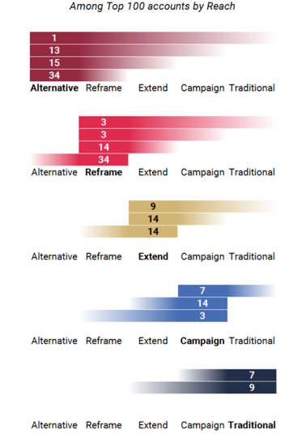
Few users are open to different content
Executive Summary Non-Traditional Media Map Landscape Social Media Sharing Behaviour Patterns of Disinformation Detailed Findings and Background Data Methodology
Imagine standing at the anchor point of each of these charts and looking down the line to see others sharing content from different sections.
The smaller the numbers, the less sharing there is.
In effect, it becomes harder to “see” the activity of users sharing the distant content. Where there is no line, there is no sharing.
This study looked at the top 100 sharers (by number of followers) of content to see how many of them shared content from different sections of the Media Map.
34 out of 100 accounts share content from both Reframe and Alternative sections. This is the area of the greatest content “overlap”.
No more than 3 of 100 accounts share content across the longstanding divide separating Reframe and Alternative media sources from Traditional media sources.

Slide 87
Continued…
Executive Summary Non-Traditional Media Map Landscape Social Media Sharing Behaviour Patterns of Disinformation Detailed Findings and Background Data Methodology
These findings have several implications:
Confusing and conspiratorial narratives are exposed to a much larger pool of social media users via those sharing both Alternative and Reframe content.
With virtually no cross-sharing occurs across the longstanding divide, users remain isolated in their narrative bubbles, apart from the general sense that those on the “other side” are receiving biased information – providing proof to the lack of common ground.
The media sources a user is willing to share with his/her network is affected by their position on the validity of traditional narratives.
Imagine standing at the anchor point of each of these charts and looking down the line to see others sharing content from different sections.
The smaller the numbers, the less sharing there is.
In effect, it becomes harder to “see” the activity of users sharing the distant content. Where there is no line, there is no sharing.

Slide 88
Phase 3 PATTERNS OF DISINFORMATION
Executive Summary Non-Traditional Media Map Landscape Social Media Sharing Behaviour Patterns of Disinformation Detailed Findings and Background Data Methodology

Slide 89
CONTENTS
Executive Summary Non-Traditional Media Map Landscape Social Media Sharing Behaviour Patterns of Disinformation Detailed Findings and Background Data Methodology
❶
Executive Summary
Key Insights
Key Implications
Recommendations
The French Media Content Landscape
Media Map Sections
Media Map Clusters
Candidate Support and Influence
Foreign Influence
Media Map Trends
Two-Step Model of Social Media Influence
Posting Behaviour
Discuss Behaviour
Quantitative Sharing Behaviour Analysis
Credibility Cloak
Time Shifting
Fake Polls
Hoax Sites
Russian Influence
Cluster by Cluster Analysis
Quotes
5 Steps of the Media Map
Conversations
Non-Traditional Media Map Landscape
❷
Social Media Sharing Behaviour
Patterns of Disinformation
PHASE THREE
❸
Detailed Findings and Background Data
Methodology

Slide 90
Four tactics are used to sow disinformation
Executive Summary Non-Traditional Media Map Landscape Social Media Sharing Behaviour Patterns of Disinformation Detailed Findings and Background Data Methodology
Our research found that media sources from the Reframe and Alternative sections of the Media Map seek to counter Traditional media narratives.
Four patterns were observed by which incorrect or intentionally confusing information was injected into the public discourse around the 2017 election:
CREDIBILITY CLOAK: cloaking false stories on an otherwise credible platform
TIME SHIFTING: taking news out of temporal context
FAKE POLLS: using fake polls
HOAX SITES: creating hoax sites
The disinformation campaigns detected via social media all share one common strategy:
Disinformation campaigns leverage traditional sources of authority and trust for their own benefit, while simultaneously using them to undermine traditional media. As a consequence, they instil a general sense of distrust and chaos, which in turn makes radical solutions more appealing.

Slide 91
CREDIBILITY CLOAK
Executive Summary Non-Traditional Media Map Landscape Social Media Sharing Behaviour Patterns of Disinformation Detailed Findings and Background Data Methodology
Respected media sources offer open platforms where anyone can post. The “credibility cloak” is a method of spreading false stories that leverages such open platforms to lend credibility to unfounded allegations. The fact that an allegation has been published on the platform of a respected media source—despite only being posted in a place that is open to anyone for publish content on that platform, and thus explicitly not carrying the formal endorsement of the platform—is used to provide “proof” of the allegation’s validity.
EXAMPLE 1
The campaign to connect presidential candidate Emmanuel Macron with illicit offshore funds is an example of how the credibility cloak tactic can be used. The story began with an article (Link) published on the open collaborative blog linked to Mediapart, a well-known and reputable media source. The article insinuates that Macron is just like Jérôme Cahuzac, the former budget minister who was sentenced to prison for hiding funds in a Swiss bank account. Cahuzac’s actions were in fact revealed by Mediapart’s own editorial content. While the article never explicitly accused Macron of having offshore accounts, the suggestion appeared in the commentary, which then spread into social media via the #EmmanuelCahuzac hashtag. People who shared links to the story believed (or pretended to believe) that the article was authored by Mediapart itself. Visually, the difference between editorial and self-published content is hard to recognize.

Slide 92
Continued…
Executive Summary Non-Traditional Media Map Landscape Social Media Sharing Behaviour Patterns of Disinformation Detailed Findings and Background Data Methodology
EXAMPLE 2
A self-published article on Mediapart’s open platform defended conservative presidential candidate François Fillon from revelations of misconduct. It appeared as if an ideological adversary (a left-wing blogger) was defending Fillon (a right-wing candidate); that such a blogger would write a story not reported elsewhere became the basis for the article’s “credibility” and enabled it to appropriate the authority and respectability of the media source. (Link)
EXAMPLE 3
A more radical way of co-opting the credibility of reputable media sources is to allege censorship. This was the case with an article run by Europe-Israel.org. It explicitly alleges that Macron has offshore accounts and that this would have been revealed. The article appeared in Le Canard Enchâiné, a traditional media source known for its investigative journalism―except that it was censored by Le Canard Enchâiné’s editors. The source of the Europe-Israel.org article claimed to have confirmed the existence of this alleged report. The Europe-Israel.org article (original link) has since been removed, but there are traces of the allegations of censorship that are visible from a simple search of the URL.
By camouflaging false information as journalistic research or associating it with a respected brand, sources aim to spread false allegations that confuse and misinform readers.

Slide 93
TIME SHIFTING
Executive Summary Non-Traditional Media Map Landscape Social Media Sharing Behaviour Patterns of Disinformation Detailed Findings and Background Data Methodology
Another method used to spread false information is the re-publishing of outdated information. Content that was factually true at the time of publishing is misleadingly recycled to give the impression the information is still valid. Often the original source is cited without its original publishing date.
EXAMPLE 1
The time-shifting tactic was used to promote a rumour that François Fillon had been cleared of all wrong-doing associated with the “fake job” scandal involving his family members. An article in the Le Scrutateur (Link) cited the opinion of a lawyer from the end of February; Fillon was indicted a month later. The article was written in April and had no basis to claim Fillon’s innocence, yet it did. The intention of the poster is visible in the article’s title: “URGENT - FILLON BLANCHI ! Les média n'en parlent Pas !” (“URGENT! Fillon cleared - the media are not talking about it!”). Other remarks and citations assert that Fillon has not been indicted, though in fact he was.
Shifting content in time turns originally factual statements into falsehoods. Republishing of outdated information is used to inject uncertainty and mistrust towards traditional media publishers.

Slide 94
FAKE POLLS
Executive Summary Non-Traditional Media Map Landscape Social Media Sharing Behaviour Patterns of Disinformation Detailed Findings and Background Data Methodology
Fake polls undermine the credibility of opinion polling and spread false information. Those engaged in these efforts assert that the polls conducted by traditional media sources are biased toward Macron (the candidate of the elite) to ensure his election. They cite the success of American presidential candidate Donald Trump and the Brexit referendum as proof that polling methodology is outdated and inaccurate.
EXAMPLE 1
Fake polls have proven effective in changing the campaign discourse. On 29 March, Sputnik, a Russian state-funded news organization, reported results (Link) from a poll by Brand Analytics, a Moscow-based social media company, showing Fillon in the lead. Articles published by sources in the Reframe section cited the poll to point out the unreliability of classical opinion polling and promote the idea that Fillon had turned the tables to become a leading candidate.
EXAMPLE 2
Brand Analytics is but one of several previously-unknown companies whose polls have been used by Reframe media sources to counter those published by Traditional media sources. Filteris and Multivote also made headlines with polls claiming to use novel methodologies that predicted an outcome that contradicted consensus estimates from reputable pollsters.
The fact that these fake polls ultimately proved to be inaccurate is immaterial. They succeeded in creating uncertainty and undermining legitimate polls to influence voters.

Slide 95
HOAX SITES
Executive Summary Non-Traditional Media Map Landscape Social Media Sharing Behaviour Patterns of Disinformation Detailed Findings and Background Data Methodology
Fake and cloned websites were also used to shape the election discourse by misleading readers.
EXAMPLE 1
The Belgian media source LeSoir.be was the model for a hoax site. A similar-looking cloned site, LeSoir.info, was used to publish a false allegation that Macron received financial support from Saudi Arabia.
EXAMPLE 2
Another site imitated the look and feel of LinkedIn, a professional social networking site, calling itself LinkedEM (Link). It posted a fake profile page of Macron with his professional experience and competencies, all of which carried negative connotations. It used the hashtag #LinkedEM to share the site in social media.

Slide 96
RUSSIAN INFLUENCE
Executive Summary Non-Traditional Media Map Landscape Social Media Sharing Behaviour Patterns of Disinformation Detailed Findings and Background Data Methodology
EXAMPLE: Social media discussion of a chemical gas attack in Syria
REJECTION
Articles using the “rejection” tactic are designed to cast reasonable doubt on the evidence that the attack actually happened. Articles attempt to discredit information indicating Russian involvement in the attack.
Narratives take aim at the believability of traditional journalistic reporting on Russia’s involvement in the attack. They tend to either introduce unreported or false details to sow doubt, or they analyse the event from a geopolitical perspective to show allegations against Russia are illogical.
REDUCTION
Articles following the reduction strategy aim to deflate the impact of the chemical gas attack.
Stories do not deny the attack, rather they convey that it was not an extraordinary event (i.e. “not a big deal since the same or worse atrocities happen all the time”).
RELATIVISATION
This strategy appeals to moral relativism to explain any possible Russian involvement with the chemical gas attack. It does so by implicating the United States to shift blame and responsibility away from Russia.
The relativisation strategy is designed to do two things. First, it exonerates Russia by creating an alternative interpretation of events. Second, it uses international events to promote an anti-globalist agenda. Candidates who criticize Russia’s involvement in Syria must therefore be globalists who are not representing France’s interests.
DENIAL
REVERSAL

Slide 97
❸

Slide 98
DETAILED FINDINGS AND BACKGROUND DATA
Executive Summary Non-Traditional Media Map Landscape Social Media Sharing Behaviour Patterns of Disinformation Detailed Findings and Background Data Methodology

Slide 99
CONTENTS
Executive Summary Non-Traditional Media Map Landscape Social Media Sharing Behaviour Patterns of Disinformation Detailed Findings and Background Data Methodology
❶
Executive Summary
Key Insights
Key Implications
Recommendations
The French Media Content Landscape
Media Map Sections
Media Map Clusters
Candidate Support and Influence
Foreign Influence
Media Map Trends
Two-Step Model of Social Media Influence
Posting Behaviour
Discuss Behaviour
Quantitative Sharing Behaviour Analysis
Credibility Cloak
Time Shifting
Fake Polls
Hoax Sites
Russian Influence
Cluster by Cluster Analysis
Quotes
5 Steps of the Media Map
Conversations
Non-Traditional Media Map Landscape
❷
Social Media Sharing Behaviour
Patterns of Disinformation
❸
Detailed Findings and Background Data
Methodology

Slide 100
CLUSTER BY CLUSTER ANALYSIS
Executive Summary Non-Traditional Media Map Landscape Social Media Sharing Behaviour Patterns of Disinformation Detailed Findings and Background Data Methodology

Slide 101
Analysis of clusters, by type of media source
Executive Summary Non-Traditional Media Map Landscape Social Media Sharing Behaviour Patterns of Disinformation Detailed Findings and Background Data Methodology
Five types of media sources publish content relevant to the public discourse. These sources were differentiated, classified and charted on the Media Map:
Traditional: commercial or public news organizations
Campaign: official party or candidate media sources
Extend: civic media sources adhering to journalistic standards
Reframe: media sources aiming to counterbalance traditional sources
Alternative: publishers of conspiratorial and “confusionist” content

Slide 102
EXTEND CLUSTERS
Executive Summary Non-Traditional Media Map Landscape Social Media Sharing Behaviour Patterns of Disinformation Detailed Findings and Background Data Methodology
ONLINE PETITIONS & CITIZEN ENGAGEMENT CLUSTER
Number of sites: 8
Percent of total links shared: 5.7 percent
Background
Political and social activists in the online public sphere make frequent use of petition sites. These sources allow users to create their own petitions, share them with their community, and garner support by collecting signatures. The intended effect is to exert political pressure.
Top themes
Most issues raised on petition sites are associated with the political left and include a homosexual’s right to adoption and issues touching on social injustice. Interestingly, supporters of the Front National have share petitions in social media to draw attention to the investigation of other candidates’ financial dealings.
Political support
While some petitions may impact the perception of candidates, sources in this cluster do not express support for presidential candidates.
COMEDY/PARODY/SATIRE CLUSTER
Number of sites: 19
Percent of total links shared: 3.7 percent
Background
This cluster includes media sources that create humorous and satirical content about the elections, predominantly about the candidates. The media sources publish funny images or videos ridiculing politicians. This section does not use humour as an offensive tool against rival candidates: their mockery is non-denominational.
Top themes
Sources in this cluster tease politicians’ behaviour and point out contradictions.
Political support
Sources in this cluster do not offer support for any of the candidates.

Slide 103
EXTEND CLUSTERS
Executive Summary Non-Traditional Media Map Landscape Social Media Sharing Behaviour Patterns of Disinformation Detailed Findings and Background Data Methodology
LGBTQ/HUMAN RIGHTS
Number of sites: 12
Percent of total links shared: 0.4 percent
Background
This cluster of media sources focuses on the social struggle for universal human rights, especially the laws and regulations concerning the gay community.
Top themes
The standout theme of this cluster is the right for homosexual couples to adopt children.
Political support
None of the media sources mapped in this cluster offer direct support for any of the candidates.
LEFT-WING BLOGS
Number of sites: 51
Percent of total links shared: 1.4 percent
Background
Media sources in this cluster explore the news and developments around the elections from a recognizable left-leaning perspective. They discuss issues emerging in traditional media and contribute to the discourse with their interpretations.
Top themes
The topics driving the discussions are very broad. No single issue stands out.
Political support
Interestingly, none of the media sources in this cluster expresses support for a candidate. Nevertheless, Mélenchon and Macron tend to be discussed in more positive terms.
ENVIRONMENT CLUSTER
Number of sites: 11
Percent of total links shared: 1.0 percent
Background
This cluster highlights ecological issues. Sources publish content around sustainable development and critique policies that are not in line with expectations of sustainable development.
Top themes
Sustainable development and ecological balance are the main themes in this cluster.
Political support
None of the media sources offer support for any of the candidates.

Slide 104
EXTEND CLUSTERS
Executive Summary Non-Traditional Media Map Landscape Social Media Sharing Behaviour Patterns of Disinformation Detailed Findings and Background Data Methodology
INVESTIGATIVE JOURNALISM
Number of sites: 38
Percent of total links shared: 1.6 percent
Background
Media sources in this cluster explore themes and issues that, in their view, do not receive sufficient attention by traditional media. Using a journalistic approach, they dig deep into stories. Some of the media sources are clearly crowd-funded and ask for contributions.
Top themes
A common theme in this cluster is the investigation of corruption by political actors.
Political support
No direct support for any candidate has been identified.
RIGHT-WING BLOGS
Number of sites: 32
Percent of total links shared: 2.6 percent
Background
This cluster of media sources presents a conservative outlook on politics. Media sources are critical of left-leaning positions and candidates.
Top themes
As with the Left and Non-Partisan blogs, these media sources cover a broad range of topics, frequently reflecting on news published by traditional media sources.
Political support
This cluster is the only one in the Extend section to articulate support for a candidate (Fillon).
NON-PARTISAN OR CENTRIST BLOGS
Number of sites: 59
Percent of total links shared: 3.5 percent
Background
As the name of this cluster suggests, the political leanings of media sources are indeterminate. They discuss much the same themes as left and right wing blogs, but do not take a political position along the left-right spectrum. They remain non-partisan.
Top themes
Akin to the left and right wing blogs these media sources cover a very broad scope of themes, reflecting and augmenting reporting from traditional media.
Political support
No sources in this cluster offer support for any of the candidates.

Slide 105
REFRAME CLUSTERS
Executive Summary Non-Traditional Media Map Landscape Social Media Sharing Behaviour Patterns of Disinformation Detailed Findings and Background Data Methodology
Top themes
Violence and insecurity in the suburbs are the key topics found in the content analysis of the most shared articles in this cluster. Stories focus on acts of violence committed by people of Arabic background. These articles “unveil the truth” behind the partially-reported facts from traditional media. Three recent cases are “revealed” by these sources to have been fabrications.
The “Theo” story that made headlines in traditional media, where a young man of Congolese descent was said to have been raped by police officers.
Mehdi Meklat, a mainstream media celebrity, is revealed to have tweeted anti-Semitic, homophobic, and sexist messages anonymously.
Farid Benyettou, an employee of a state-funded deradicalisation project, turned out the be the mentor of the Kouachi brothers, who were involved in the Charlie Hebdo attacks.
A rising star of the cluster is Sébastien Jallamion, an ex-policeman, who used to work in the “zones sensibles” in the suburbs. He was fired because he shared pictures of a terrorist attack on his (pseudonymous) Facebook page. He is presented as a figure who served an ungrateful nation. He writes extensively for several media sources in the cluster.
FRENCH IDENTITY
Number of sites: 38
Percent of total links shared: 12.3 percent
Background
The French Identity cluster consists of three sub-clusters (explained in more detail on the next slide):
Catholic Identity
Regionalists
Frenchness
All sub-clusters are unified in their opposition to Macron, who is seen as the candidate of the elites. He represents the system that has placed France on the path of decline.
Political support
Marine Le Pen receives staunch backing from over half the sources in this cluster, making it the cluster with the clearest and strongest candidate preference.

Slide 106
Reframe sub-clusters
Executive Summary Non-Traditional Media Map Landscape Social Media Sharing Behaviour Patterns of Disinformation Detailed Findings and Background Data Methodology
Catholic Identity
These media sources are dedicated to preserving Catholic values in French society. The focus of the Catholic sub-cluster (referred to occasionally as the cathosphère) is the prevention of gay adoption and other medically enabled fertility treatments, such as Surrogacy. Treatments (and children) should only be allowed in a traditional family context is. One line of reasoning seen in these sources is that the real problem with gay marriage is that it creates demand for babies, which in turn create inevitable demand for the scientific production of humans. By this line of argument, sources avoid homophobic reasoning and frame their opposition to gay adoption as a struggle against the instrumentalisation of the human body.
2. Regionalists
These media sources focus on regional identity and are mainly from Brittany, the Basque region, and Corsica. On the one hand, they resist the French state. On the other, they pursue a deeper connection with their pagan ancestors.
Having been colonized by France, they see the French state imposing migrants upon them. Were they an independent region, as their reasoning goes, they could properly defend themselves.
These sources publish content meant to link immigration and criminality. The see the state as having failed to establish law and order, which is epitomized by the appearance of “Muslim militias” in suburbs populated by immigrants. The French state requires Brittany to accept refugees, despite their “well-known” links to terrorism and sexual assaults. Countries which resist EU regulations on accepting refugees (Hungary, Poland, and Austria) are regularly praised. Viktor Orban, Prime Minister of Hungary, is a revered figure.
Some of the media sources see Marine Le Pen critically. They would like to see a return to authentic Jean Marie Le Pen-style Front National. Marine Le Pen, they think, will cause a conflict between her voters, as she attracts votes from “less committed” supporters. If she is elected, these sources argue, the traditional political class will be against her, which will make her unsuccessful. However, should she fail, the people will be so disappointed that more radical movements will be able to seize power.

Slide 107
Reframe sub-clusters
3. Frenchness
This sub-cluster wants to preserve the traditional French character of the nation. They identify threats to the French way of life, which include migrants, crime, and the creeping withdrawal of the state from areas such as culture, education, and the upholding of the division between church and state. The current state of affairs is contrasted with a nostalgic view of the past. A story that underpins this line of thought is seen in a new treaty with Morocco that will see the establishment of Arabic schools in the suburbs—a treaty that has been signed by the Minister of Education, who has a Muslim/Arab background.
Per these sources, immigrants in the suburbs is a major cause of crime and insecurity. Unaccompanied children pose a grave risk to public safety as they already terrorize several towns across France. Worse, they represent the Grand Remplacement, an invasion of strangers from remote cultures that is commanding state resources and money. At the same time, they are diluting and diminishing French culture. Media sources lament that there are no longer good grocery stores, cafés, or butchers (they all became Halal). The story is about decline.

Slide 108
REFRAME CLUSTERS
Executive Summary Non-Traditional Media Map Landscape Social Media Sharing Behaviour Patterns of Disinformation Detailed Findings and Background Data Methodology
Top themes
Within this cluster there is an activist focus that contains a sense of immediate danger. There is consistent vigilance of the hard right, the sources of its popularity and recent legitimacy, its local manifestations, and how to combat it. More generally, sources rail against the précarité that has been brought about by recent legislation. As a way of ensuring vigilance, sources commemorate the big events of social progress, such as social security and abortion rights.
Calls to action take the form of organizing local protests, strikes, and other forms of resistance, with documentation and manuals for demonstrations and contacts for local activist groups that work on specific social problems, such as prisons. These sources report on police violence and its recent manifestations, describing recent cases and the organization of protests. There are consistent references to the movement’s most recent success, the Nuit Debout.
Political support
These sites do not support any of the big candidates. Some of them support Poutou, but others try to not get involved in the campaign directly, instead promoting intellectuals from the alternative left, like Emmanuel Todd. They often criticize right-wing candidates and Macron, but also Hamon and Mélenchon.
PROTEST/REVOLUTION
Number of sites: 10
Percent of total links shared: 0.7 percent
Background
These sources have two aims. One is to instigate protests: they call for revolution from the left. The other is to recommend concrete policy propositions that quite often are not part of the programs of any of the leftist candidates. In contrast to the Petition and LGBTQ/Human Rights clusters (both in the Extend Section), these have a strong leftist ideology and aim to overcome the liberal/capitalist world order. Contrary to the policy sites, the protest sites promote less analysis and more activity. They seek to mobilize their community to resist existing measures and regulations seen as oppressive and abuses by those in power.
Their relation to traditional media is hostile. However, their approach to it seems to be more rational than that of sources belonging to other clusters either on the hard left or the hard right. By and large, they avoid conspiracy theories.
Contrary to Anti-Imperialist sources, this cluster tends to concentrate on developments within France. They strive to give a program to liberate the working class and resist neoliberal tendencies. They do, however, criticize the world order, especially with regard France’s position in it.

Slide 109
REFRAME CLUSTERS
Executive Summary Non-Traditional Media Map Landscape Social Media Sharing Behaviour Patterns of Disinformation Detailed Findings and Background Data Methodology
ANTI-IMPERIALIST
Number of sites: 12
Percent of total links shared: 0.3 percent
Background
This cluster contains the remains of the traditional Communist groupings. They publish articles on the imperialist system. They concentrate on foreign politics and ex-Third World countries. They frame their worldview through a Cold War logic: they see the West (mainly the US) versus the East, embodied by Russia. Russia is idolized, hence these sites have a visible anti-American and anti-Zionist stance. The antiquated nature of a Cold War frame given the geo-political transformations of the last 25 years means these sources are often forced to borrow ideas from the extreme right.
Political support
Mélenchon and Le Pen, in that order, receive support from sources in this cluster.
Top themes
The anti-elite themes in this cluster find voice in a variety of themes.
An interesting element in this cluster is the reference to Ken Loach’s latest film, I, Daniel Blake. The story of a English labourer, who, advised to take off from work after a heart attack ends up dying a pauper as the State lets him wither, is understandably a cautionary tale.
One of the main sources in this cluster (legrandsoir.info) publishes “Le Décodex alternatif”, a fact-checking site in direct competition with Le Monde’s that draws heavily upon Metapedia, the alternative Wikipedia. In the same vein, sources like info24.fr publish information on Macron that have been “suppressed” by the mainstream media.
Mélenchon comes in for both support and criticism. He seen as needing and deserving the support of Hamon and other left-wing candidates, yet his ties to Serge Dassault are also vehemently criticized.
Trump’s “téléréalité” attack on Syria is a more recent example of content in this cluster. This is not surprising, however, as Russian influence is detectable on a number of sites in this cluster.

Slide 110
REFRAME CLUSTERS
Executive Summary Non-Traditional Media Map Landscape Social Media Sharing Behaviour Patterns of Disinformation Detailed Findings and Background Data Methodology
Top themes
The most shared articles from this media source cluster naturally focus on the violence and injustice experienced by France’s Muslim population. Recent cases of police violence against Muslims in France along with the unjust application of regulations on religion by the State are seen as State-supported bias. Also shared are articles on white supremacy and the innate racism of the white. For example, Alexandre Bisonnette, believed to be the shooter at a Mosque in Quebec, Canada, is said to be of Arabic origin… and to be two separate people by the mainstream white media!
American imperialism is another dominant theme in this cluster, driven by the belief that the United States has been secretly supporting the Assad regime.
More generally, sources in this cluster fight against Islamophobia. For example, the Socialist politician Malek Boutih is presented as a traitor for having stoked Islamophobia in a TV interview. These ideas can take on a more anti-Semitic tone at times. One article takes a quote from Bernard-Henri Lévy out of context from his remarks on the Boycott Divest Sanction (BDS), suggesting that he said Muslims “are Nazis” and are “the archenemies of the Jews”.
The most widely shared articles are written in a moderate tone when compared to content published across all sources. These come from four sites (Contre-Attaques, Islam et Info, Etat d’exception and Be Palestine), all of which (with the possible exception of Be Palestine) often republish articles and videos from the mainstream media, hence the moderate tone. Some sources, however, plant seeds of conspiracy and offer confusing and fake content. While these articles are often heavily (re)framed, there is no apparent evidence of links to Russian sites.
PRO-ISLAM
Number of sites: 7
Percent of total links shared: 0.1 percent
Background
Pro-Islam sites are of two kinds: the ones created by Muslims for Muslims, and the ones not identified as such. The Muslim-edited media sources are vehemently critical of the violence visited by French society on its minority Muslim population. They also express a scathing criticism of right-wing political perspectives. This is blurred with a latent and sometimes obvious anti-Zionist, anti-Israel line, in which they advocate terrorist resistance against the occupiers of Palestine.
Media sources not explicitly claiming to be written by Muslims for Muslims are more moderate and reserved in their content. They mainly focus on the injustices suffered by the Muslim community in France, such as police violence, no right to practice religion in everyday life, and negative representations of the Muslim community and Islam in the media.
Political support
These sources do not lend support to any of the candidates.

Slide 111
REFRAME CLUSTERS
Executive Summary Non-Traditional Media Map Landscape Social Media Sharing Behaviour Patterns of Disinformation Detailed Findings and Background Data Methodology
ANTI-GLOBAL PATRIOTS
Number of sites: 19
Percent of total links shared: 0.9 percent
Background
The overwhelming majority of these sources are right wing and see the EU, global commerce, and migrants as their main opponents. As opposed to the French Identity cluster, however, they interpret social and political phenomena mainly in terms of the global/local narrative.
These sources seek to spread anti-global sentiment. For them, the banking system and the financing sector are like “tapeworms”, parasitically killing an otherwise healthy and balanced world economy. The “One Percent” are systematically opposed. Macron, along with the only other candidate presumed to emanate from the financial and media monopoly, Fillon, are identified as puppets in the hands of this shadowy global sphere. The flames of anti-Islam and anti-immigration sentiment are fanned and then pointed to as a evidence of the alleged Master Plan: the financial elite are responsible for the wave of immigration and, because of this, must now force acceptance of the “refugees”. Their plan is to undermine European Christian nation-states. Russian sites are occasionally cited by these sources.
Top themes
There are two basic themes in the most popular articles from this cluster. The first relates to the offences committed by the globalists, i.e., either the State or Europe or by their anointed emissary, Macron. Per these sources, the State and the EU are covering up the truth. Whether it is criticism of the pseudo-centres of “déradicalisation” that are revealed as state-subsidized institutions of Islamisation, or the secret conspiracies to “Islamify” Europe, or the many ways the media hide evidence of Macron’s wrong-doing, “they” are complicit.
The second theme relates to the influx of refugees. Per these sources, the refugees are ingrates forced on the sovereign nation of France, who then commit violence against French police and firemen. When they are not behaving civilly, they are living off state subsidies and taking money that belongs to a sovereign France.
A Pro-Russian stance is widespread. Russian news sources such as Izvestia are often cited.
Political support
Within this cluster there is strong support for Le Pen and minimal support for Mélenchon.

Slide 112
REFRAME CLUSTERS
Executive Summary Non-Traditional Media Map Landscape Social Media Sharing Behaviour Patterns of Disinformation Detailed Findings and Background Data Methodology
For some, terrorism is the lesser threat, mainly because it comes from outside and can be identified and therefore defeated. But the Muslim masses who have already settled in the country without being integrated; on the contrary, they distort French culture and society according to their alien norms and customs. Because this theme is shared with the French Identity cluster, articles are often cross-posted. They want to dismiss the Muslim threat and treat any criticism of their aims as racist. (http://lesobservateurs.ch/2017/04/06/nauseabond-de-denoncer-lexistence-de-djihadistes-europe/)
Political support
Sources in this cluster express support only for Marine Le Pen. However, some sources which define themselves as conservative or neo-conservative (like dreuz.info) are rather favourable to Fillon and reject Le Pen’s protectionist economic stance. Some sites criticize Le Pen for her declaration that coexistence with Islam is possible, as this suggests, erroneously in their view, there is a variant of non-fundamentalist Islam that is “compatible with the Republic”. The candidates that sources in this cluster see as their main adversaries are, in their view, being protected both by the judiciary and media. For example, despite the fact that Hamon has been investigated, the media is keeping silent, just as it has done with Macron’s scandals. These sources also believe there is a conspiracy against Fillon.
ANTI-ISLAM
Number of sites: 15
Percent of total links shared: 3.5 percent
Background
These sources are similar to those in the French Identity cluster, but focus specifically on Islam. Some offer “analysis” of the history and the religious culture of Islam. These sources are clearly directed against the perceived growth of Islam in France. They see the danger in being outbred by “Muslims”. This is the demographic problem they identify, which they sometimes refer to as “ethno-mathematics” or the Grand Remplacement.
Top themes
The top themes in this cluster are the cultural fear of losing French identity due to the influx of Muslims, insecurity in the suburbs, and the danger of terrorism.
These sites denounce mainstream politicians and intellectuals as being the victims of politically correct speech, useful idiots, or even complicit with Islamism. The mainstream, in their view, is unwilling to see the obvious dangers of Islam, its terroristic tendencies, and the existence of a “parallel society” that threatens French culture and Christianity. These sources cite the case where Paris mayor Anne Hidalgo “secretly in public spaces. sponsored” Muslim cultural organizations with State funds. They mention a scandal in Spain, where the Madrid mayor failed to authorize the placement of a Nativity scene in the city centre for Christmas, arguing that only religiously-neutral symbols should be allowed.

Slide 113
REFRAME CLUSTERS
Executive Summary Non-Traditional Media Map Landscape Social Media Sharing Behaviour Patterns of Disinformation Detailed Findings and Background Data Methodology
For example, sources believe traditional media is captured by corporate interests and big names, many of whom are part of the global Jewish elite. One source positively cites the stunning story of Icelandic bankers sentenced to prison (here posted on the famous conspiracy site, http://yournewswire.com/iceland-jail-bankers-46-years/), which is reposted by hard right blogs as well.
Opposition to global elites in this new left comes stems from a familiar ecological point of view that is now expressed as localism (buy French/buy local) and the use local renewable energy sources. Exploitation of foreign workers is one way which these sources express and rationalize the importance of sovereignty. For them, dumping from China must be stopped, especially because the Chinese worker is being mistreated.
Political support
In this cluster, Mélenchon receives moderate support as the flagship of the radical change these sources believe France needs. There is also an effort to delineate Mélenchon’s programme from that of Le Pen’s: http://heuredupeuple.fr/programmes-melenchon-pen-oppose/. Poutou receives weak support from sources in this cluster as well.
Sources in this cluster tend to oppose Macron, naturally, as the candidate of the mainstream, which sees him as the source of renewal France needs.
ANTI-CORPORATE
Number of sites: 24
Percent of total links shared: 0.7 percent
Background
This cluster represents a new left whose mission is to renew social criticism. They see the EU, liberal economics, and globalism as their enemies and their content reflects this. Sources in this cluster are sovereigntist and reject global capitalism. They bear a strong resemblance to the Anti-Global Patriots except they have a positive view on Islam and refugees. Some of the sources in this cluster seek the intellectual renewal of the left, while others focus on pragmatic left-leaning sovereigntist approaches to politics.
Top themes
There are a variety of topics in this cluster. Most prominent is a thesis of leftist renewal, and that the present is ripe for change. With the traditional signposts having vanished, it is urgent to rethink politics, and the place of the left in it as well, and to engage in more decisive action. Action needs to come in two forms. One is resistance. There are hints of conspiracy in some of the pragmatic sovereigntist sources that connect them tangentially to the Alternative space.

Slide 114
ALTERNATIVE CLUSTERS
Executive Summary Non-Traditional Media Map Landscape Social Media Sharing Behaviour Patterns of Disinformation Detailed Findings and Background Data Methodology
CONSPIRATORIAL/ANTI-SYSTEM
Number of sites: 32
Percent of total links shared: 2.7 percent
Background
The objective of these media sources is to upend or discredit the system. Any information that could lead someone to question the system is utilized, often leading to complex conspiratorial theories. For these sources, the conspiracy revolves around the freemasons, who are identified as a king of Satan-devoted anti- church, who are, in turn, being used by the secret Jewish conspiracy to undermine the world economy. A further line of tension is the one between rationality and heart; the former is associated with Judaism, universalism, and globalism, while the latter is seen as non-deracinated and authentic.
The sites repurpose factual information, modify it, and use it as a source of legitimation to spread it thinking.
Political support
Asselineau and Le Pen are the two candidates spoken of positively, although recently Mélenchon has joined the ranks. The key criteria for earning political support are anti-elitism and rejection of liberal economics.
Top themes
Sources in this cluster believe Macron’s “scandals” are not being pursued by traditional media, as he is the candidate of the elite. This cluster continues the investigation. Questions arise around where his money comes from, and how he has spent it. Macron is said to be worse than Hollande, mainly because of the “devastating” legislation he initiated.
Syria is an important theme in this cluster. Per these sources, and contrary to reports in traditional media, the Western powers are supporting the terrorist, while Bashar al Assad is a trustworthy and tolerant leader, as witness reports prove. Religious tolerance existed before the terrorists upended it. Some claim that Christians were safer in Syria then now in Europe. Moreover, reports alleged that images and videos from Syria are fake, included the “staged” rescue videos by the White Helmets.
These sources claim free speech is undermined because traditional media seek to discredit the media sources that pose uncomfortable questions. Particularly under attack is Le Monde fact checking effort, Le Décodex. This has been created to silence dissent and is used by politicians to refuse to enter into dialog with banned media sources.
Finally, Rockefellers are said to live longer because they have access to “secret medicine” imported from Israel that is being denied to anyone else.

Slide 115
ALTERNATIVE CLUSTERS
Executive Summary Non-Traditional Media Map Landscape Social Media Sharing Behaviour Patterns of Disinformation Detailed Findings and Background Data Methodology
CONFUSION/BEYOND INFORMATION
Number of sites: 17
Percent of total links shared: 1.6 percent
Background
These sites tend to discuss the world order, global tendencies, and events. Articles published by this cluster of media sources are confusing, incoherent, and noisy, leaving the reader unsure what to make of them. The sole unifying attitude is anti-elitism. Some sites are aware of their contradictions, but because they are concerned with a new worldview in the making, they suggest that these contradictions will be possible to overcome in due course, even if we do not yet see how.
The themes discussed often touch on geopolitics and foreign policy, presenting the reader with an astonishing complexity of inconsistent ideas, connections, and surprising twists. Often Russia emerges as a positive actor in the geopolitical arena and the Third World is pictured as the vulnerable victim of transatlantic imperialism.
It becomes virtually impossible to decipher whether the source is serious or a caricature given the abundance of red herrings. Is the source aiming to convey some alternative secret? Or is it counting on our complicity to make fun of the idea that there is an alternative secret?
To a great extent, the media sources are collaborative in nature, allowing a broader set of authors to publish. About half of all media sources are explicitly and overtly pro-Russian.
They also propose an alliance with certain productive and creative sectors of mainstream science and technology as a way of furthering their aims, such as harnessing quantum physics, biology, ecology, cybernetics, and informatics to lead to a new holistic worldview.
Top themes
Per these sources, whenever there is an anti-system candidate, the system will launch a new candidate. This true for Fillon, who within his party’s confines represented the anti-system. The system in response to Fillon launched Macron.
These sources also explore candidates’ backgrounds, presenting them all as greedy careerist politicians who are all part of the system. They stand with the elite, serving foreign interests. Macron, for example, is seen as part of the Rothschild bank, the Bilderberg group, and the French-American Foundation. Hamon’s wife is a rich liberal working for a luxury company. Other politicians are attacked as well for having fake or exaggerated university degrees.
These sources also take issue with opinion polls since they are owned by the same “capitalists” who control traditional media. For these sources, the polls are biased in favour of business interests, which means they will support Macron. Alternative opinion polls, such as the one conducted by Filteris, provide a clearer picture and are free of the capitalist influence.
Political support
Fillon and Asselineau receive weak support in this cluster.

Slide 116
QUOTES
Executive Summary Non-Traditional Media Map Landscape Social Media Sharing Behaviour Patterns of Disinformation Detailed Findings and Background Data Methodology

Slide 117
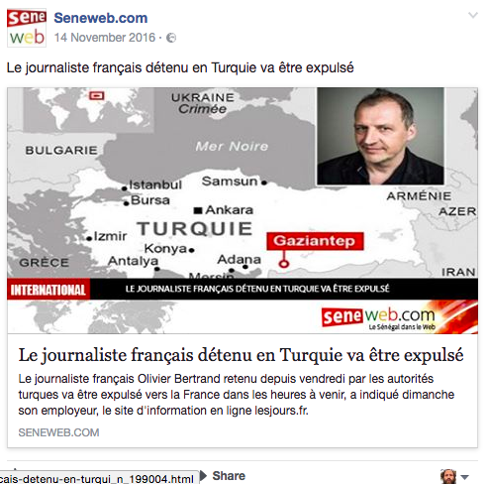
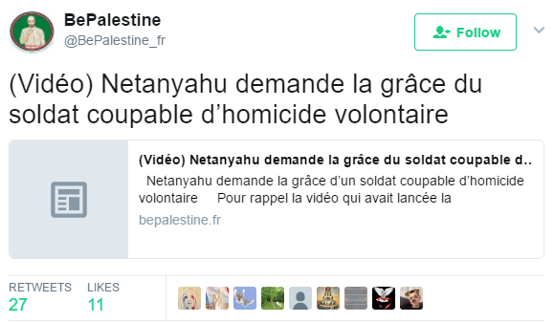
REPEAT POST BEHAVIOUR
Executive Summary Non-Traditional Media Map Landscape Social Media Sharing Behaviour Patterns of Disinformation Detailed Findings and Background Data Methodology
Post – Repeat | Post – Mission | Post – Provoke
Summary of the behaviour | Quotes and examples | Drivers | Presence on the Media Map
REPEAT POST ON FACEBOOK
REPEAT POST ON TWITTER

Slide 118
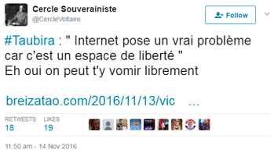
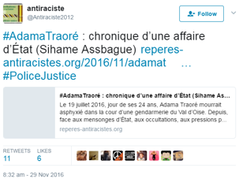
MISSION POST BEHAVIOUR: Filing & pointing
Executive Summary Non-Traditional Media Map Landscape Social Media Sharing Behaviour Patterns of Disinformation Detailed Findings and Background Data Methodology
Post – Repeat | Post – Mission | Post – Provoke
Summary of the behaviour | Quotes and examples | Drivers | Presence on the Media Map
 | Context | User highlights the ex-minister’s name to point to the establishment’s role in censoring the Internet. The hashtag is intended to clarify the link between the article and the political actor – thereby contributing to the overall perception of the person.
 | Original | #Taubira : " Internet pose un vrai problème car c'est un espace de liberté " Eh oui on peut t'y vomir librement https://t.co/SQYscOLdjA Link to the tweet: http://twitter.com/CercleVoltaire/status/798251664247496704
 | Translation | The Internet poses a real problem, since it is a space of liberty. “And yes, anyone can vomit you in the face online”
 | Context | User thematizing the Traore case by hashtagging this title, in an effort to raise awareness of police brutality and racism.
 | Original | #AdamaTraoré : chronique d’une affaire d’État (Sihame Assbague) https://t.co/Smg54kEhfG #PoliceJustice Link to the tweet: http://twitter.com/Antiraciste2012/status/803637699244683264
 | Translation | #AdamaTraoré: chronicle of a state-affaire {LINK} #PoliceJustice

Slide 119
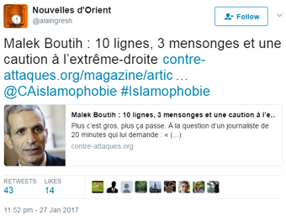
MISSION POST BEHAVIOUR: Filing & pointing
Executive Summary Non-Traditional Media Map Landscape Social Media Sharing Behaviour Patterns of Disinformation Detailed Findings and Background Data Methodology
Post – Repeat | Post – Mission | Post – Provoke
Summary of the behaviour | Quotes and examples | Drivers | Presence on the Media Map
 | Context | User adds hashtag(s) to provide an interpretative frame to an article, by filing it to a topic, or highlighting a political player’s role, such as adding the hashtag“Islamophobie” to the below shared article post.
 | Original | Malek Boutih : 10 lignes, 3 mensonges et une caution à l’extrême-droite https://t.co/DFV0yraFYg @CAislamophobie #Islamophobie Link to the tweet: http://twitter.com/alaingresh/status/825250253884506112
 | Translation | Malek Boutih: 10 lines and 3 lies and a warning to the extreme right.@CAislamophobie #Islamphobia

Slide 120
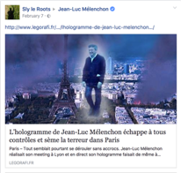
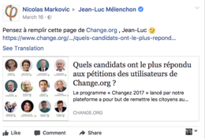
MISSION POST BEHAVIOUR: Addressing & alerting
Executive Summary Non-Traditional Media Map Landscape Social Media Sharing Behaviour Patterns of Disinformation Detailed Findings and Background Data Methodology
Post – Repeat | Post – Mission | Post – Provoke
Summary of the behaviour | Quotes and examples | Drivers | Presence on the Media Map
SUPPORT AND REQUESTS
 | Context | User posts friendly and funny article to politician’s page to express to promote their hero and reconfirm their belonging to the community.
 | Original | See screenshot ULink: http://www.facebook.com/permalink.php?id=11450328749&story_fbid=10154115970131987
 | Translation | A hologramme haunts the city, spreading fear.
 | Context | User requests politician to participate in a survey.
 | Original | Pensez à remplir cette page de Change.org , Jean-Luc ;) Link: https://www.facebook.com/permalink.php?id=11450328749&story_fbid=10155213315175921
 | Translation | Do not forget to fill out this page on Change.org, Jean-Luc! :)

Slide 121
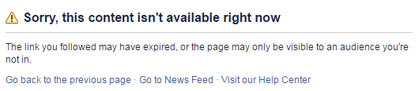
MISSION POST BEHAVIOUR: Addressing & alerting
Executive Summary Non-Traditional Media Map Landscape Social Media Sharing Behaviour Patterns of Disinformation Detailed Findings and Background Data Methodology
Post – Repeat | Post – Mission | Post – Provoke
Summary of the behaviour | Quotes and examples | Drivers | Presence on the Media Map
IMPORTANT INFORMATION: Users alerts an audience to a specific piece of news that remained unnoticed, but deserved heightened attention.
 | Context | A French user uses a Swiss French-speaking Facebook page to disseminate information hidden by the mainstream media on the critical migrant-situation in Sweden threatening the whole of Western-Europe
 | Original | De PIRE EN PIRE ! ! ! Avec la COMPLICITÉ des MEDIA qui cachent ces événements ABJECTS !!! Merci à nos amis Suisses d'avoir relayé l'information. Link: http://www.facebook.com/permalink.php?id=212297922293183&story_fbid=1169169456535673
 | Translation | From bad to worse!!!! With the COMPLICITY of the media that hides these hideous events!!! Thanks to our Swiss friends to spreading word.

Slide 122
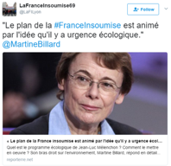
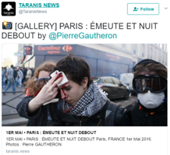
Executive Summary Non-Traditional Media Map Landscape Social Media Sharing Behaviour Patterns of Disinformation Detailed Findings and Background Data Methodology
MISSION POST BEHAVIOUR: Addressing & alerting
Post – Repeat | Post – Mission | Post – Provoke
Summary of the behaviour | Quotes and examples | Drivers | Presence on the Media Map
PERSONABLE NEWS
 | Context | Users tag the handle of a political actor to the shared article, ensuring that the tagged individual will notice their activity; creating a bond between the user and the political actor.
 | Original | "Le plan de la #FranceInsoumise est animé par l'idée qu'il y a urgence écologique." @MartineBillard https://t.co/HH8d4Rl2KI Link: https://twitter.com/LaFILyon/status/835465346102480896
 | Translation | “The plan of #Franceinsoumise {Melenchon’s party} is driven by the idea that there is a real ecological emergency” @MartineBillard
 | Context | Posters tag the journalist or photographer of a news story. Hereby they render the material more personable and socially embedded.
 | Original | ÉMEUTE ET NUIT DEBOUT by @PierreGautheron https://t.co/wQfInOl0nq Link: https://twitter.com/TaranisNews/status/858934258894868480
 | Translation | Riot and Nuit Debout (student movement in Paris) by PierreGautheron

Slide 123
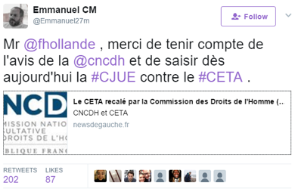
MISSION POST BEHAVIOUR: Addressing & alerting
Executive Summary Non-Traditional Media Map Landscape Social Media Sharing Behaviour Patterns of Disinformation Detailed Findings and Background Data Methodology
Post – Repeat | Post – Mission | Post – Provoke
Summary of the behaviour | Quotes and examples | Drivers | Presence on the Media Map
CRITICISM
 | Context | User posts articles, and tag political actors in with subtle satirical undertone to express criticism of the actor’s behaviour.
 | Original | Mr @fhollande , merci de tenir compte de l'avis de la @cncdh et de saisir dès aujourd'hui la #CJUE contre le #CETA . https://t.co/PSqvW6Sn6m Link: https://twitter.com/Emmanuel27m/status/809680206084575232
 | Translation | Thank you Mr (@fhollande) for taking into consideration the opinion of the @cncdh and immediately putting into force the #CJUE (The European Court of Justice) against #CETA .

Slide 124
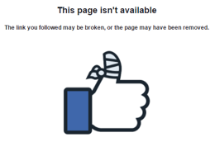
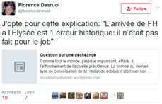
Executive Summary Non-Traditional Media Map Landscape Social Media Sharing Behaviour Patterns of Disinformation Detailed Findings and Background Data Methodology
MISSION POST BEHAVIOUR: Quoting & highlighting
important part of an article
Post – Repeat | Post – Mission | Post – Provoke
Summary of the behaviour | Quotes and examples | Drivers | Presence on the Media Map
 | Context | Posters highlight the key element of a story, by including a quote of the article in their post along the shared link.
 | Original | BREIZATAO - POLITIKEREZH (22/03/2017) Christian Schoettl, maire de Janvry dans l'Essonne, est revenu dans un entretien sur les emplois fictifs dont bénéficiaient Jean-Luc Mélenchon et sa famille lorsqu'il était secrétaire d'Etat de Lionel Jospin. http://breizatao.com/2017/03/21/un-elu-de-lessonne-revele-comment-jean-luc-melenchon-et-sa-famille-beneficiaient-demplois-fictifs-video/ Link: http://www.facebook.com/permalink.php?id=11450328749&story_fbid=10210764210678656
 | Translation | Christian Schoettl, mayor of Janvry, Essone, has brought up in an interview Mélanchon’s fake employments during the period he was holding office under the prime-ministership of Lionel Jospin.
 | Context | User quotes the central claim of the article ridiculing Francois Hollande’s five years in office.
 | Original | J'opte pour cette explication: "L'arrivée de FH a l'Elysée est 1 erreur historique: il n’était pas fait pour le job" https://t.co/XC8lrdbieA Link: http://twitter.com/florencedesruol/status/793372339199148032
 | Translation | I pick the following interpretation: “The arrival of FH at the Elysée is a historic mistake: he is not made for the job!”

Slide 125

Executive Summary Non-Traditional Media Map Landscape Social Media Sharing Behaviour Patterns of Disinformation Detailed Findings and Background Data Methodology
MISSION POST BEHAVIOUR: Quoting & highlighting
important part of an article
Post – Repeat | Post – Mission | Post – Provoke
Summary of the behaviour | Quotes and examples | Drivers | Presence on the Media Map
 | Context | The user quotes a funny line that sums up very succinctly the main claim of the argument, thereby contextualising the text.
 | Original | "En France, les socialistes ont une si haute idée de leur moralité qu'on croirait presque qu'ils rendent la corruption honnête en s'y livrant" Link: http://www.europe-israel.org/2017/04/jean-luc-melenchon-a-t-il-favorise-sa-fille-et-abuse-de-largent-public/ Link: http://www.facebook.com/permalink.php?id=11450328749&story_fbid=1298223890253310
 | Translation | “In France the socialists have such a high regard for their own morality that one would believe that they make even corruption an honest business just by participating in it.”

Slide 126
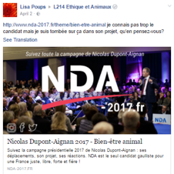
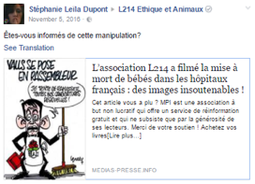
Executive Summary Non-Traditional Media Map Landscape Social Media Sharing Behaviour Patterns of Disinformation Detailed Findings and Background Data Methodology
MISSION POST BEHAVIOUR: Asking questions
Post – Repeat | Post – Mission | Post – Provoke
Summary of the behaviour | Quotes and examples | Drivers | Presence on the Media Map
 | Context | The user came across a topic discussed in a presidential candidate’s (Nicolas Dupont-Aignan) programme. She would like to know about the credibility of the candidate on animal-rights. She poses her question to a Facebook page focusing on animal issues.
 | Original | je connais pas trop le candidat mais je suis tombée sur ça dans son projet, qu'en pensez-vous?http://www.nda-2017.fr/theme/bien-etre-animal Link: http://www.facebook.com/permalink.php?id=350866824756&story_fbid=734698960023439
 | Translation | I do not know this candidate very well, but I have come across the following in his programme. What do you think?
 | Context | User shares an article which reveals the analogy between cruelty to animals and human abortion. She publishes the article on the FB page of the animal-protection group L214. She asks them if they are aware of a manipulative representation of their activity.
 | Original | Êtes-vous informés de cette manipulation? http://www.medias-presse.info/lassociation-l214-a-filme-la-mise-a-mort-de-bebes-dans-les-hopitaux-francais-des-images-insoutenables/63776 Link: http://www.facebook.com/permalink.php?id=350866824756&story_fbid=1350927428264460
 | Translation | Are you aware of this manipulation?

Slide 127
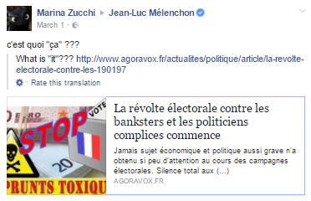
Executive Summary Non-Traditional Media Map Landscape Social Media Sharing Behaviour Patterns of Disinformation Detailed Findings and Background Data Methodology
MISSION POST BEHAVIOUR: Asking questions
Post – Repeat | Post – Mission | Post – Provoke
Summary of the behaviour | Quotes and examples | Drivers | Presence on the Media Map
 | Context | User asks for explanation from her own camp about a dubious practice of campaign financing. She publishes her question on J-L Mélanchon’s Facebook page. She draws peer’s attention to the subject the article:
 | Original | c'est quoi "ça" ??? “Jamais sujet économique et politique aussi grave n'a obtenu si peu d'attention au cours des campagnes électorales. Silence total aux (...)“ http://www.agoravox.fr/actualites/politique/article/la-revolte-electorale-contre-les-190197 Link: http://www.facebook.com/permalink.php?id=11450328749&story_fbid=1617614771601614
 | Translation | what is “this”??? Never has a subject as important as this from both an economic and a political perspective been so completely neglected during electoral campaigns.

Slide 128
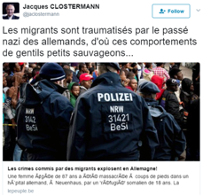

PROVOKE POST BEHAVIOUR: Content-driven provocation
Executive Summary Non-Traditional Media Map Landscape Social Media Sharing Behaviour Patterns of Disinformation Detailed Findings and Background Data Methodology
Post – Repeat | Post – Mission | Post – Provoke
Summary of the behaviour | Quotes and examples | Drivers | Presence on the Media Map
 | Context | The user, a French nationalist, sovereignist by his own self-definition, provocatively suggests that the crimes committed by migrants in Germany are due to the trauma caused by Nazi Germany to non-Germans during the last War.
 | Original | Les migrants sont traumatisés par le passé nazi des allemands, d'où ces comportements de gentils petits sauvageons...https://t.co/LA9AecIVKc Link: http://twitter.com/jaclostermann/status/840452304574791681
 | Translation | The migrants are traumatized by the Nazi-German past, that is why they behave like sweet little savages
 | Context | User shares an article taken from the sovereignist ‘francedesouche’ about a socialist politician who ‘beat his wife because she was leading a Western lifestyle’. The slanderous gossip is destined to provoke left-wing and anti-racist readers.
 | Original | L’assistant parlementaire PS Yacine Chaouat tabassait sa femme car elle vivait à l’occidentale Link: http://twitter.com/YannMerkado/status/834411049264640000
 | Translation | The socialist assistant at parliament, Yacine Chaouat, beat his wife because she was leading a western lifestyle

Slide 129
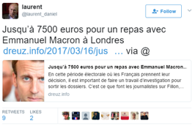

PROVOKE POST BEHAVIOUR: Content-driven provocation
Executive Summary Non-Traditional Media Map Landscape Social Media Sharing Behaviour Patterns of Disinformation Detailed Findings and Background Data Methodology
Post – Repeat | Post – Mission | Post – Provoke
Summary of the behaviour | Quotes and examples | Drivers | Presence on the Media Map
 | Context | The user, whose profile picture happens to be a photo of Vladimir Putin, claims that Macron had extensively spent tax-payers’ money during his campaign.
 | Original | Jusqu’à 7500 euros pour un repas avec Emmanuel Macron à Londres https://t.co/bFQgt8PMuv via @ Link: http://twitter.com/laurent_daniel/status/842748362017423360
 | Translation | As much as 7500 euros for a meal with Emmanuel Macron in London!!!
 | Context | Macron is supposed to have paid one of his militants with money coming from the French Parliament without the mainstream media ever mentioning this.
 | Original | #Macron : un de ses militants payé par l’Assemblée nationale ! Silence complet des médias Link: http://twitter.com/didiergildas/status/838303427633496065
 | Translation | Macron: one of his militants was paid by the French Parliament. Total media silence.

Slide 130

PROVOKE POST BEHAVIOUR: Content-driven provocation
Executive Summary Non-Traditional Media Map Landscape Social Media Sharing Behaviour Patterns of Disinformation Detailed Findings and Background Data Methodology
Post – Repeat | Post – Mission | Post – Provoke
Summary of the behaviour | Quotes and examples | Drivers | Presence on the Media Map
 | Context | User shares an article accusing presidential candidate Francois Fillon of being both homophobic and antisemitic.
 | Original | #Fillon non seulement homophobe mais aussi antisémite. https://t.co/eCRyuDKho2 Link: https://twitter.com/gayregis/status/801509740845142016
 | Translation | #Fillon is not only homophobic but antisemitic as well.

Slide 131

Executive Summary Non-Traditional Media Map Landscape Social Media Sharing Behaviour Patterns of Disinformation Detailed Findings and Background Data Methodology
PROVOKE POST BEHAVIOUR: Attacking and infecting
communities
Post – Repeat | Post – Mission | Post – Provoke
Summary of the behaviour | Quotes and examples | Drivers | Presence on the Media Map
 | Context | Macron characterized as a prostitute trying to instrumentalise the memory of the Shoa to gain votes.
 | Original | L’entreprise de racolage de Macron use et abuse de la Shoah ! Il en est réduit à faire la pute !
 | Translation | Macron’s soliciting campaign uses and abuses the Shoah! He is acting like a prostitute!

Slide 132


Executive Summary Non-Traditional Media Map Landscape Social Media Sharing Behaviour Patterns of Disinformation Detailed Findings and Background Data Methodology
PROVOKE POST BEHAVIOUR: Attacking and infecting
communities
Post – Repeat | Post – Mission | Post – Provoke
Summary of the behaviour | Quotes and examples | Drivers | Presence on the Media Map
 | Context | User publishes a slanderous article on J-L Mélenchon, ultra-leftist presidential candidate, on the latter’s Facebook page. In the article the politician is accused of all kinds of financial maneuvering and cheating.
 | Original | http://resistancerepublicaine.eu/…/melenchon-riche-proprie…/ link: https://www.facebook.com/permalink.php?id=11450328749&story_fbid=10210561056960448
 | Translation | http://resistancerepublicaine.eu/…/melenchon-riche-proprie…/-mélenchon rich owner Photo added! Mélenchon and Stalin.
 | Context | User shares a scathing article about ultra-leftist candidate J-L Mélanchon’s programme, claiming that if Mélanchon was to be the next president, according to his hyper-collectivist programme the state would “rule everything, detain everything, dominate everything”. This article is shared on Mélenchon’s Facebook page clearly to provoke his followers.
 | Original | Ami(e)s Insoumis(e)s regardez donc sur quoi je viens de tomber !!! c'est comment dire ..... du foutage du gueule carrément même Link: https://www.facebook.com/permalink.php?id=11450328749&story_fbid=10203318587722710
 | Translation | Rebellious friends (J-L Mélenchon’s followers’ monicker), look what i have come across! it is, how shall I put it? ...clearly bullshit, to say the least!

Slide 133


Executive Summary Non-Traditional Media Map Landscape Social Media Sharing Behaviour Patterns of Disinformation Detailed Findings and Background Data Methodology
PROVOKE POST BEHAVIOUR: Ironic ambiguity
Post – Repeat | Post – Mission | Post – Provoke
Summary of the behaviour | Quotes and examples | Drivers | Presence on the Media Map
 | Context | Fake news utilized sarcastically by the author to provoke the Fillon camp: Fillon is supposed to have said that despite his first round elimination he would insist on being present in the second round ignoring the rules.
 | Original | Fillon maintient sa candidature au 2e tour : "je refuse qu’on vole cette élection au peuple français" https://t.co/gFKwM76TvM via @le_gorafi Link: https://twitter.com/ornikkar/status/856430808256696321
 | Translation | Fillon maintains his bid for the presidency in the second round of the elections: “I will not allow them to steal the possibility of voting from the French people”!
 | Context | The user quotes a phrase (originally from gorafi, a humoristic journal) without indicating the source and thereby instrumentalising a piece of fake news to provoke supporters of the great favourite of the presidential race.
 | Original | Macron : « quand je serre la main d’un pauvre, je me sens sale pour toute la journée » https://t.co/siqZE5O0Ho Link: http://twitter.com/57flibustier57/status/848759555592945664
 | Translation | Macron: “ if i shake hands with a poor man, I feel dirty for the rest of day.

Slide 134



DISCUSS BEHAVIOUR: AGREE Appreciate
Executive Summary Non-Traditional Media Map Landscape Social Media Sharing Behaviour Patterns of Disinformation Detailed Findings and Background Data Methodology
Discuss – Agree | Discuss – Debate | Discuss – Debunk
Summary of the behaviour | Quotes and examples | Drivers | Presence on the Media Map
 | Context | Article shared about meat and slaughterhouses
 | Original | “Très intéressant et riche comme article”
 | Translation | Very interesting and rich article
 | Context | Article about the protest of FFOC
 | Original | “Je vous rejoins dans votre colère !”
 | Translation | I do share your anger!

Slide 135




DISCUSS BEHAVIOUR: AGREE Appreciate
Executive Summary Non-Traditional Media Map Landscape Social Media Sharing Behaviour Patterns of Disinformation Detailed Findings and Background Data Methodology
Discuss – Agree | Discuss – Debate | Discuss – Debunk
Summary of the behaviour | Quotes and examples | Drivers | Presence on the Media Map
 | Context | The posted article argues against voting for Macron to counter Le Pen in the second round. Enthusiasm is expressed concerning the content of the posted article.
 | Original | “Il faut vraiment être debile pour voter macron!!!!”
 | Translation | You really have to be an idiot to vote for Macron!!!!
 | Context | An article by Dupont-Aignan’s posted by his page on the “great replacement”, meaning migrants replace white people.
 | Original | “Merci Monsieur NDA de nous rappeler cette vérité !”
 | Translation | Thank you Mr. NDA (Nicolas Dupont-Aignan) for reminding us of this truth!

Slide 136



DISCUSS BEHAVIOUR: AGREE Escalate
Executive Summary Non-Traditional Media Map Landscape Social Media Sharing Behaviour Patterns of Disinformation Detailed Findings and Background Data Methodology
Discuss – Agree | Discuss – Debate | Discuss – Debunk
Summary of the behaviour | Quotes and examples | Drivers | Presence on the Media Map
 | Context | Comment on an article on the presumed cheating during the presidential elections to the detriment of Melenchon
 | Original | Je ne comprends pas pourquoi,il ne fait rien avec toute les irréguarités qu'il y a eu,peut être parcqu'il sait que ce serait compliqué puisqu'a la tête du conseil c'est fabius donc ça craint...deja sur deux pétition qui ont été envoyé au conseil pas de nouvelles silence....
 | Translation | : I do not understand why he doesn’t do anything about the irregularities that took place. maybe because he knows that with Fabius at the head of the committee nothing will happen. Already there is no news about the two petitions sent to the committee…
 | Context | Comment on the same article on the presumed cheating during the presidential elections to the detriment of Melenchon
 | Original | Tout simplement parce que si il le faisait on l'accuserait d'être un mauvais perdant et que ça nuirait à la suite, c'est à dire les législatives. :) Et que oui avec Fabius, le conseil est vérolé. -_-
 | Translation | Simply because if he did he would be accused of being a bad loser and it would be detrimental to his campaign for the upcoming elections.:) And with Fabius at the head of the committee, it is pointless…

Slide 137



DISCUSS BEHAVIOUR: AGREE Escalate
Executive Summary Non-Traditional Media Map Landscape Social Media Sharing Behaviour Patterns of Disinformation Detailed Findings and Background Data Methodology
Discuss – Agree | Discuss – Debate | Discuss – Debunk
Summary of the behaviour | Quotes and examples | Drivers | Presence on the Media Map
 | Context | Georges Fenech knows no voters of the right who would vote for Macron
 | Original | Ni les électeurs de droite, ni normalement ceux de Mélenchon ne voteront Macron, les premier parti au 2 em tour va être le parti de l' abstention
 | Translation | Neither voters on the right nor the voters of Mélenchon will vote for Macron in the second round. The biggest party in this election is bound to be that of abstention.
 | Context | Testimony of Khadhafi that proves that he financed the presidential campaign of Sarközy
 | Original | Malheureusement avec tout les preuves en main la justice Française n'arrive pas a le condamner
 | Translation | Unfortunately, with all the evidence in hand the French judiciary system is unable to sentence him.

Slide 138

DISCUSS BEHAVIOUR: AGREE Outcry
Executive Summary Non-Traditional Media Map Landscape Social Media Sharing Behaviour Patterns of Disinformation Detailed Findings and Background Data Methodology
Discuss – Agree | Discuss – Debate | Discuss – Debunk
Summary of the behaviour | Quotes and examples | Drivers | Presence on the Media Map
 | Context | The deputy LR (moderate right) refuses the “republican front” in the second round of the presidential election.
 | Original | “Bravo Macron imposteur menteur manipulateur incompétent et j'en passe le dictionnaire n'est pas suffisant pour qualifier un personnage telle que lui et OUI ! C'est un personnage de toute pièce fabriquer du reste de l'équipe de Hollande Vals un homme qui va faire payé ce qui arrive à gagner leur vie à augmenter la taxe foncière de 30% il va créé un impôt supplémentaire à tout les propriétaires immobilier comme si on paye pas suffisamment et il est pour l'immigration l'ouverture de nos frontières ... pour lui la priorité et la formation et l'intégration des immigrés en France en leur donnant un logement en les passant prioritaire sur toute les formation à pôle emplois devant les français bref j'en passe cette homme ancien ministre de l'économie de Hollande qui a eu l'intelligence de donner 41 milliards d'euros par an”
 | Translation | “Bravo Macron impostor, liar, manipulator, incompetent and I will not continue, ‘cuz a whole dictionary is not enough to describe such a personality, yes something like HIM! This is a personality artificially synthesized out of the leftover of the Hollande-Vals team. He will heavily tax those who have heretofore managed to earn their living. He will raise the property tax by 30 percent. He will come up with a new form of tax on real estate as if we did not have to pay abundantly already as it is. And he is for opening the borders and allow uncontrolled free immigration. For him the priority is the education and integration of all those immigrants already in France and also to give them housing and priority access to all those courses that may lead to a job. Before the true-born French! To cut a long story short, I completely dismiss this man who was Hollande’s economy-minister and had the intelligence to distribute 41 billion each year”

Slide 139



DISCUSS BEHAVIOUR: AGREE Outcry
Executive Summary Non-Traditional Media Map Landscape Social Media Sharing Behaviour Patterns of Disinformation Detailed Findings and Background Data Methodology
Discuss – Agree | Discuss – Debate | Discuss – Debunk
Summary of the behaviour | Quotes and examples | Drivers | Presence on the Media Map
 | Context | Article on the reform of the legitimate self-defense of police, which, according to its evaluation, stops half-way.
 | Original | “les français devraient se reveiller surtout !!!!!!”
 | Translation | French people should wake up in the first place!!!!! (possibly implying that they should defend themselves, and not wait for the police).
IN THE SAME THREAD:
 | Context | Article on the reform of the legitimate self-defense of police, which, according to its evaluation, stops half-way.
 | Original | “La légitime défense POUR TOUS”
 | Translation | Legitimate defense FOR EVERYBODY.

Slide 140




DISCUSS BEHAVIOUR: AGREE Outcry
Executive Summary Non-Traditional Media Map Landscape Social Media Sharing Behaviour Patterns of Disinformation Detailed Findings and Background Data Methodology
Discuss – Agree | Discuss – Debate | Discuss – Debunk
Summary of the behaviour | Quotes and examples | Drivers | Presence on the Media Map
 | Context | The posted article talks about the theory of the “great replacement”, and chastises those who do not believe in it.
 | Original | “Peuple d'aveugles, de lâches et de lobotomisés. Voué à sa perte et y prêtant même son concours.........”
 | Translation | These are people [meaning: the French) who are blind, coward and lobotomized individuals. The French are doomed, and even promoting their downfall out of their own will…..
 | Context | Shared critical article on Cambadélis, first secretary of the Socialist Party, who threatened to exclude Macron supporters.
 | Original | “Une crapule, déjà condamné deux fois, et qui ose faire la leçon. Beurk.”
 | Translation | A liar, who was already sentenced twice, and still dares to lecture people. Yikes.

Slide 141
DISCUSS BEHAVIOUR: AGREE Outcry
Executive Summary Non-Traditional Media Map Landscape Social Media Sharing Behaviour Patterns of Disinformation Detailed Findings and Background Data Methodology
Discuss – Agree | Discuss – Debate | Discuss – Debunk
Summary of the behaviour | Quotes and examples | Drivers | Presence on the Media Map
 | Context | The shared article critiques the sea rescue of refugees
 | Original | “NOUS N’EN VOULONS PAS EN FRANCE !!!!!!! MARINE AU SECOURS !!!!”
 | Translation | WE DON’T WANT THEM IN FRANCE!!!!!!!! MARINE, HELP!!!!!

Slide 142
DISCUSS BEHAVIOUR: AGREE Outcry
Executive Summary Non-Traditional Media Map Landscape Social Media Sharing Behaviour Patterns of Disinformation Detailed Findings and Background Data Methodology
Discuss – Agree | Discuss – Debate | Discuss – Debunk
Summary of the behaviour | Quotes and examples | Drivers | Presence on the Media Map
 | Context | A deputy of LR (moderate right) refuses to vote for Macron in the second round.
 | Original | “Ils sont bien emmerdés maintenant avec leur front républicain.Du plomb dans l'aile, cela ne fonctionne plus!”
 | Translation | So now they have problems with their republican front. These days it isn’t that easy to pull it off.
 | Context | An article by Fdesouche and posted on its page asserts that a journalist from the mainstream media linked Marine Le Pen to nazism.
 | Original | Tu peux associer Macron à manipulateur et menteur ! C'est avec plus de plaisir encore que je voterais pour Marine ! 😁😁
 | Translation | Macron is now connoted as being a manipulator and a liar. So I will be even happier to vote for Marine!😁😁

Slide 143
DISCUSS BEHAVIOUR: AGREE Outcry
Executive Summary Non-Traditional Media Map Landscape Social Media Sharing Behaviour Patterns of Disinformation Detailed Findings and Background Data Methodology
Discuss – Agree | Discuss – Debate | Discuss – Debunk
Summary of the behaviour | Quotes and examples | Drivers | Presence on the Media Map
 | Context | An article compared Marine Le Pen to the Nazis, but the person posting is with Marine.
 | Original | L'enfoiré c lui le nazis c immonde de sortir de pareils horreurs faut qu'il soit puni et prison ordure
 | Translation | Macron is now connoted as being a manipulator and a liar. So I will be even happier to vote for Marine!😁😁

Slide 144




DISCUSS BEHAVIOUR: AGREE Call for action
Executive Summary Non-Traditional Media Map Landscape Social Media Sharing Behaviour Patterns of Disinformation Detailed Findings and Background Data Methodology
Discuss – Agree | Discuss – Debate | Discuss – Debunk
Summary of the behaviour | Quotes and examples | Drivers | Presence on the Media Map
PROTEST
 | Context | A leftist blog states that the second round is absurd, it is not possible to choose between the two candidates, furthermore, the first round was rigged.
 | Original | “C'est à nous de protester...il y a des manifs dans toute la france jeudi et une à paris le 1er mai...
 | Translation | “It is us who should protest...there are demonstrations all over France on Thursday, and there is one in Paris on the 1st of May.
 | Context | Article mentioning that the new program of a self-managed social center is online
 | Original | J'aime l'idée du : c'est en manifestant continuellement avec les opprimés que le FN ne peut ni soutenir ni attaquer, et donc ne rien dire.
 | Translation | I like this idea: a continuous demonstration with and in the name of the oppressed, which the FN can neither support nor attack and consequently it is in no position to say anything whatsoever!

Slide 145




DISCUSS BEHAVIOUR: AGREE Call for action
Executive Summary Non-Traditional Media Map Landscape Social Media Sharing Behaviour Patterns of Disinformation Detailed Findings and Background Data Methodology
Discuss – Agree | Discuss – Debate | Discuss – Debunk
Summary of the behaviour | Quotes and examples | Drivers | Presence on the Media Map
COLLECTIVE ACTION
 | Context | A left-wing blog calls for organizing a big “agora” before the second round, for that the people can express themselves.
 | Original | Bonne initiative, montrons que le petit peuple est devenu adulte, capable de se gérer.
 | Translation | Good initiative. Let us show them, those in power, that little people have become adult, capable of managing their life.
COMMERCIAL BOYCOTT
 | Context | The posted article states that organic products, unfortunately, re too expensive.
 | Original | Simple, il "suffit" d'arrêter de passer par les supermarchés.
 | Translation | Easy!; it suffices to avoid the supermarkets

Slide 146


DISCUSS BEHAVIOUR: AGREE Call for action
Executive Summary Non-Traditional Media Map Landscape Social Media Sharing Behaviour Patterns of Disinformation Detailed Findings and Background Data Methodology
Discuss – Agree | Discuss – Debate | Discuss – Debunk
Summary of the behaviour | Quotes and examples | Drivers | Presence on the Media Map
ELECTION IMPACT
 | Context | A student association calls for constant mobilization against fascism and the annulment of social benefits.
 | Original | Et n'oubliez pas d'aller voter aux législatives !
 | Translation | Do not forget to go to vote in the parliamentary elections!

Slide 147


DISCUSS BEHAVIOUR: DEBATE Mapping agreement
Executive Summary Non-Traditional Media Map Landscape Social Media Sharing Behaviour Patterns of Disinformation Detailed Findings and Background Data Methodology
Discuss – Agree | Discuss – Debate | Discuss – Debunk
Summary of the behaviour | Quotes and examples | Drivers | Presence on the Media Map
 | Context | User responding to an shared article from a media source in the Alternative Section of the media map
 | Original | “Merci pour ce lien. Je n'ai jamais considéré les crises comme une source fiable à 100%, c'est pour ça que je pratique le recoupement. Mais factuellement, je trouve que ce blog reste, malgré la baisse de niveau, une source à prendre en compte.”
 | Translation | Thanks for this site. I have never considered les-crises.fr as a 100% reliable source, this is the reason why I do cross-checking. However, in terms of facts, I think that this blog, despite the decreasing quality, remains a source to be considered.
 | Context | A Mélenchon supporter comments on a shared article critical of his/her candidate of choice
 | Original | Le mot qui est de trop dans cet article est le mot " mépris" JLM ne parle pas avec mépris mais plutôt avec passion.
 | Translation | The word that is too much in this article is “contempt”. JLM does not talk with contempt, but rather with passion.

Slide 148




DISCUSS BEHAVIOUR: DEBATE Mapping agreement
Executive Summary Non-Traditional Media Map Landscape Social Media Sharing Behaviour Patterns of Disinformation Detailed Findings and Background Data Methodology
Discuss – Agree | Discuss – Debate | Discuss – Debunk
Summary of the behaviour | Quotes and examples | Drivers | Presence on the Media Map
 | Context | Comment on a shared article on the anniversary of the Treaty of Rome
 | Original | Ne sommes nous pas très loin de l'esprit du Traité de Rome? L'idée était magnifique mais à défaut de faire une Europe Sociale nous avons laissé s'implanter l'Europe du fric et des friqués. C'est cette Europe qui produit les partis extrémistes (FN) et voit naître les opportunistes ( Hollande - Macron).....Réfléchissons!
 | Translation | I would think that we are pretty far away from the Treaty of Rome. The idea was great, but since we failed to create a Social Europe, the Europe of money and moneyed people came about. This is the Europe that creates the extremist parties (FN), and where opportunists emerge (Hollande-MAcron)... Let’s think!
 | Context | Comment on a shared article attacking traditional media coverage of the elections
 | Original | Ouais enfin, les médias traditionnels ne sont pas les derniers pour diffuser des fausses infos hein ! Se contentant de reprendre des dépêches AFP sans faire le moindre travail de vérification
 | Translation | Yeah, well traditional media is not the least active in diffusing fake news! They are just taking the dispatches by AFP, without any work of verification.

Slide 149



DISCUSS BEHAVIOUR: DEBATE Extend the argument
Executive Summary Non-Traditional Media Map Landscape Social Media Sharing Behaviour Patterns of Disinformation Detailed Findings and Background Data Methodology
Discuss – Agree | Discuss – Debate | Discuss – Debunk
Summary of the behaviour | Quotes and examples | Drivers | Presence on the Media Map
 | Context | Adding demands to an article on animal rights.
 | Original | “Ce pas compréhensible que rien n'a bouger depuis des années la viande vient du moyen âge et n'avait jamais été remise en qu'es-tu ion et en plus un gouvernement indifférent au sort des animaux voilà où il faut partir maintenant d'où une forte bataille.”
 | Translation | It is not understandable that nothing has changed for years. Meat eating has started in the Middle Ages, and has not been questioned ever since. And the government is indifferent to the fate of the animals, this is the point where we have to start from, and engage in a heavy battle.
 | Context | Adding demands to an article on animal rights.
 | Original | “En plus de ces abattoirs le fléau de la chasse sévit en France là aussi cela se termine en civet de sanglier chevreuil eux aussi ont droit à la vie faut obtenir la suppression de la chasse qui est une monstruausite comme les abattoirs”
 | Translation | Not only the slaughterhouses, but there is also hunting, which finishes as wild boar or roe deer stew, however they also have the right to live. We have to get hunting banned, which is as horrible as slaughter houses.

Slide 150

DISCUSS BEHAVIOUR: DEBATE Extend the argument
Executive Summary Non-Traditional Media Map Landscape Social Media Sharing Behaviour Patterns of Disinformation Detailed Findings and Background Data Methodology
Discuss – Agree | Discuss – Debate | Discuss – Debunk
Summary of the behaviour | Quotes and examples | Drivers | Presence on the Media Map
 | Context | The article does not talk about Mélenchon – the User extends the article to cover his candidate.
 | Original | Je sais pas, mais c'est vieux, ca vient de 2010. On ne peut pas accuser Fillon Lepen, et Macron... pour des emplois fictifs et détournement de fonds, ou favoritisme si Mr Mélenchon, n'est pas totalement transparent. Alors pour ses futurs électeurs, j'aimerais une honnêté et une transparence totale, ou par interview, ou sur FB. En dix ans, voir plus on a eu des présidents, pourris pas diverses affaires, la soif de l'argent et du pouvoir... ca ne peut plus durer. Le prochain président doit être clean, et agir pour le peuple et pas pour servir ses propres intérêts. Je rappelle juste que ces articles de France 24 son public et consultable par tous, je n'invente rien. Cordialement.
 | Translation | I don’t know, however, it’s old, it is from 2010. We cannot accuse Fillon, Lepen and Macron... for phony jobs and embezzlement and favoritism if Mr. Mélenchon is not totally transparent. So for his future electors, I would like that that honesty and total transparence be established, either by an interview or FB. For ten years or even more, we have had presidents involved in many affairs, as a sign of thirst for money and power... It cannot last longer. The next president has to be clean, should act for the people, and should not serve his own interests. I just wanted to remind you of the fact that the articles by France 24 are public and accessible to everybody, I don’t make up anything. Sincerely.

Slide 151




DISCUSS BEHAVIOUR: DEBATE Extend the argument
Executive Summary Non-Traditional Media Map Landscape Social Media Sharing Behaviour Patterns of Disinformation Detailed Findings and Background Data Methodology
Discuss – Agree | Discuss – Debate | Discuss – Debunk
Summary of the behaviour | Quotes and examples | Drivers | Presence on the Media Map
 | Context | Left-wing blog citing the presumed affairs of Macron.
 | Original | “Quand on travaille pour d'autres, on ne travaille pas pour le Peuple. 4 candidats sont mouillés dans des conflits d'intérêts avant même les élections : ils sont corrompus d'avance et travailleront contre le Peuple si leurs intérêts le commande. On ne peut pas avoir confiance en eux pour nous défendre. Seul un candidat est vierge de tout conflit d'intérêt et ne fera donc pas de clientélisme au service de quelques uns contre l'intérêt du plus grand nombre : c'est Jean-Luc Mélenchon.”
 | Translation | When one is working for others, they do not work for the people. 4 candidates have been mixed up with conflicts of interest, even before the elections: they are corrupted beforehand, and will act against the people if it is their interests. We cannot trust them for protecting us. There is only one candidate who is free from all conflict of interest, and who, therefore, will not practice clientelism serving the few against the interests of the many: this is Jean-Luc Mélenchon.
 | Context | Article discussing the possibility that organic food would become more wide-spread.
 | Original | "Pourquoi les produits issus de l’industrie chimique sont-ils la norme quand ceux naturels font exception et portent en eux une connotation trop souvent négative en raison de leur prix plus élevé que la moyenne ?"
 | Translation | How come that products of the chemical industry have become the norm, while natural products are the exception and are also connoted negatively due to their higher price compared to the average?

Slide 152

DISCUSS BEHAVIOUR: DEBATE Extend the argument
Executive Summary Non-Traditional Media Map Landscape Social Media Sharing Behaviour Patterns of Disinformation Detailed Findings and Background Data Methodology
Discuss – Agree | Discuss – Debate | Discuss – Debunk
Summary of the behaviour | Quotes and examples | Drivers | Presence on the Media Map
 | Context | Article discussing the possibility that organic food would become more wide-spread.
 | Original | Très bonne question. Ensuite, plus nous consommeront du biologique, moins ils seront cher. Donc, pourquoi ne pas s'y mettre ?
 | Translation | Very good question. Also, the more we will consume organic, the less expensive will they become. So why shouldn’t we start?

Slide 153

DISCUSS BEHAVIOUR: DEBATE Extend the argument
Executive Summary Non-Traditional Media Map Landscape Social Media Sharing Behaviour Patterns of Disinformation Detailed Findings and Background Data Methodology
Discuss – Agree | Discuss – Debate | Discuss – Debunk
Summary of the behaviour | Quotes and examples | Drivers | Presence on the Media Map
 | Context | An article on the presumed antisemitism of Mélenchon. The commentary underscores the opinion formulated in the article, by a quasi identical citation coming from a different source.
 | Original | “‘Je suis contre le communautarisme, tous les communautarismes, le CRIF, cette organisation haineuse’ (sur France Inter, décembre 2016) qui a dit ca? a) mlp b) jlm”
 | Translation | I am against communitarianism, all kinds of communitarianism, the CRIF (the counsel of the Jewish institutions) is a hateful organisation - who said this on France Inter in December 2016? a) mlp, b) jlm.
 | Context | The posted article is on the reform of the penal law. Police will be allowed to defend themselves.
 | Original | “J'apprécie surtout que ‘le dispositif pénal doit garantir l'application des peines prononcées’ car aussi nombreux soient-ils et aussi bien armés qu'il peuvent l'être ( policiers et gendarmes) ne seront pas efficace s'il n'y a pas de peines derrière ou si c'est peines sont dérisoires par rapport aux méfaits commis”.
 | Translation | I appreciate especially when it says that “the penal procedure should guarantee that the sentence is enforced”, for even if policemen and gendarmes are numerous and well armed, they cannot be efficient, if the sentence is not applied or if it is too mild with regard to the mischief committed.

Slide 154

DISCUSS BEHAVIOUR: DEBATE Advance rational arguments
Executive Summary Non-Traditional Media Map Landscape Social Media Sharing Behaviour Patterns of Disinformation Detailed Findings and Background Data Methodology
Discuss – Agree | Discuss – Debate | Discuss – Debunk
Summary of the behaviour | Quotes and examples | Drivers | Presence on the Media Map
 | Context | Article on the Theo affair, in which Theo is presented as a cheater and a criminal.
 | Original | “Quand bien même il aurait pu détourner 1 million d'Euro à titre privé que ça NE JUSTIFIE NULLEMENT qu'il ait été VIOLÉ!! On les passe à la matraque Fillon et Le Pen aussi?!?”
 | Translation | “Even if he had embezzled 1 million Euros for himself, it DOES NOT JUSTIFY AT ALL that he was RAPED! Are we going to club Fillon and Le Pen as well?
 | Context | Mélenchon declared that he would join the Bolivarian Alliance founded by Cuba and Venezuela.
 | Original | si, c'est le sujet, Mélenchon grand soutien et admirateur de la révolution bolivarienne. Des larmes quand il est mort. Mélenchon n'est qu'un rêveur qui sait parler, mais qui n'a jamais défendu le peuple vénézuélien. Et vous croyez qu'il défendra le peuple français ? cela ne l'intéresse pas, Ce qui l'intéresse c'est lui-même
 | Translation | Indeed, this is the topic, Mélenchon is a great supporter and admirer of the bolivarian revolution. He had tears in the eyes when he [Chavez] died. Mélenchon is only a dreamer who knows how to speak, but he has never defended the people of Venezuela. And do you think he will defend the French people? he has no interest in it. He is only interested by himself.

Slide 155


DISCUSS BEHAVIOUR: DEBATE Advance rational arguments
Executive Summary Non-Traditional Media Map Landscape Social Media Sharing Behaviour Patterns of Disinformation Detailed Findings and Background Data Methodology
Discuss – Agree | Discuss – Debate | Discuss – Debunk
Summary of the behaviour | Quotes and examples | Drivers | Presence on the Media Map
 | Context | An article citing the pro-Assad position of Asselineau on Syria, while stating that Mélenchon remains ambiguous on the question.
 | Original | “Les gens qui finissent avec des phrases du genre ‘libre à vous de rester avec JLM’ viennent en grande majorité de l'UPR ensuite vous êtes mal informé sur la position de JLM et apparemment vous ne vous êtes pas renseigné”.
 | Translation | Those, who finish their comments by “you are free to stay with JLM” are coming for the great part from the UPR [Asselineau’s party]. Also, you are ill-advised on JLM’s position, you have not been looking for the right information.
 | Context | Mélenchon expresses his view that he, personally, doesn't like the Islamic veil.
 | Original | “C'est maladroit (...) l'article est clair, son ressenti est le même quel que soit les religions concernant à la tenue vestimentaire appropriée pour les hommes et les femmes. mais et c'est là l'ESSENTIEL, il respecte le choix personnel. Il a même ajouté qu'il en avait marre de ces histoires de religion ramenées une fois de plus sur le tapis avec cette question concernant lepen. Alors ceux qui y voient de l'islamophobie sont de mauvaise foi (heu sans jeu de mot , ne vous vexez pas !) Si c'est ce voile qui doit finalement faire que l'on détourne son vote de la France Insoumise, c'est une réaction contreproductive : aucun autre candidat n'apportera une perspective d'avenir en commun dans la paix !
 | Translation | It is clumsy (...), however the article is clear. He has the same feeling concerning the appropriate clothes for men and women”. regardless of the religion. And this is the IMPORTANT thing, namely that he respects personal choice. He even added that he was fed up with making religion a big topic once again with regard to clothing, like Le Pen. So anyone who sees Islamophobia here is of bad faith (hey, I didn’t mean the pun, don’t be upset!). If finally it should be the veil that turns us away from voting for France Insoumise, it is a counterproductive reaction: neither of the other candidates is presenting a perspective of living together in peace for the future!

Slide 156



DISCUSS BEHAVIOUR: DEBUNK Chasing trolls
Executive Summary Non-Traditional Media Map Landscape Social Media Sharing Behaviour Patterns of Disinformation Detailed Findings and Background Data Methodology
Discuss – Agree | Discuss – Debate | Discuss – Debunk
Summary of the behaviour | Quotes and examples | Drivers | Presence on the Media Map
 | Context | Humorously discrediting the poster, who posted an article discussing Mélenchon’s wealth.
 | Original | “T'as du trop forcer sur la Marie Jeanne !!”
 | Translation | Man, you over-abused Mary Jane (weed) !!
 | Context | The same article discussing Mélenchon’s wealth.
 | Original | “Un gentil petit troll vient déposer sa petite crotte délicatement.. Mais cela reste tout même de la merde nauséabonde ! Retourne chez ta blonde !!”
 | Translation | I nice little troll has just deposed his excrement delicately… However, this is still disgusting shit! Return to your blond!

Slide 157


DISCUSS BEHAVIOUR: DEBUNK Chasing trolls
Executive Summary Non-Traditional Media Map Landscape Social Media Sharing Behaviour Patterns of Disinformation Detailed Findings and Background Data Methodology
Discuss – Agree | Discuss – Debate | Discuss – Debunk
Summary of the behaviour | Quotes and examples | Drivers | Presence on the Media Map
 | Context | Nepotism and fictitious employment by Mélenchon - article posted to Mélenchon’s page.
 | Original | “Tu t'es trompé de page post ça sur le mur de la blonde soumise”
 | Translation | You posted on the wrong page, put it on the wall of the blond subdued.

Slide 158



DISCUSS BEHAVIOUR: DEBUNK Detoxing fake stories
Executive Summary Non-Traditional Media Map Landscape Social Media Sharing Behaviour Patterns of Disinformation Detailed Findings and Background Data Methodology
Discuss – Agree | Discuss – Debate | Discuss – Debunk
Summary of the behaviour | Quotes and examples | Drivers | Presence on the Media Map
 | Context | Slander about Mélenchon’s wealth
 | Original | “allez, les petits fachos de sortie: http://www.debunkersdehoax.org/le-vaste-patrimoine-de-melenchon-bobard-facho”
 | Translation | Come on, you’re the outlet of little fascists.
 | Context | Same article, slander about Mélenchon’s wealth.
 | Original | “hoax de FN merci on connait on est pas dupe”.
 | Translation | Thanks, this is a hoax by the FN, we won’t be fooled.

Slide 159




DISCUSS BEHAVIOUR: DEBUNK Detoxing fake stories
Executive Summary Non-Traditional Media Map Landscape Social Media Sharing Behaviour Patterns of Disinformation Detailed Findings and Background Data Methodology
Discuss – Agree | Discuss – Debate | Discuss – Debunk
Summary of the behaviour | Quotes and examples | Drivers | Presence on the Media Map
 | Context | Another slander about the illegal employment practices of Mélenchon.
 | Original | “AVIS à tous les insoumis(e)s: ne pas se faire abuser par cette propagande de réinformation d'extrême droite fascisante de BREIZATAO qui sont les actuels nostalgiques du nationaliste breton Morvan MARCHAL qui s'était tristement illustré pendant l'Occupation en collaborant activement avec les nazis afin d'obtenir l'indépendance de la Bretagne tout en livrant aux SS les résistants patriotes des maquis bretons pour la France Libre. De cette bien triste aventure il en reste l'actuel drapeau breton... Quand on fait de la désinformation, il faut faire de la "réinformation" sur les désinformateurs et dénoncer les impostures tout comme les imposteurs !”
 | Translation | Recommendation to all insoumis (The unconquered, that is the Mélenchonists) : do not be deceived by this propaganda of “re-information” coming from the extreme right fascists of BREIZATAO. They are nostalgic about the breton nationalist Morvan MARCHAL, who became sadly famous for collaborating with the nazis under the occupation in order to obtain Bretagne’s independence. Also, he handed over to the SS the resistant breton patriots who fought for the France Libre. Of this sad adventure only remains the present-day breton flag, dating back to this period. WHen there is disinformation, one should engage in “re-information” on the desinformators and denounce both the impostors and the sham.
 | Context | Slander about Mélenchon’s wealth.
 | Original | “Le site d'extrême droite continue à partager sa propagande je vois. http://www.jean-luc-melenchon.fr/tout-sur-moi-mes-mensurations-mon-patrimoine-mes-projets-immobiliers/”
 | Translation | I can see that that this extreme right site continues to share propaganda.

Slide 160




DISCUSS BEHAVIOUR: DEBUNK Debunk publication
Executive Summary Non-Traditional Media Map Landscape Social Media Sharing Behaviour Patterns of Disinformation Detailed Findings and Background Data Methodology
Discuss – Agree | Discuss – Debate | Discuss – Debunk
Summary of the behaviour | Quotes and examples | Drivers | Presence on the Media Map
 | Context | Post: Fillon will maintain his candidacy in the second round.
 | Original | “bien sûr c'est un article de Le Gorafi on l'a tagué à la fin ;-)”
 | Translation | “of course it is an article from Gorafi, it is tagged at the end ;-)”
 | Context | In the article Mélenchon’s wealth is discussed, while the poster adds that he also said that there is no future without the Arabs.
 | Original | “Je suis allée faire un tour sur le site... j'en reviens estomaquée de tant de bêtise. Est-il possible que mes compatriotes soient si bêtes? Après réflexion c'est le site et la concentration qui veut ça. Heureusement !”
 | Translation | I looked around the site...I have seen so many inanities, that I got sick in the tummy. Is this possible that my compatriots are so stupid? Thinking about it, it is only the site that collects all this debility in such concentration at one place. it is the sites’ fault!!

Slide 161


DISCUSS BEHAVIOUR: DEBUNK Debunk publication
Executive Summary Non-Traditional Media Map Landscape Social Media Sharing Behaviour Patterns of Disinformation Detailed Findings and Background Data Methodology
Discuss – Agree | Discuss – Debate | Discuss – Debunk
Summary of the behaviour | Quotes and examples | Drivers | Presence on the Media Map
 | Context | Résistance républicaine publishes a slander on Mélenchon.
 | Original | “resistance républicaine un site d'extrême droite En janvier 2015, Riposte laïque et Résistance républicaine se joignent à Renaud Camus et au Bloc identitaire pour lancer une section française de PEGIDA, mouvement allemand anti-islam”.
 | Translation | Résistance républicaine is an extreme right site. In January 2015 Riposte laïque and Résistance républicaine joined Renaud Camus and the Bloc identitaire to launch a French section of PEGIDA, the anti-islamic German movement.
 | Context | Article debunking faschosphere media articles.
 | Original | “dreuz le symbole de la fachosphere...beurk !”
 | Translation | Dreuz is a symbol of the alt-right… yikes!

Slide 162



DISCUSS BEHAVIOUR: DEBUNK Misunderstood comedy
Executive Summary Non-Traditional Media Map Landscape Social Media Sharing Behaviour Patterns of Disinformation Detailed Findings and Background Data Methodology
Discuss – Agree | Discuss – Debate | Discuss – Debunk
Summary of the behaviour | Quotes and examples | Drivers | Presence on the Media Map
 | Context | Comedy site states that Fillon will maintain his candidacy in the second round.
 | Original | “Non c’est le Gorafi. Une intox. Ils ont parfois un humour un peu...particulier!^^”
 | Translation | No, this is the Gorafi. A hoax. Sometimes they have a somewhat special humour.
 | Context | Macron supposedly declared the sentence cited.
 | Original | “Allez vous faire voter pour Macron alors ‘qu'il se sent sale quand il serre la main d'un pauvre’”
 | Translation | Yeah, go and vote for Macron, it doesn’t matter if ‘he feels dirty whenever he shooks hands with a poor man’

Slide 163

DISCUSS BEHAVIOUR: DEBUNK Misunderstood comedy
Executive Summary Non-Traditional Media Map Landscape Social Media Sharing Behaviour Patterns of Disinformation Detailed Findings and Background Data Methodology
Discuss – Agree | Discuss – Debate | Discuss – Debunk
Summary of the behaviour | Quotes and examples | Drivers | Presence on the Media Map
 | Context | The comedy site comes up with the citation that ‘he feels dirty whenever he shooks hands with a poor man’.
 | Original | “mais les paroles de macron ne sont pas satyrique”
 | Translation | OK, but Macron’s words are not satyrical!
 | Context | Macron’s plan is to legally reintroduce child labour- announces the comedy site.
 | Original | J'aimerais savoir c'est une blague ou pas....
 | Translation | I would like to know if this is a joke or not...

Slide 164
METHODOLOGY
Executive Summary Non-Traditional Media Map Landscape Social Media Sharing Behaviour Patterns of Disinformation Detailed Findings and Background Data Methodology

Slide 165
CONTENTS
Executive Summary Non-Traditional Media Map Landscape Social Media Sharing Behaviour Patterns of Disinformation Detailed Findings and Background Data Methodology
❶
Executive Summary
Key Insights
Key Implications
Recommendations
The French Media Content Landscape
Media Map Sections
Media Map Clusters
Candidate Support and Influence
Foreign Influence
Media Map Trends
Two-Step Model of Social Media Influence
Posting Behaviour
Discuss Behaviour
Quantitative Sharing Behaviour Analysis
Credibility Cloak
Time Shifting
Fake Polls
Hoax Sites
Russian Influence
Cluster by Cluster Analysis
Quotes
5 Steps of the Media Map
Conversations
Non-Traditional Media Map Landscape
❷
Social Media Sharing Behaviour
Patterns of Disinformation
❸
Detailed Findings and Background Data
Methodology

Slide 166
METHODOLOGY: 5 steps of the Media Map
Executive Summary Non-Traditional Media Map Landscape Social Media Sharing Behaviour Patterns of Disinformation Detailed Findings and Background Data Methodology
We created the Media Map in a five-step process:
Created the keywords that served to corral an initial data set for review
Parsed out the links being shared to identify the sources that published the original comment or article
Developed the classification scheme by which the Media Map came to life
Coded the top 800+ sites
Re-ran the query using a combination of keywords and domain names to generate data

Slide 167
METHODOLOGY: 5 steps of the Media Map
Executive Summary Non-Traditional Media Map Landscape Social Media Sharing Behaviour Patterns of Disinformation Detailed Findings and Background Data Methodology
Step 1: Data collection and keyword generation
We used the Talkwalker platform to collect and code data for this project. The platform houses terabytes of data, literally billions and billions of pieces of content that are shared publicly in the open web. Talkwalker collects data not just from social media platforms like Twitter, Facebook, Instagram, and YouTube, but also from forums, blogs, newspaper comments, and the like.
The vastness of social media requires the use of search techniques to narrow the data for review. The first tools that are used are date ranges and explicit keywords. We collected six months of data (initially going back to September 2016) as the beginning date for our analysis. We would later revise this timing to the beginning of November as this coincided with the first primaries.
Keywords were chosen in an iterative process. Obvious terms were words like “présidentielle” and “éléction”, along with candidate and party names and abbreviations. We also wanted to include the issues being discussed by the French public. To this end, we began selecting topics plucked from the headlines and the candidates’ and parties’ messaging and platforms. From taxes to the EU, immigration to trade agreements, we arrived at a final list of several hundred keywords. The final keyword grid had four main categories—election terms, candidates, parties, and issues—and applied them in different combinations. The keyword search included the requirement that a link must be shared and that the language of the comment should be in French.
The resulting dataset contained over one hundred million comments, of which a random sample of 300 000 were downloaded for further processing.

Slide 168
METHODOLOGY: 5 steps of the Media Map
Executive Summary Non-Traditional Media Map Landscape Social Media Sharing Behaviour Patterns of Disinformation Detailed Findings and Background Data Methodology
Step 2: Link parsing
One of the unique challenges in this study arises from the way in which links are shared in social media. It is now often the case that links are “shortened”.
Link shortening involves using a service that takes a long URL and shortens it using a short domain name (like t.co or bit.ly) followed by an alphanumeric code. The service that provides the shortening keeps a record of the full URL of the content being shared so that users who click on the short link are redirected to the desired page. This was inspired initially by Twitter’s 140-character limit but it also allows the publisher to track click-throughs and thus engagement. Twitter has a built-in link shortening feature as well.
The challenge we face is that our methodology hinges upon searching all public social media posts by the hostname or domain name of a media source. When the link is shortened via Twitter, this isn’t a problem: Twitter exposes the expanded URL so that the unshortened link is searchable. It merely requires some parsing of the data file to extract it. We refer to these as the “visible links.” It is a problem, however, if the link has already been shortened, e.g., by the bit.ly service, as it means we are unable to identify the site. We refer to these as the “shortened links”.

Slide 169
METHODOLOGY: 5 steps of the Media Map
Executive Summary Non-Traditional Media Map Landscape Social Media Sharing Behaviour Patterns of Disinformation Detailed Findings and Background Data Methodology
Step 2: Link parsing (continued)
We identified two issues with shortened links. One is the possibility of bias. If the distribution of sites shared using shortened links is somehow different from that of the sites shared via visible links, our Media Map may still be complete, but the measures of impact would be biased. We tested this hypothesis after the coding was completed to formally compare these distributions, the data from which are shown below in Step 4. The second problem was that it implied we would be unable to fully use our social media tool to study the spread of content.
To address this, we used a custom-built web-based application to resolve the shortened links to their final unshortened destination. We note that the parsing and resolution process was both time consuming and imperfect. Some links could not be resolved. The sheer numbers and the timing of the analysis did not permit further resolution.
The outcome of the link parsing was a list of domain and hostnames sorted in descending order by number of articles shared per site (most shared to least) for the team to begin work on developing the Media Map. In technical terms, we distilled each full URL to its base domain or hostname, whichever was more relevant. A domain name would be more relevant for a website, while a hostname was more often used for blogs, of which there may be many per domain. The domain or hostname is the lowest level of atomicity for the Media Map. A domain or hostname is equivalent to a media source in the terminology of the report; thus, when we speak of the more than eight hundred sources, it is to this which we refer.

Slide 170
METHODOLOGY: 5 steps of the Media Map
Executive Summary Non-Traditional Media Map Landscape Social Media Sharing Behaviour Patterns of Disinformation Detailed Findings and Background Data Methodology
Step 3: Site analysis
With the links now resolved, our analysts began systematically reading sources that were obviously not traditional media, i.e., newspapers, radio, or television properties. The team of analysts began reviewing each media source, reading its own description and recent articles, studying the imagery and language used, and taking notes along the way.
Following several days of reading, the team got together for a day-long workshop to discuss the findings. The purpose of the workshop was to elicit individual opinions as a way of finding collective agreement on how to divide the data.
By the end of the day—nearly eight hours of discussion—we had identified key themes that would come to define the Media Map, namely narrative distance from traditional media sources and the traditional left-right political culture which, at some point, began to give way to a new global-local narrative.
Further discussion and reading over the subsequent days led us to refine the clusters, or sub-groups, and sections of the Media Map.

Slide 171
METHODOLOGY: 5 steps of the Media Map
Executive Summary Non-Traditional Media Map Landscape Social Media Sharing Behaviour Patterns of Disinformation Detailed Findings and Background Data Methodology
Step 4: Coding
With the Media Map’s section and cluster boundaries settled, the team began to code the list of sources, applying both section and cluster designations as well as indicating whether the site supported a given politician and whether there were links to Russian sources. During this process, the list was cleaned to ensure non-relevant domains, e.g., pure entertainment sites that may have been caught up in the keyword search, were not included. Additionally, each source was required to be regularly publishing long-form content on topics connected to the political discourse. Finally, we excluded sources from French-speaking but not France-oriented sites, like African, Canadian, or Swiss sources not concerned with French politics.
The coding process was both time-consuming and complex. Setting aside the sheer number of sites reviewed, the team made a concerted effort to remain grounded in observation and avoid judgment.
As mentioned in the link shortening discussion above, this is the step in which we tested whether the distribution of sections and clusters was different between the shortened links and the visible links.
In total, 20 percent of the mentions we extracted were from shortened links while 80 percent were from visible links. Our comparison shows some statistically-significant differences between the two groups at the section and cluster level. For this reason, we use both shortened and visible links -to report the sizes of sections or clusters for maximal accuracy.
For the remarks on influencers, however, we are only using the 80 percent of the data where links are visible. The overall meaning of our findings at this level does not change. Put differently, though there are some numerical differences, our conclusions about the diffusion of information and the things that are importing within each segment or cluster remain sufficiently robust. Moreover, we are able to use the full capabilities of the Talkwalker platform to show and measure influence and can avoid the massive difficulties that would arise from needing to extract and aggregate data outside the platform.

Slide 172
METHODOLOGY: 5 steps of the Media Map
Executive Summary Non-Traditional Media Map Landscape Social Media Sharing Behaviour Patterns of Disinformation Detailed Findings and Background Data Methodology
Step 5: Revising the query and collecting final data
With the list of domain and hostnames coded to their sections and clusters, we modified the Talkwalker query
For every section except Traditional, we used the domain and hostnames instead of the keywords used in Step 1 to select mentions.
For the Traditional section, we used both domain and hostnames as well as the Step 1 keywords as these sources were assumed to cover other topic areas like sports and entertainment.
Finally, given our link shortening dilemma, we created a query that was essentially a process of elimination, whereby we used the Step 1 keywords and excluded any domain or hostname included in the Media Map.

Slide 173
METHODOLOGY: 5 steps of the Media Map
Executive Summary Non-Traditional Media Map Landscape Social Media Sharing Behaviour Patterns of Disinformation Detailed Findings and Background Data Methodology
A note on sampling
As noted above we used sampling in a couple of places for this analysis.
In Step 1, from the over one hundred million mentions we initially identified, we downloaded a random sample of 300 000 for analysis. This is a healthy sample by any measure and creates no intrinsic issue from a statistical perspective in terms of reliability. The decision was as much a function of the limitations placed by Twitter and enforced by Talkwalker for downloading Twitter data.
In Step 5, we sampled data for the shortened link query for the same reasons, this time pulling down about 50 000 of about 15 000 000 mentions, or about 0.32 percent. To arrive at the totals we reported, i.e., number of posts and share of mentions by section and cluster, we weighted the shortened link data back to their appropriate level by dividing the counts by the sampling rate.
Finally, our decision to code only the top 800+ sources of the approximately 1300 became a matter of both timing and what we would call the Pareto principle. We were already well into the long tail of the distribution, where, in our sample of 300 000, we were finding sources that were only shared once. There were clearly more sources we could have evaluated, but the very low levels of sharing assured us that we were not missing an appreciable part of the data and our conclusions would not meaningfully change.

Slide 174
METHODOLOGY: Conversations
Executive Summary Non-Traditional Media Map Landscape Social Media Sharing Behaviour Patterns of Disinformation Detailed Findings and Background Data Methodology
POSTS
We took a random sample for each cluster and coded in total 5,000 posts. The coding has been performed manually, through human reading and interpretation. The total and section level aggregation is based on weighting, which makes sure that the social media conversation is proportionally represented.
The percentages on the charts show what percentage of the coded posts in the given cluster / section belongs to the given category. The arrows indicate the top3 / bottom3 clusters, which means the three highest and the three lowest scoring cluster out of all clusters for that given category.
DISCUSS
We took a random sample of Facebook posts for each cluster and coded in total 4,200 Facebook comments related to those posts. The coding has been performed manually, through human reading and interpretation. The total and section level aggregation is unweighted data, as based on the limitation of Facebook API the total shares of the clusters are unavailable.
The percentages on the charts show what percentage of the coded comments in the given cluster / section belongs to the given category. The arrows indicate the top3 / bottom3 clusters, which means the three highest and the three lowest scoring cluster out of all clusters for that given category.
The clusters where we only had a small number of coded comments (less than 100) are marked with an asterisk (*).

Slide 175
ACKNOWLEDGEMENTS
Bakamo.Social would like to gratefully acknowledge the support and contributions it has enjoyed over the course of this study. Bakamo.Social would like to thank:
Open Society Foundation for making the study possible, and supporting the research process.
Pierre Haski for providing broad insight into the French media landscape and helping us understand intricate connections and meanings.
Zsigmond (Fifou) Szabó, Balázs Berkovits, and Blanka Réti for contributing to the analysis. Miklós Fekete for designing our reports.
The Bakamo.Social team of over 20 analysts, who helped us read and understand social media conversations.

